Slide 1
Writing A Biography
Purpose
Structure
Content
Drafting
Created by
© Susan Powers 2013

Slide 2
Learning Goal:
I can explain verbally what a biography is and the purpose it serves. I can write a plan of my own biography, using the planner to help me.
I can write a draft of my biography, using the correct structure and using 5th grade transitions properly.

Slide 3
Form: What IS a BIOGRAPHY?
bi·og·ra·phy
bīˈägrəfē/
noun
noun: biography; plural noun: biographies
1. an account of someone's life written by someone else.
synonyms: life story, life history, life, memoir;
From Wikipedia

Slide 4
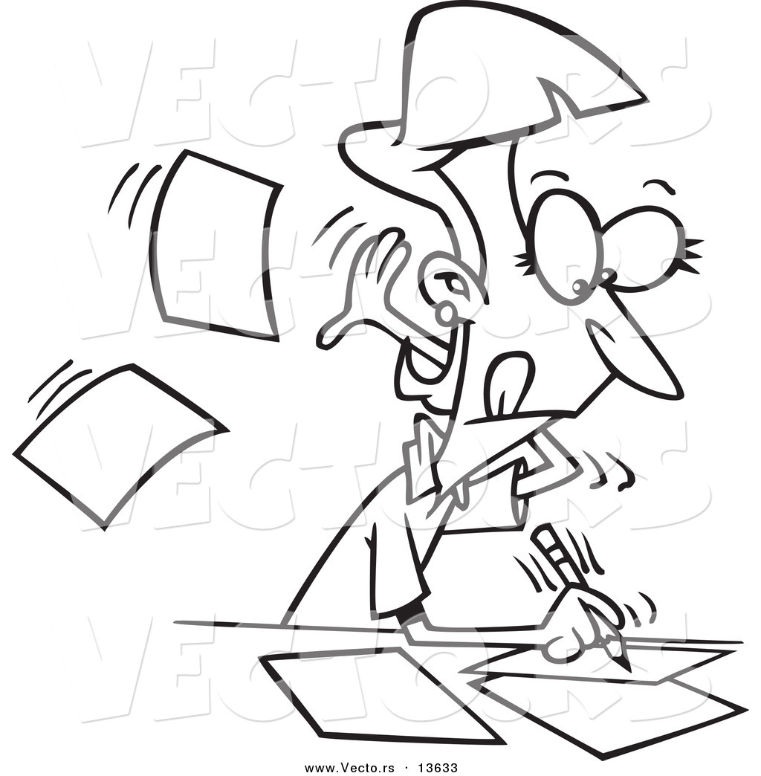
Function:
What is the author’s purpose?
What purpose do biographies serve?
To inform
To entertain
To educate

Slide 5
Main Features
Chronological order
Third person
Past tense forms
Formal language
Dates
Main achievements
Important life events

Slide 6
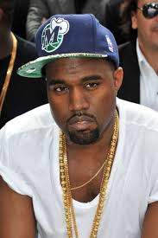
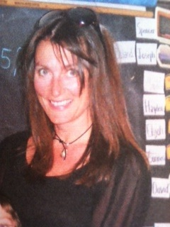
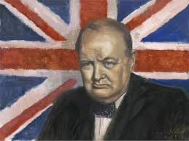
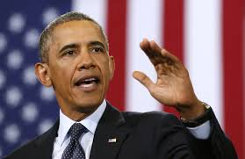
Form: What does a biography look like?
Pop stars
Politicians
Heroes
Historical figures
Anyone

Slide 7
HOOK the reader by picking a title that sounds interesting and fun to read.
The World’s First….
A Dream, A Desire and Determination
GRAB the reader’s attention with a lead & a main idea sentence that brings the subject to life.
Use a good quote said by the subject
What would you do if….?
Have you ever wondered…..?
SOPHISTICATED Sentences: use transitions, phrases & clauses when telling about your subject and their personal details
As a child, ….During his youth……
Eventually, in 1939….. Before she died, …..
If George were alive today….
What Martha has brought to society today….
Without Edison’s brilliant ideas…..
CONCLUSION: Connect your reader with the subject, to conclude.
©Susan Powers 2013

Slide 8
Be A Thinker. Be Reflective.
In pairs or small group, read both biography examples.
Focus on the structure of the biography & annotate your metacognitive thinking.
Think: which biography has been written the best.
Why do you think this?
Be prepared to cite evidence from the text to back up your opinion.

Slide 9
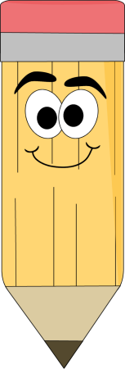
Read the biography of Emily Pankhurst & the biography of William Wallace.
Compare the writing structure of each and decide which you think is better.
Be prepared to give reasons for your answer and to cite parts of the text as evidence.
Taken From Wikipedia and amended for educational purposes.

Slide 10
What do you notice about the structure of the biography of William Wallace?

Slide 11
Bridge. Though outnumbered, the Scottish armies defeated the English. Five thousand English were killed including one of the hated King’s men. It is said the Bridge at Stirling collapsed as the English forces were coming through the narrow gap.
Motivated by his success, William Wallace led raids into Northern England to torment Edward. The price on Wallace's head grew and the English later invaded Scotland to find and defeat Wallace. A year after the Battle of Stirling Bridge, Wallace lost the Battle of Falkirk, when English archers helped to defeat the Scottish rebels. However, Wallace escaped and for the next seven years he lived as an outlaw, always on the run from Edward I.
Eventually, though only a knight, Wallace was made Commander of the Army of the Kingdom of Scotland. It was unusual at the time, for a knight to have so much influence and power. William Wallace became known throughout Europe, and he even travelled to France to seek an alliance with the French against King Edward I.
Finally, in August 1305, John Menteith, a Scottish knight loyal to Edward I betrayed William Wallace and had him arrested for treason. William Wallace was brought to London where he was given a short trial and sentenced to death. When he was charged with treason he replied,
"I could not be a traitor to Edward, for I was never his subject."
At the time, treason implied a long drawn out execution of being hung, drawn and quartered. Wallace's ripped off limbs were displayed in different parts of England as warning to other rebellious Scots.But, his legend only grew after his death, becoming a symbol of a rebel leader. His cause was later taken up by Scottish King Robert the Bruce, who finally led Scotland to victory.
Taken From Wikipedia and amended for educational purposes.

Slide 12
Sequencing: in order of events/time
Introduction:
Middle:
End:
Beginning:
Conclusion

Slide 13
Famous Revolutionaries
Spartacus (c. 109–71 BC) One of the slave leaders who led a major revolt against the Roman empire, in the Third Servile War. Spartacus has become symbolic of revolutionary leaders fighting oppression.
Susan B. Anthony (1820-1906) – American political activist.
Peaceful Revolutionaries
Mahatma Ghandi (1869-1948) – Indian nationalist and politician.
Jesus Christ (c.585BC -30AD)
- Spiritual leader who change religion across the world and introduced Christianity.
Select a revolutionary who interests you.
Research important facts about this subject’s life,
Then plan and draft a biography about your subject using the strategies and instruction you have just learned.

Slide 14
Home work
Write about your role model in life . It can be a celebrity or a relative of yours.

