Slide 1
Spelling 1

Slide 2
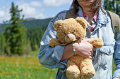
Possession (n.): when you own something. Ex: This teddy is in my possession.

Slide 3
Choice (n.): Choice means the act of picking something from different options. Ex: This is my choice.

Slide 4
Strode(v.): Strode means walking with long steps. Ex: he strode very fast in the race. It's when someone

Slide 5
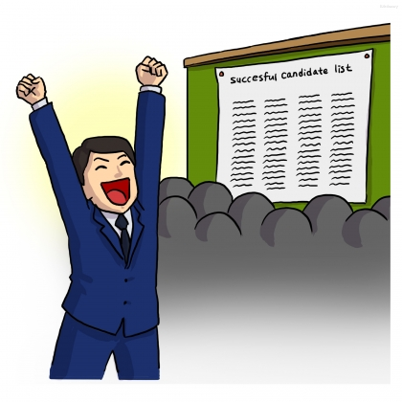
Exclaimed (v.): say something with strong emotion, like happiness, excitement or fear. Ex: he exclaimed in excitement when he won.

Slide 6
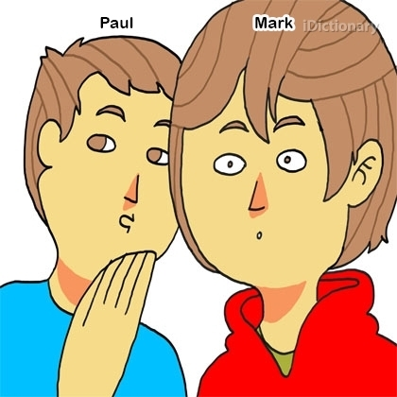
Muttered (v.): Muttered means to speak in a low voice. Ex: he muttered to his friend,

Slide 7
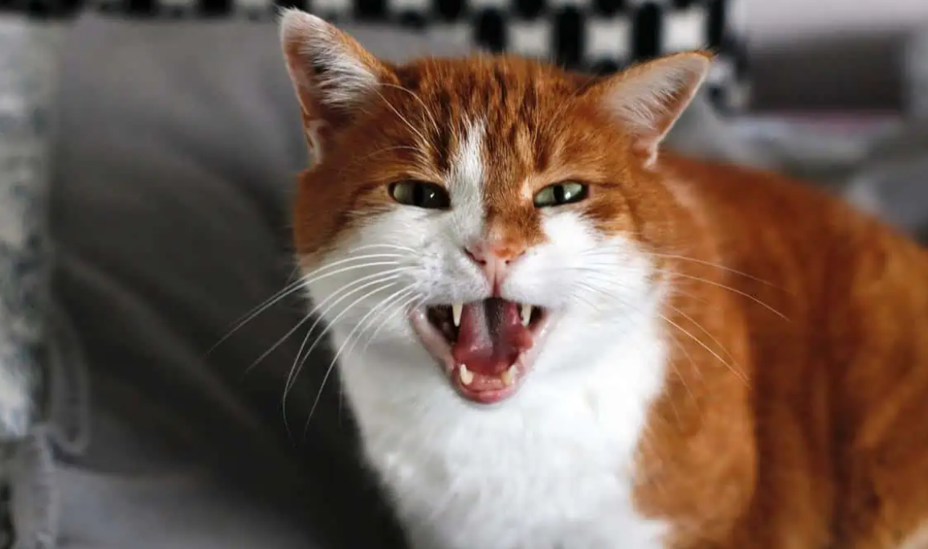
Snarled (v.): Snarled means to speak or make a sound in an angry way. Ex: the cat snarled very loudly.

Slide 8
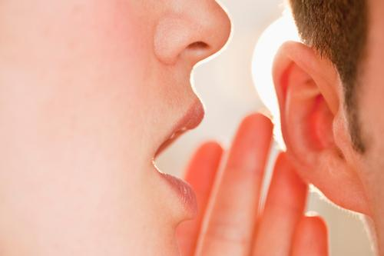
Whispered (v.): Whispered means to speak very quietly. Ex: he whispered in his friend’s ear.

Slide 9
Ought (v.): It's like when you should do something because it's the right thing to do. Ex: I ought to do my homework.

Slide 10
Extraordinary (adj.): Extraordinary means something that is very special. Ex: he is a very extraordinary baby.

Slide 11
Desperate (adj.): Desperate means feeling of need, or a strong desire for something.

Slide 12
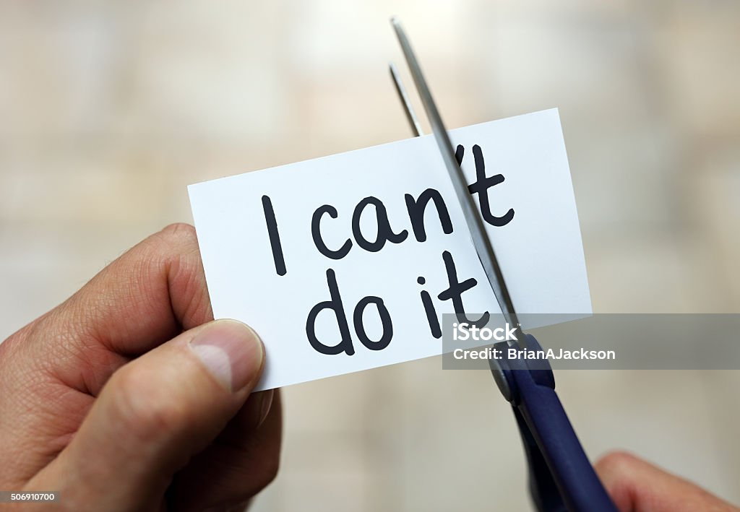
Unable: When you are not able to do something. Example 1: The injured athlete was unable to compete in the race. Example 2: Due to a power outage, we were unable to watch our favorite TV show. Preoccupied: When your mind is already busy thinking about something else. Example 1: The boy was preoccupied with his tests. Example 2: He seemed preoccupied and lost in thought. Transform: To change something completely Example 1: Sarah transformed the scarf into a hat. Example 2: The magician transformed the handkerchief into a dove.
Spelling 2

Slide 13
Imaginable: Something that you can think about or imagine. Example 1: The science fiction movie had every imaginable futuristic gadget. Example 2: The artist's imagination knew no bounds, creating the most unimaginable artwork. Adventurous: Willing to take risks and try new things. Example 1: He was an adventurous explorer. Example 2: He went on an adventurous hiking trip. Unacceptable: Something that is not okay or not allowed. Example 1: Cheating on an exam is an unacceptable behavior in academic settings. Example 2: The poor quality of the product made it unacceptable to the customers

Slide 14
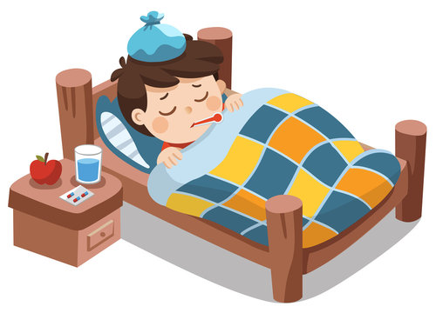
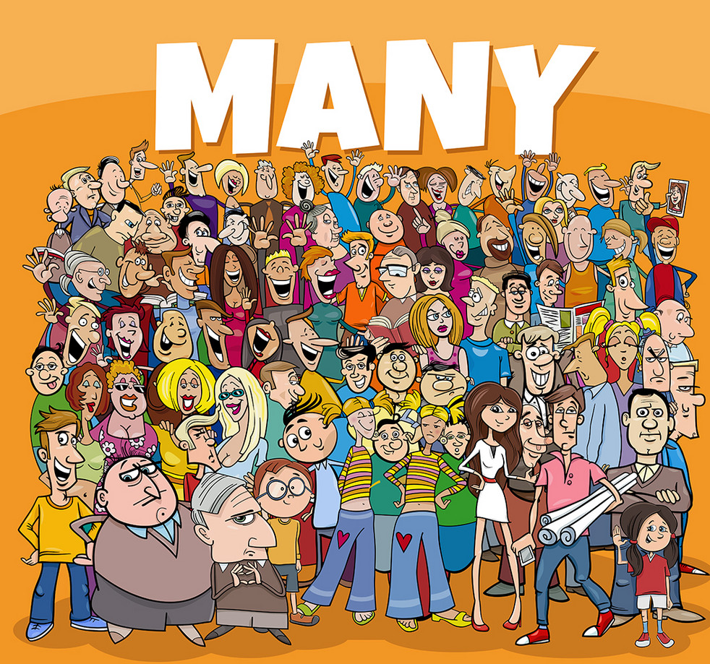
Unwell: When you are not feeling healthy or sick. Example 1: Mary stayed home from work because she was feeling unwell. Example 2: The flu season left many people feeling unwell and seeking medical attention. Enormous: Very, very big or huge. Example 1: The elephant was an enormous creature, towering over all other animals in the safari. Example 2: The project required an enormous amount of time and resources to complete. Numerous: A lot of something, many in number. Example 1: The store offers numerous options for customers to choose from. Example 2: The scientist conducted numerous experiments to gather data for the research.

Slide 15
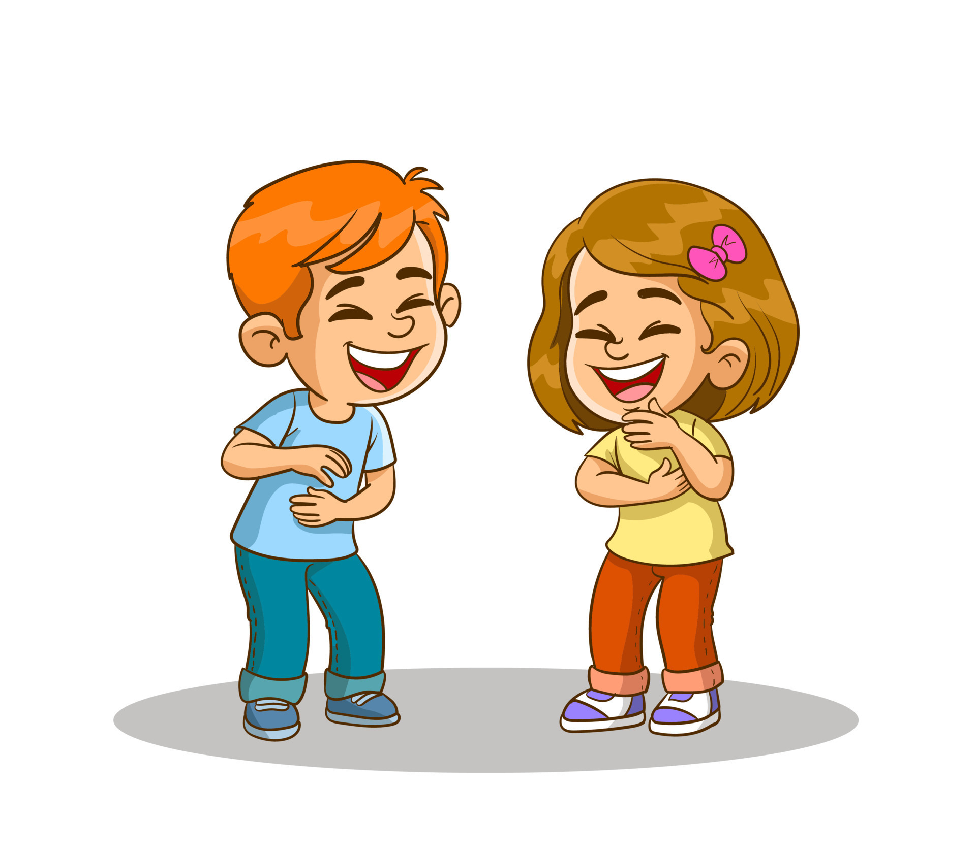
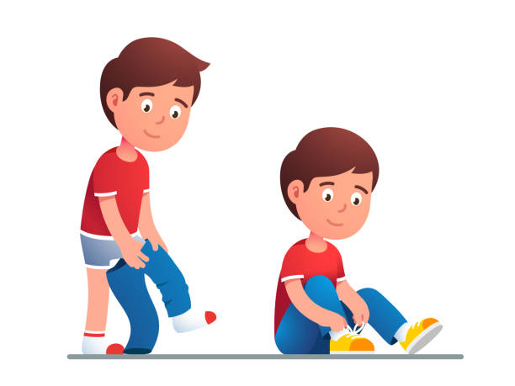
Laughable: Something that is funny and makes you laugh. Example 1: The politician's claim was so absurd that it was laughable. Example 2: The actor's attempt at a serious role turned out to be laughable due to his poor acting skills. Irresistible: Something that is too hard to say "no" to, you can't resist it. Example 1: The smell of freshly baked cookies was irresistible, and I couldn't help but have one. Example 2: The puppy's adorable face was irresistible, and we decided to adopt it. Independent: When you can do things on your own without help. Example 1: After moving out of her parents' house, Lisa became independent and started taking care of herself. Example 2: The teenager wanted to prove his independence by making his own decisions.
Spelling 3

