Slide 1
Viruses

Slide 2
objectives
• learn about the structure of a virus
• discuss whether viruses are non-living or living.

Slide 3
watch this video and answer this questions

Slide 5
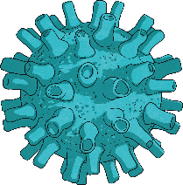
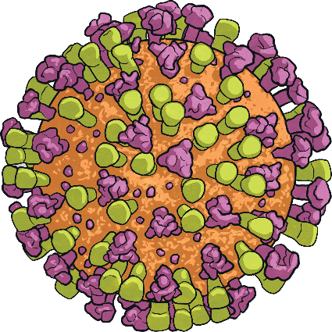
What are viruses?
Viruses are very, very small. A virus is much smaller than one of your cells. You cannot see a virus with the kind of microscope that you use in school. To see a virus, you need to use a special kind of microscope called an electron microscope.
Viruses are passed from one host to another in the following ways: (JUST READ)
Through the exchange of body fluids
Physical contact
Through the air
Through food
By other organisms

Slide 7
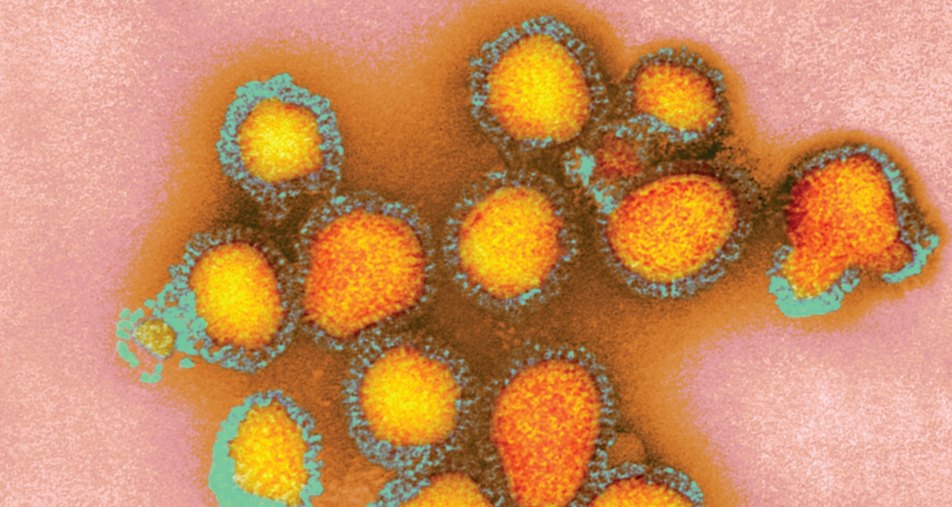
Look at the photograph and try to describe what you see to your partner

Slide 8
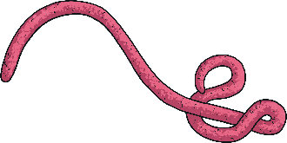
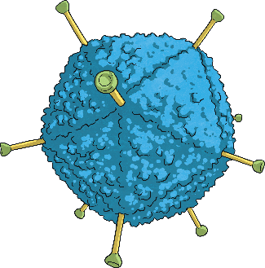
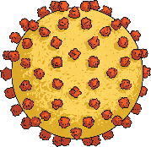
Viruses are not made of cells. They do not have a cell membrane or cytoplasm. The blue-green outer layer in the photograph is a coat made of protein. There are little pegs on the outside of this coat.
The orange part inside contains a substance called RNA.
The RNA is made of little threads that contain a set of coded instructions for making more viruses.

Slide 9
virus:
a particle made of either RNA or DNA, surrounded by a protein coat; viruses hijack the machinery of a host cell to replicate
electron microscope:
a microscope that uses electron beams instead of light beams; it is able
to achieve much higher resolution than a light microscope
protein:
polymers of amino acids; they are important nutrients for living organisms, as they are used in growth and repair

Slide 10
RNA:
a nucleic acid found in all living cells; most cells contain both RNA and DNA, but some viruses contain only RNA
influenza:
an illness caused by a virus, often known as flu; it affects the respiratory system and usually results in a high temperature

Slide 11
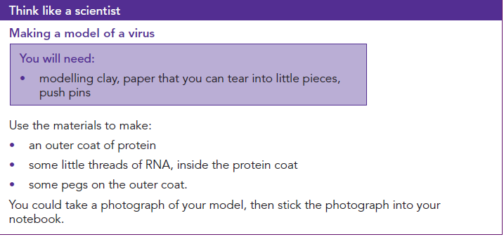

Slide 12
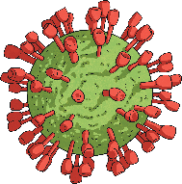
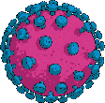
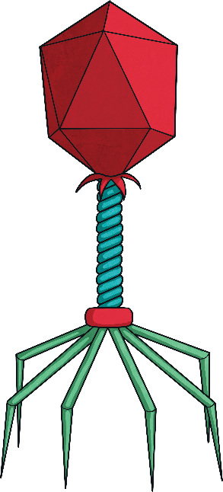
How viruses replicate
Viruses cannot do anything at all on their own. They do not respire, feed, excrete or grow. They are not sensitive and cannot move. Viruses have to get inside a living cell before they can make copies of themselves.
influenza viruses. This kind of virus can invade (get inside) cells of birds, humans and other mammals. The viruses get into your body by going up your nose when you breathe in. The little pegs on the virus’s coat help it to stick onto one of your cells and then get inside the cell.

Slide 13
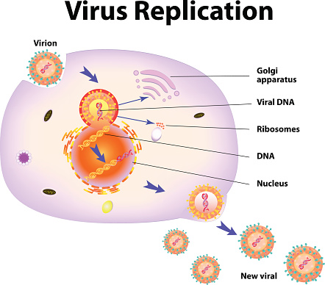
When the viruses are inside the cell, each virus bursts open. The virus forces the cell to copy the instructions on its RNA, and make many new viruses. This is called replication. This kills the cell. Then the new viruses burst out of the dying cell, ready to infect more cells.
This makes the animal whose cells are infected feel ill. H3N2 viruses
cause a very unpleasant and dangerous kind of influenza (flu).
In 1968–1969, these viruses killed approximately one million people.

Slide 14
These flu viruses are just one of thousands of different kinds of viruses we know about. Each kind of virus has a particular kind of cell that it infects.
Some viruses infect plant cells.
In 2019, a new virus appeared. We do not know exactly where it came from, but scientists think it developed in a wild animal and then spread to humans. The new virus is similar to the viruses that cause flu and colds. Its official name is SARS-CoV-2. The illness it causes is called Covid-19. This stands for coronavirus disease 2019. The virus quickly spread all over the world.
Watch and take notes

Slide 15
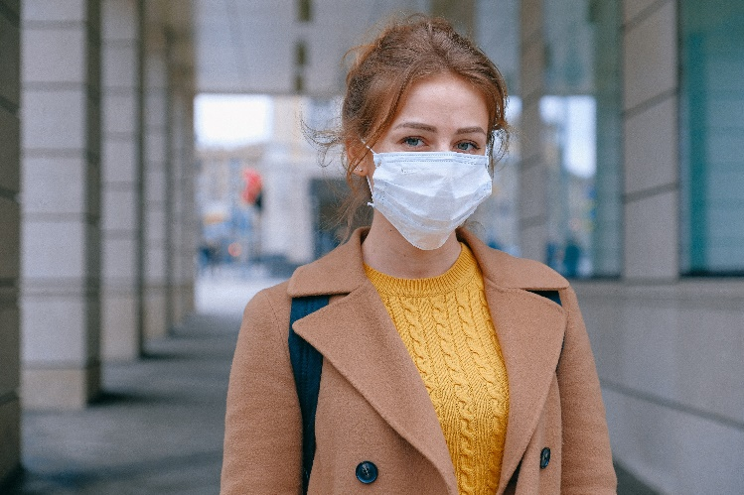
Many people get the virus without being ill at all, or just have mild symptoms. But in some people, it causes dangerous illness and even death.
Scientists will work hard for many years to find the best ways of preventing this, including vaccination, and drugs to treat Covid-19.

Slide 16
How Can You Keep Your
Immune System Healthy?
JUST READ this slide
The following have a positive effect on your immune system:
Exercise
Staying stress free
Taking vitamin B12 and C
Eating healthy food
The following things have a negative effect on your immune system:
Age
If you are already ill e.g. HIV or TB
If you are highly stressed
Poor nutrition

Slide 17
What is the Economic
Importance of Viruses?
JUST READ this slide
Viruses are infectious diseases. They have a negative effect on companies as their employees are not able to work. Large outbreaks and pandemics can effect a large number of people which can have negative effects on community services and food supply. This can lead to inflation due to supply and demand. It can also result in strain on the health care industry and shortages in medical supplies can result

Slide 18
How does the Immune System Work?
JUST READ this slide
The human body contains white blood cells which are our first defense against bacteria and viruses. The white blood cells engulf and break down the virus. The body will also raise its temperature to try make it a hostile environment for the virus. A virus is a primary infection which can compromise your immune system so that a secondary infection, such as bronchitis, can develop.
Building an immunity, antibodies, is the cells way of remembering which viruses and bacteria have made you sick before to prevent the virus from making you sick again. A vaccine helps build this immunity by giving you a small dose of the virus, not enough to make you sick. This makes your cells remember and recognize the virus so you don’t catch it and get sick in the future. Some viruses can evolve and mutate easily so that they are not recognized and can make us sick again. The flu virus is a virus that is one the does this which means that people can get the flu every year.
Unfortunately there is no medication that can treat a virus. Some medication may help relieve some of the symptoms, but it can’t kill the virus once you are infected. There are also some viruses that are extremely virulent and no immunization for them currently exists e.g. HIV, Ebola, Covid-19

Slide 19
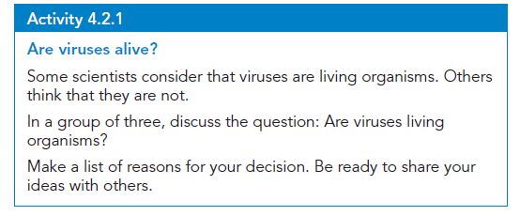
Exit slip

