Slide 1
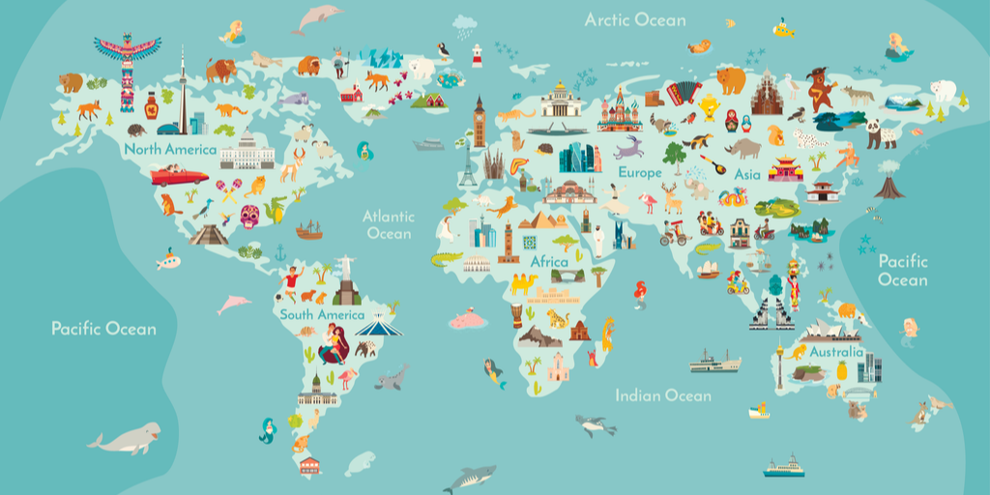
Our world

Slide 2
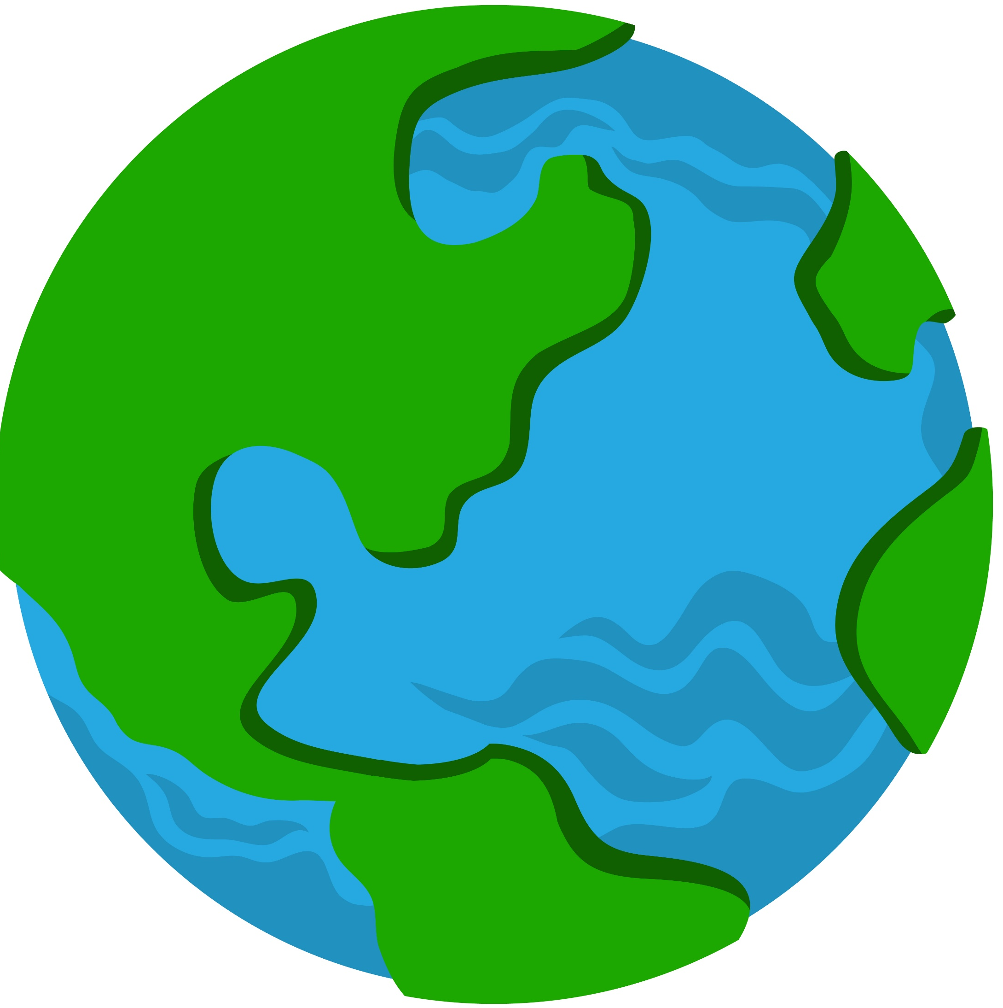
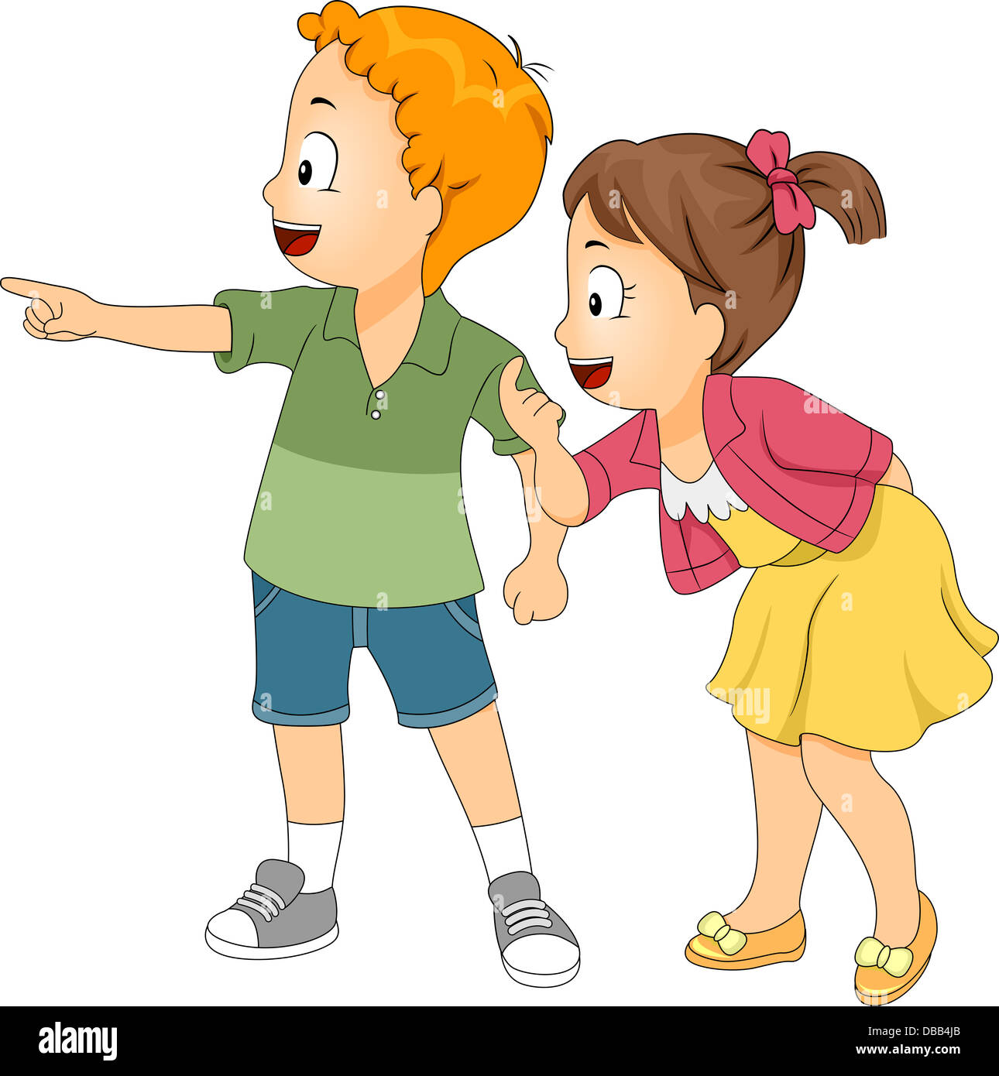
Planet Earth : is the planet that we live on.

Slide 3
Planet Earth’s surface is made of land and water.
water
Land

Slide 4
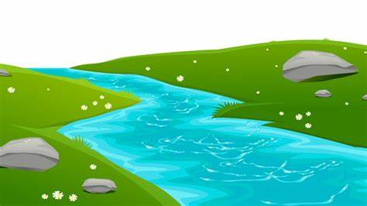
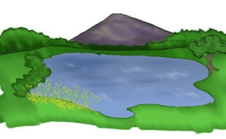
Planet Earth’s surface is mostly covered with water like: Oceans, rivers, lakes,…
river
ocean
Lake

Slide 5
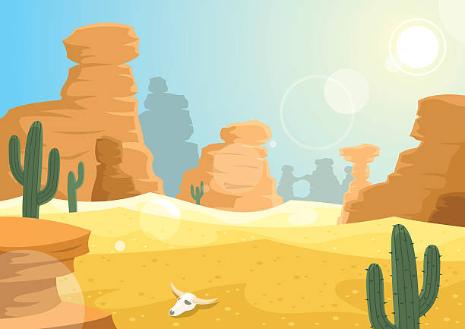
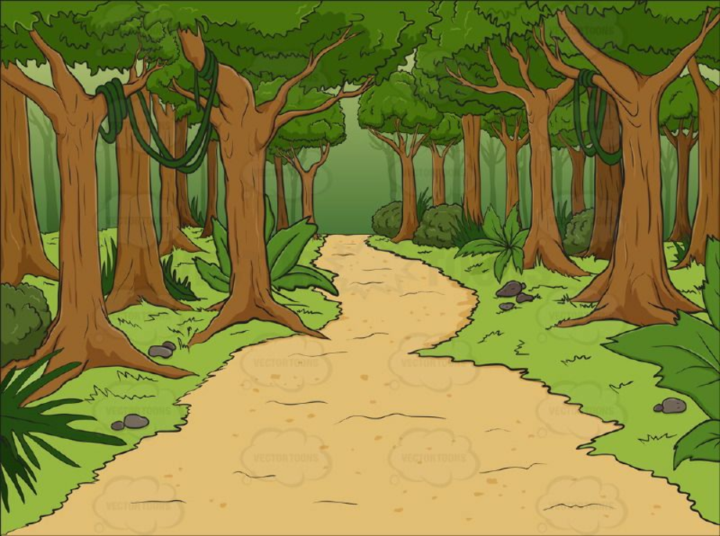
Planet Earth’s also made up of land: continents, desert, forest

Slide 6
What a continent is? Continents are huge landmasses on Earth, like pieces of a giant puzzle.
1- Asia
2- Africa
3-North America
4-South America
5-Antarctica
6-Europe
7-Austerlia

