Slide 1
Forces change shape
Year 2 , T1 W9 L3

Slide 2
Lesson Objectives:
Forces can change the shape of an object.
Identify simple patterns in results, for example increasing and decreasing patterns.

Slide 3
Video
Bending ,twisting ,stretching and squashing
https://youtu.be/rIUlBnLesL4

Slide 5
Effects of Force

Slide 6
Effects of Force

Slide 7
How can we use force to change the shape of objects?

Slide 8
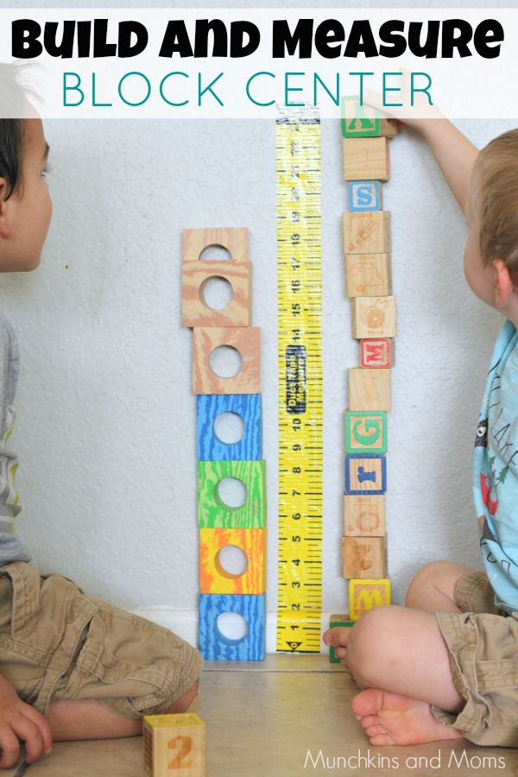
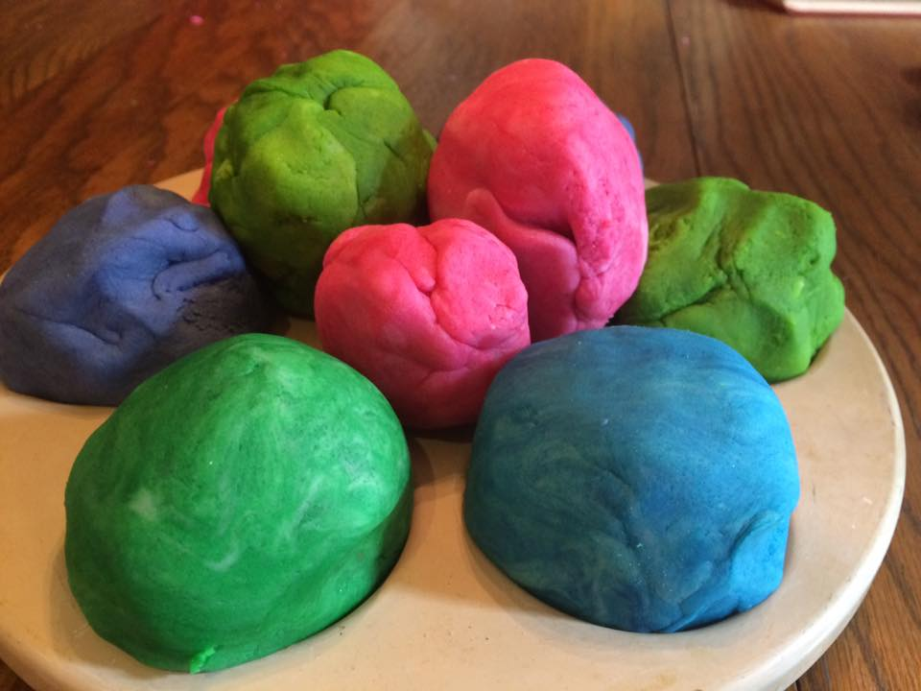
What happens to the playdough when you drop it from different hights?

Slide 9
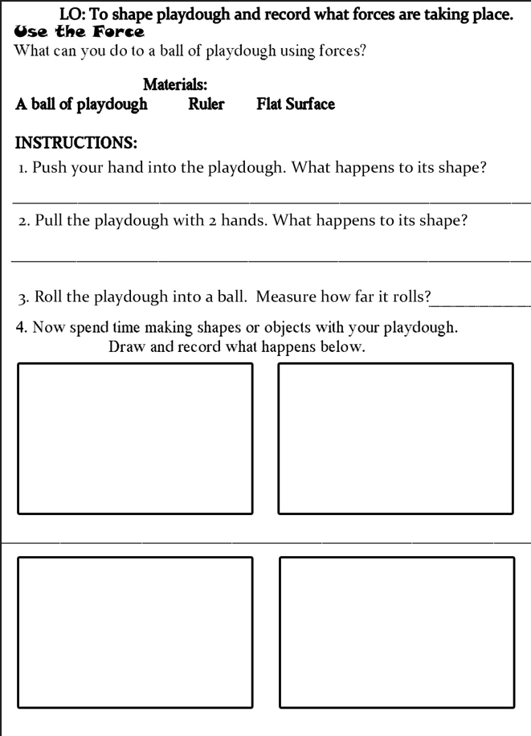
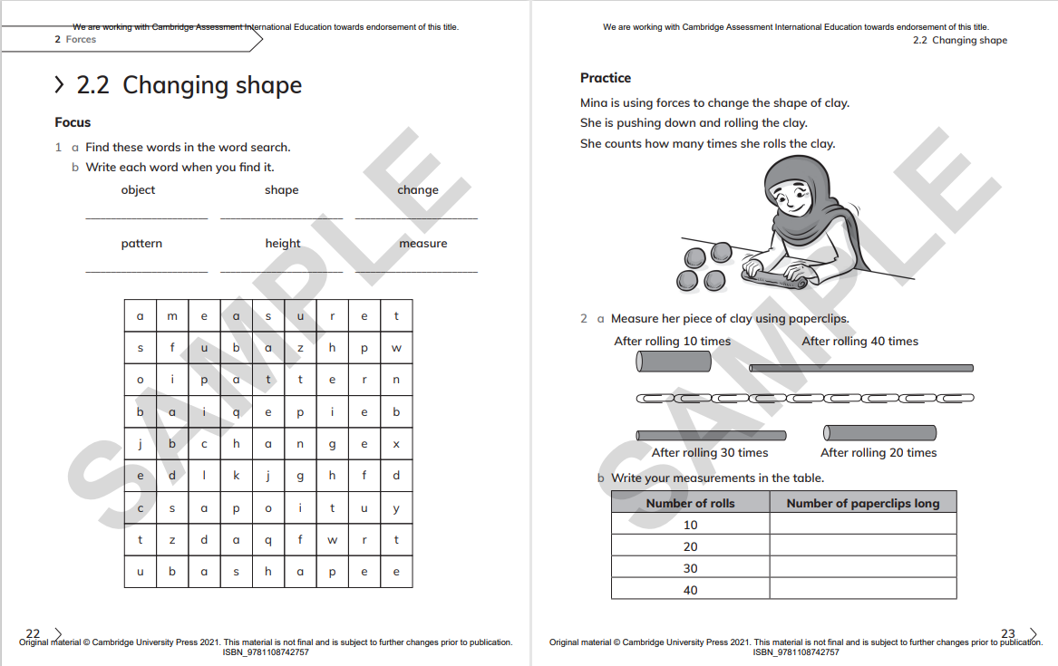
Class work

