Slide 1
How computers
see the world

Slide 2
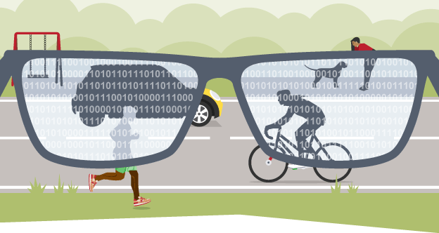
There are a number of very common needs for a computer, including the need to store and view data.
Computers use electrical signals that are on or off, so they have to see
everything as a series of binary numbers. This data is represented as a sequence of 1s and 0s (on and off). All data that we want a computer to process needs to be converted into this binary format.

Slide 3
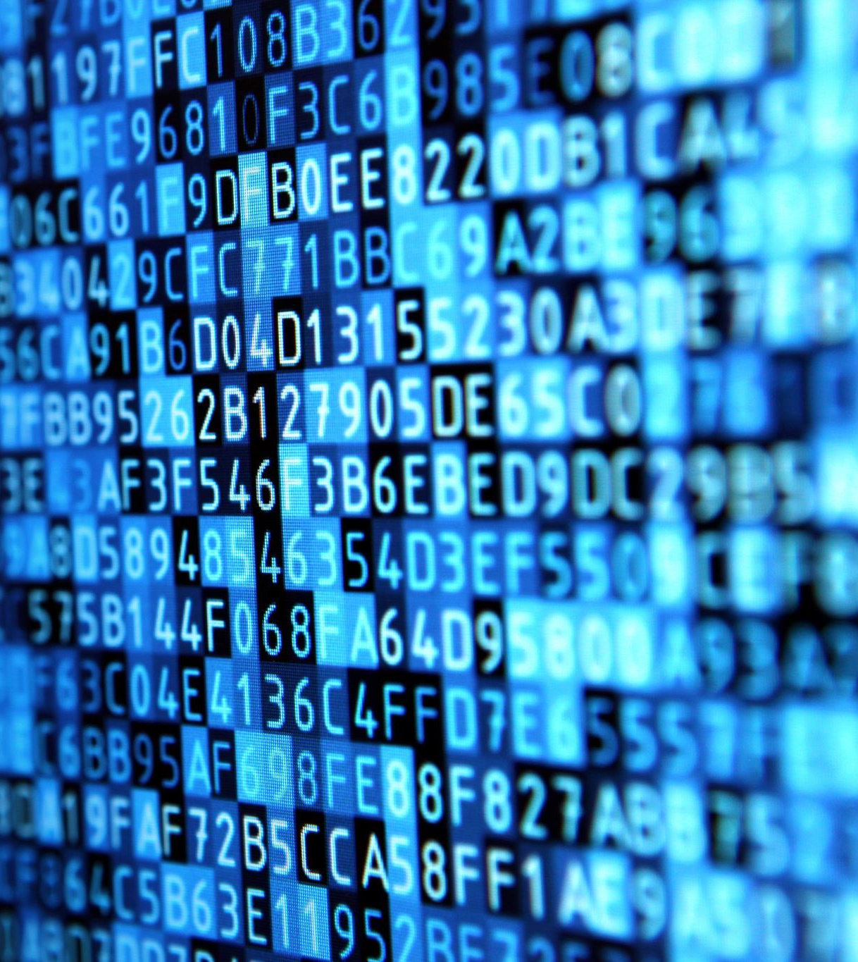
What is binary?
Binary is a number system that only uses two digits: 1 and 0.
All information that is processed by a computer is in the form of a sequence of 1s and 0s. Therefore, all data that we want a computer to process needs to be converted into binary.

Slide 4
The binary system is known as a ‘base 2’ system. This is because:
there are only two digits to select from (1 and 0)
when using the binary system, data is converted using the power of two.

Slide 5
Converting from binary to denary
Understanding denary
People use the denary (or decimal) number system in their day-to-day lives. This system has 10 digits that we can use: 0, 1, 2, 3, 4, 5, 6, 7, 8 and 9.
The value of each place value is calculated by multiplying by 10 (by the power of 10). The first few place values look like this:

Slide 6
Converting from binary to denary
To convert a binary number to denary, start by writing out the binary place values. In denary, the place values are 1, 10, 100, 1000, etc – each place value is 10 times bigger than the last. In binary, each place value is 2 times bigger than the last (ie increased by the power of 2). The first few binary place values look like this:

Slide 7
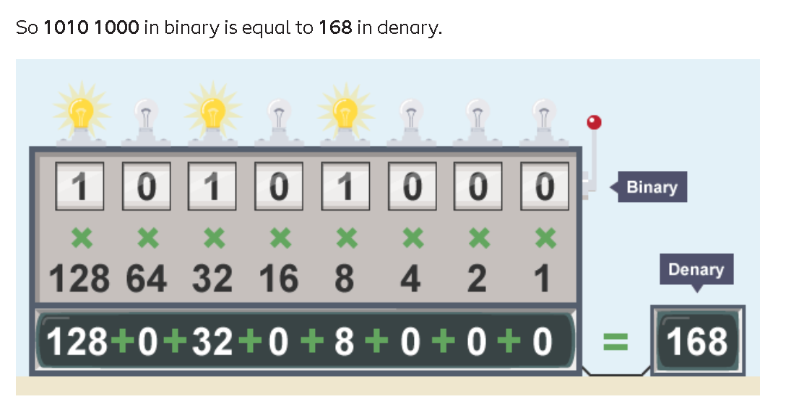

Slide 8
Converting from denary to binary
There is a very simple method to convert a denary number into a binary number. Let’s take the number 199.
Start by writing out the first few binary place values (128, 64, 32, 16, 8, 4, 2, 1).

Slide 9
Start at the far left point and say “Can 128 be taken away from 199?”. If it can, do that.
199 – 128 = 71. Because 128 could be taken off, put a 1 in the ‘128’ place value column:

Slide 10
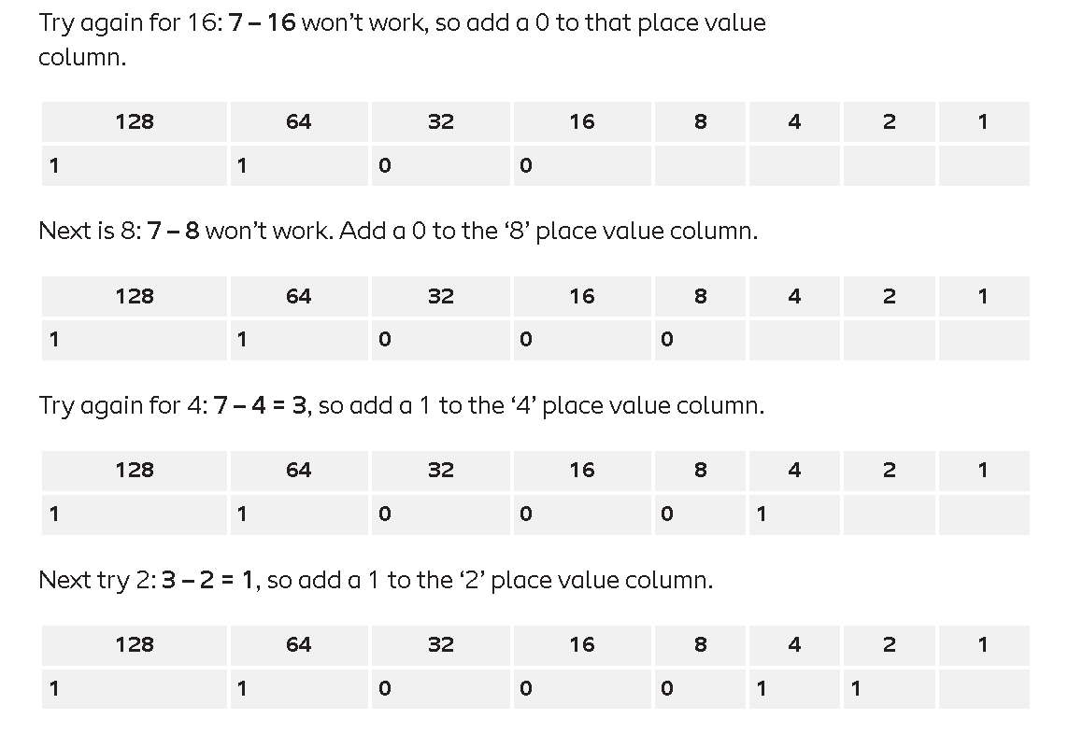

Slide 11
Note that binary numbers are usually written in blocks of four, separated by a space (0111 1011). In denary, numbers are often written in blocks of three (6 428 721).

Slide 12
Note that binary numbers are usually written in blocks of four, separated by a space (0111 1011). In denary, numbers are often written in blocks of three (6 428 721).

Slide 13
Note that binary numbers are usually written in blocks of four, separated by a space (0111 1011). In denary, numbers are often written in blocks of three (6 428 721).

Slide 14
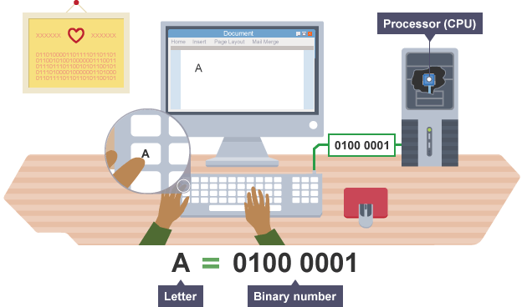
Representing text
When any key on a keyboard is pressed, it needs to be converted into a binary number so that it can be processed by the computer and the typed character can appear on the screen.

Slide 15
The ASCII code
(American Standard Code for Information Interchange) is the most common character encoding format for text data in computers and on the internet.

Slide 16
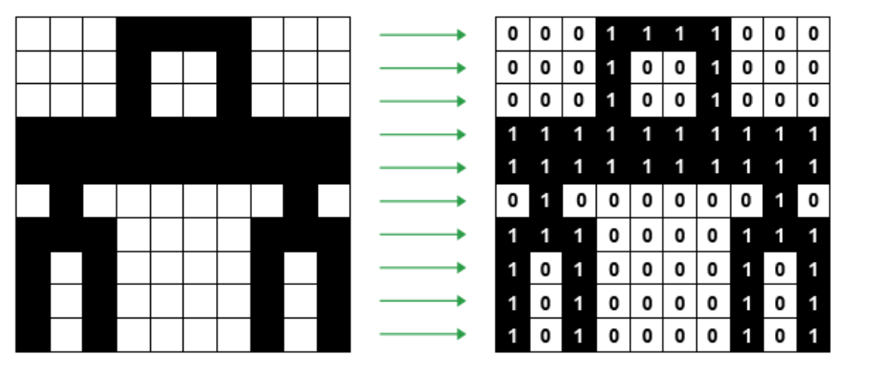
Representing images
Images also need to be converted into binary in order for a computer to process them so that they can be seen on our screen. Digital images are made up of pixels. Each pixel in an image is made up of binary numbers.
If we say that 1 is black (or on) and 0 is white (or off), then a simple black-and-white picture can be created using binary.

Slide 17
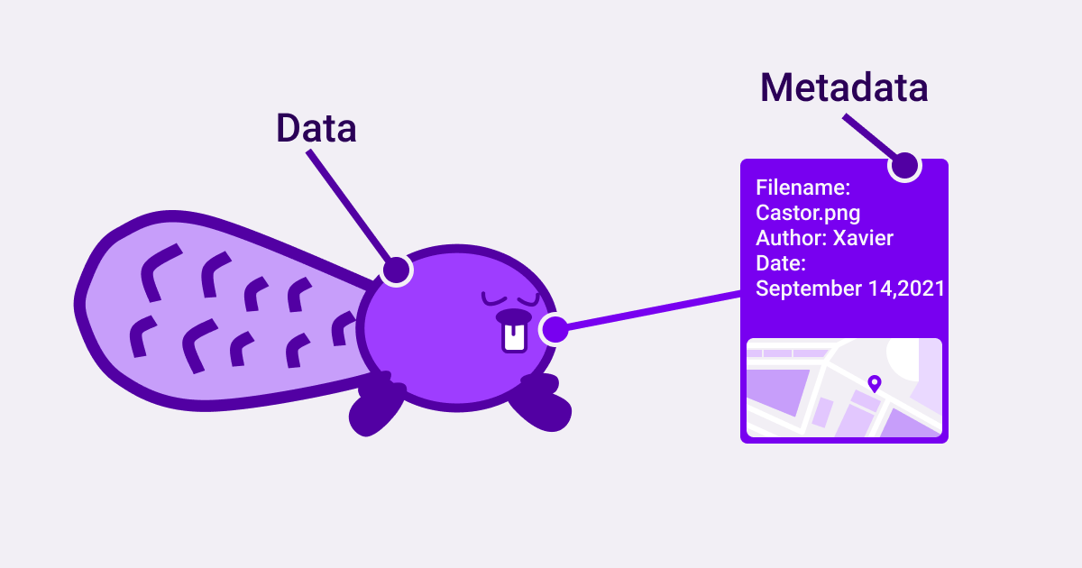
To create the picture, a grid can be set out, and the squares colored (1 – black and 0 – white). But before the grid can be created, the size of the grid needs to be known. This data is called metadata and computers need metadata to know the size of an image. If the metadata for the image to be created is 10x10, this means the picture will be 10 pixels across and 10 pixels down.

Slide 18
Adding colour
The system described so far is fine for black and white images, but most images need to use colors as well. Instead of using just 0 and 1, using four possible numbers will allow an image to use four colors. In binary this can be represented using two bits per pixel:
00 – white
01 – blue
10 – green
11 – red

Slide 19
While this is still not a very large range of colours, adding another binary digit will double the number of colours that are available:
1 bit per pixel (0 or 1): two possible colours
2 bits per pixel (00 to 11): four possible colours
3 bits per pixel (000 to 111): eight possible colours
4 bits per pixel (0000 – 1111): 16 possible colours
…
16 bits per pixel (0000 0000 0000 0000 – 1111 1111 1111 1111): over 65 000 possible colours
The number of bits used to store each pixel is called the colour depth. Images with more colours need more pixels to store each available colour. This means that images that use lots of colours are stored in larger files.

Slide 20
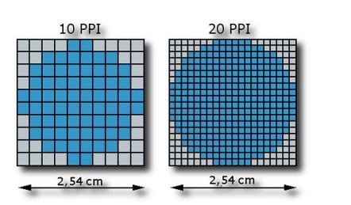
Image quality
Image quality is affected by the resolution of the image. The resolution of an image is a way of describing how tightly packed the pixels are.
In a low-resolution image, the pixels are larger so fewer are needed to fill the space. This results in images that look blocky or pixelated. An image with a high resolution has more pixels, so it looks a lot better when you zoom in or stretch it. The downside of having more pixels is that the file size will be bigger.

Slide 21
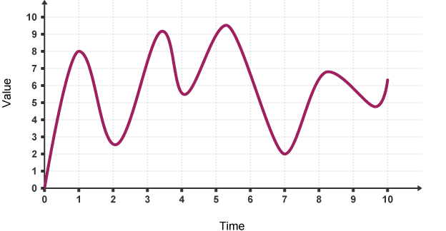
Representing sound
Sound needs to be converted into binary for computers to be able to process it. To do this, sound is captured - usually by a microphone - and then converted into a digital signal.
An analogue to digital converter will sample a sound wave at regular time intervals. For example, a sound wave like this can be sampled at each time sample point:

Slide 22
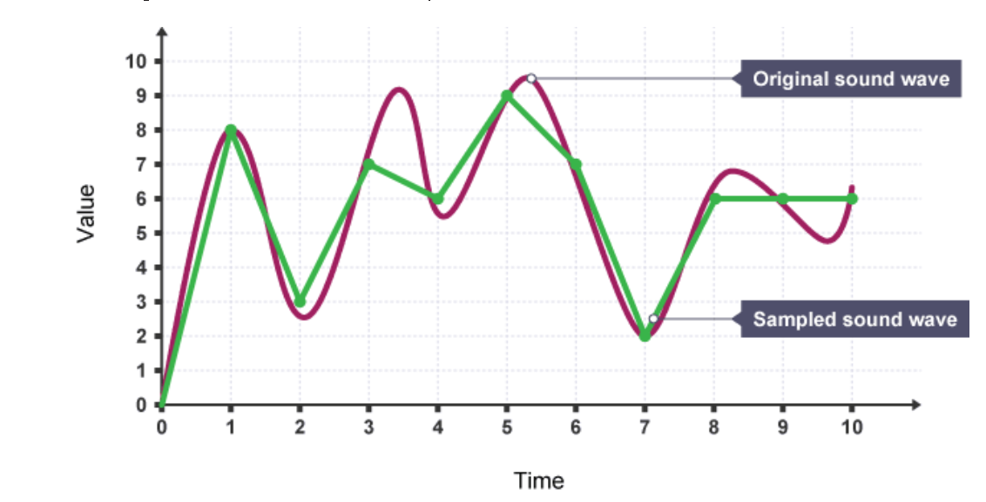
The samples can then be converted to binary. They will be recorded to the nearest whole number.

