Slide 1
VOCABULARY WORDS
Week 9

Slide 2
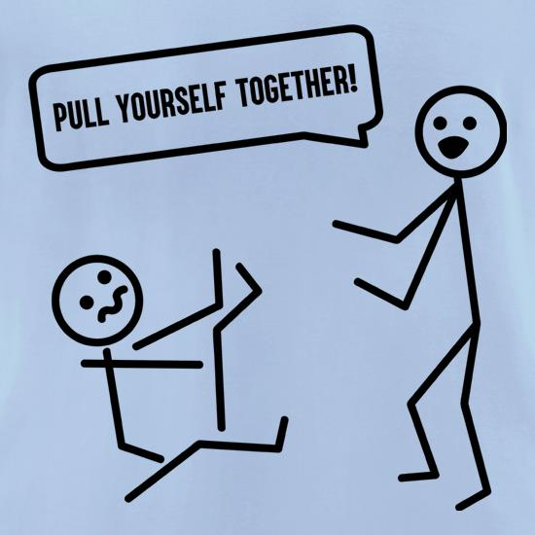
Pull yourself together
Meaning:
Calm down
Sentence:
You have to pull yourself together and find another job.

Slide 3
So far so good
Meaning:
Things are going well so far
Sentence:
How is the job going?
So far so good

Slide 4
I am broke
Meaning:
I don’t have any money.
Sentence:
I must return home but I am broke.

Slide 5
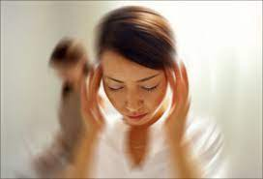
Light headed
Meaning:
Dizzy or about to faint
Sentence:
I began to feel light headed from lack of sleep

Slide 6
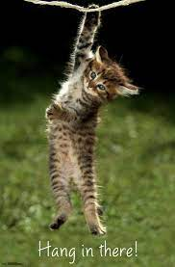
Hang in there
Meaning:
Don’t give up
Sentence:
In the second of half of the match, we need to hang in there.

Slide 7
No pain, No gain
Meaning:
You need to work hard to get what you want.
Sentence:
yesterday as part of his training for the marathon. His legs are aching today, but no pain, no gain.

