Slide 2
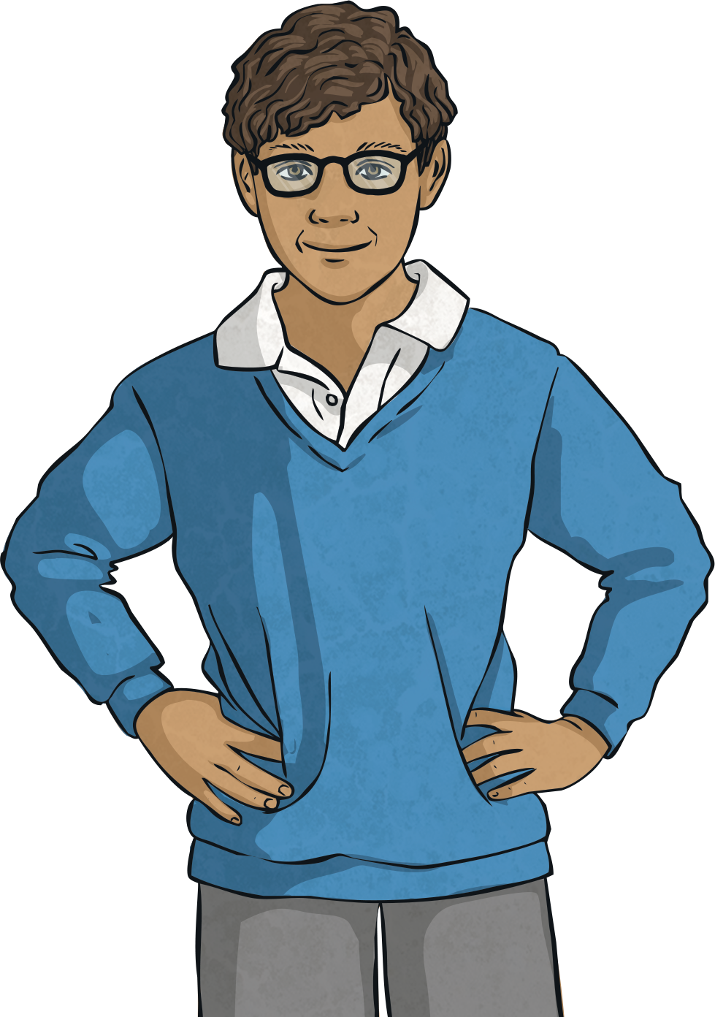
What Is an Expanded Noun Phrase?
An expanded noun phrase gives much more detail than a simple noun phrase, for example:
the boy
Choose a noun
(and a determiner)
the school boy
Add adjectives
to modify the noun
the happy, excited school boy
Add a prepositional phrase to give extra details
the happy, excited school boy with a bright blue jumper

Slide 3
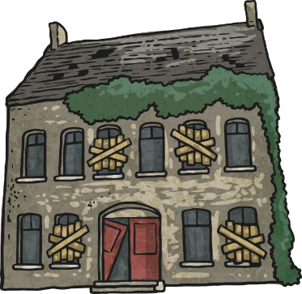
What Is an Expanded Noun Phrase?
An expanded noun phrase gives much more detail than a simple noun phrase, for example:
a house
Choose a noun
(and a determiner)
a country house
Add adjectives
to modify the noun
a derelict, old country house
Add a prepositional phrase to give extra details
a derelict, old country house with boarded and broken windows

Slide 4
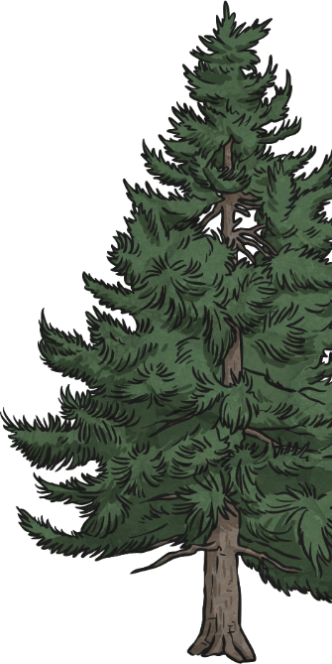
What Is an Expanded Noun Phrase?
Following the steps below, how could you expand this noun phrase?
two trees
Choose a noun
(and a determiner)
two fir trees
Add adjectives
to modify the noun
two tall, ancient fir trees
Add a prepositional phrase to give extra details
two tall, ancient fir trees in the middle of the park

Slide 5
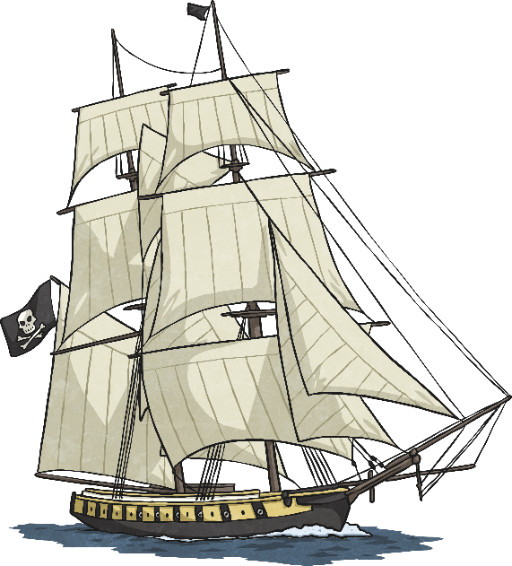
What Is an Expanded Noun Phrase?
Following the steps below, how could you expand this noun phrase?
a ship
Choose a noun
(and a determiner)
a pirate ship
Add adjectives
to modify the noun
an enormous, menacing pirate ship
Add a prepositional phrase to give extra details
an enormous, menacing pirate ship on the calm ocean

Slide 6
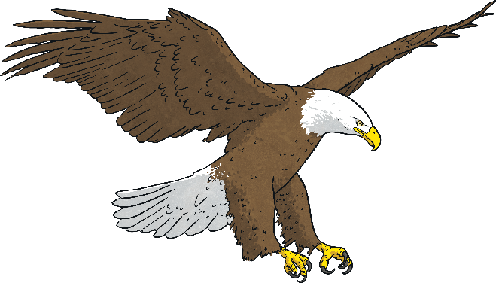
What Is an Expanded Noun Phrase?
Following the steps below, how could you expand this noun phrase?
an eagle
Choose a noun
(and a determiner)
an American eagle
Add adjectives
to modify the noun
an intimidating, predatory American eagle
Add a prepositional phrase to give extra details
an intimidating, predatory American eagle with a wide wingspan

Slide 7
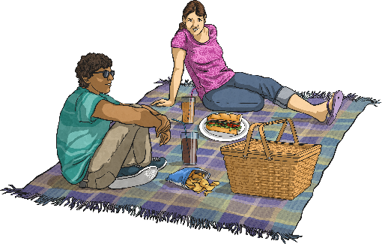
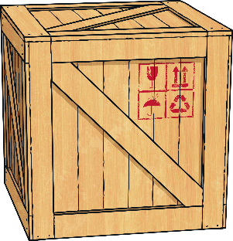
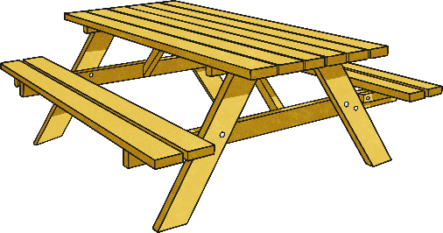
The Triple-Decker Sandwich
Can you use the three things below to create an expanded noun phrase of your own?
picnic
wooden
table
An example could be:
the delicious picnic at the wooden table beneath a tall, shady tree
Did you think of any other examples?

Slide 8
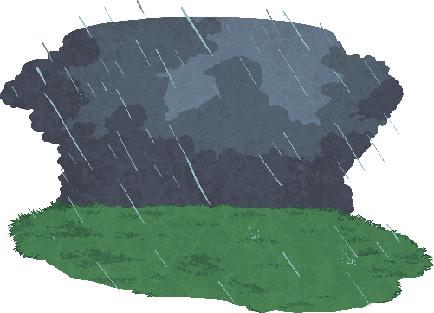
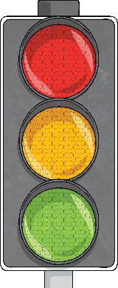
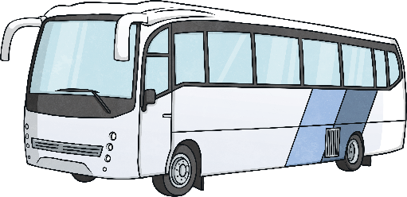
The Triple-Decker Sandwich
Below are three fantastic additions which could be used to make an expanded noun phrase. Can you use all three in one expanded noun phrase which still makes sense?
rain
traffic lights
bus
An example could be:
the large, impressive bus at the traffic lights in the rain
Did you think of any other examples?

Slide 9
How Could We Expand It?
To expand a noun phrase, you can use nouns and adjectives to modify the original noun and prepositional phrases to add extra detail. List some ideas of how you may be able to expand this noun phrase:
the bear
Write down as many expanded noun phrases as you can think of.

Slide 10
How Could We Expand It?
To expand a noun phrase, you can use nouns and adjectives to modify the original noun and prepositional phrases to add extra detail. List some ideas of how you may be able to expand this noun phrase:
a bottle
Write down as many expanded noun phrases as you can think of.

Slide 11
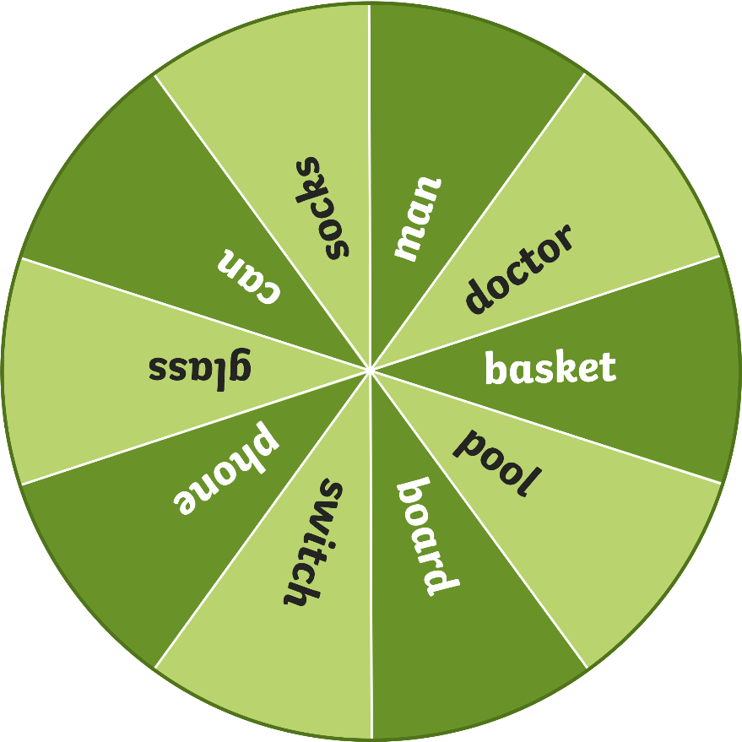
They Have Been Matched!
Spin the wheel to select a noun.
Spin
Write down a simple noun phrase using the noun on the spinner. For Example, the basket. Now, use nouns, adjectives and prepositional phrases to expand it.

Slide 12
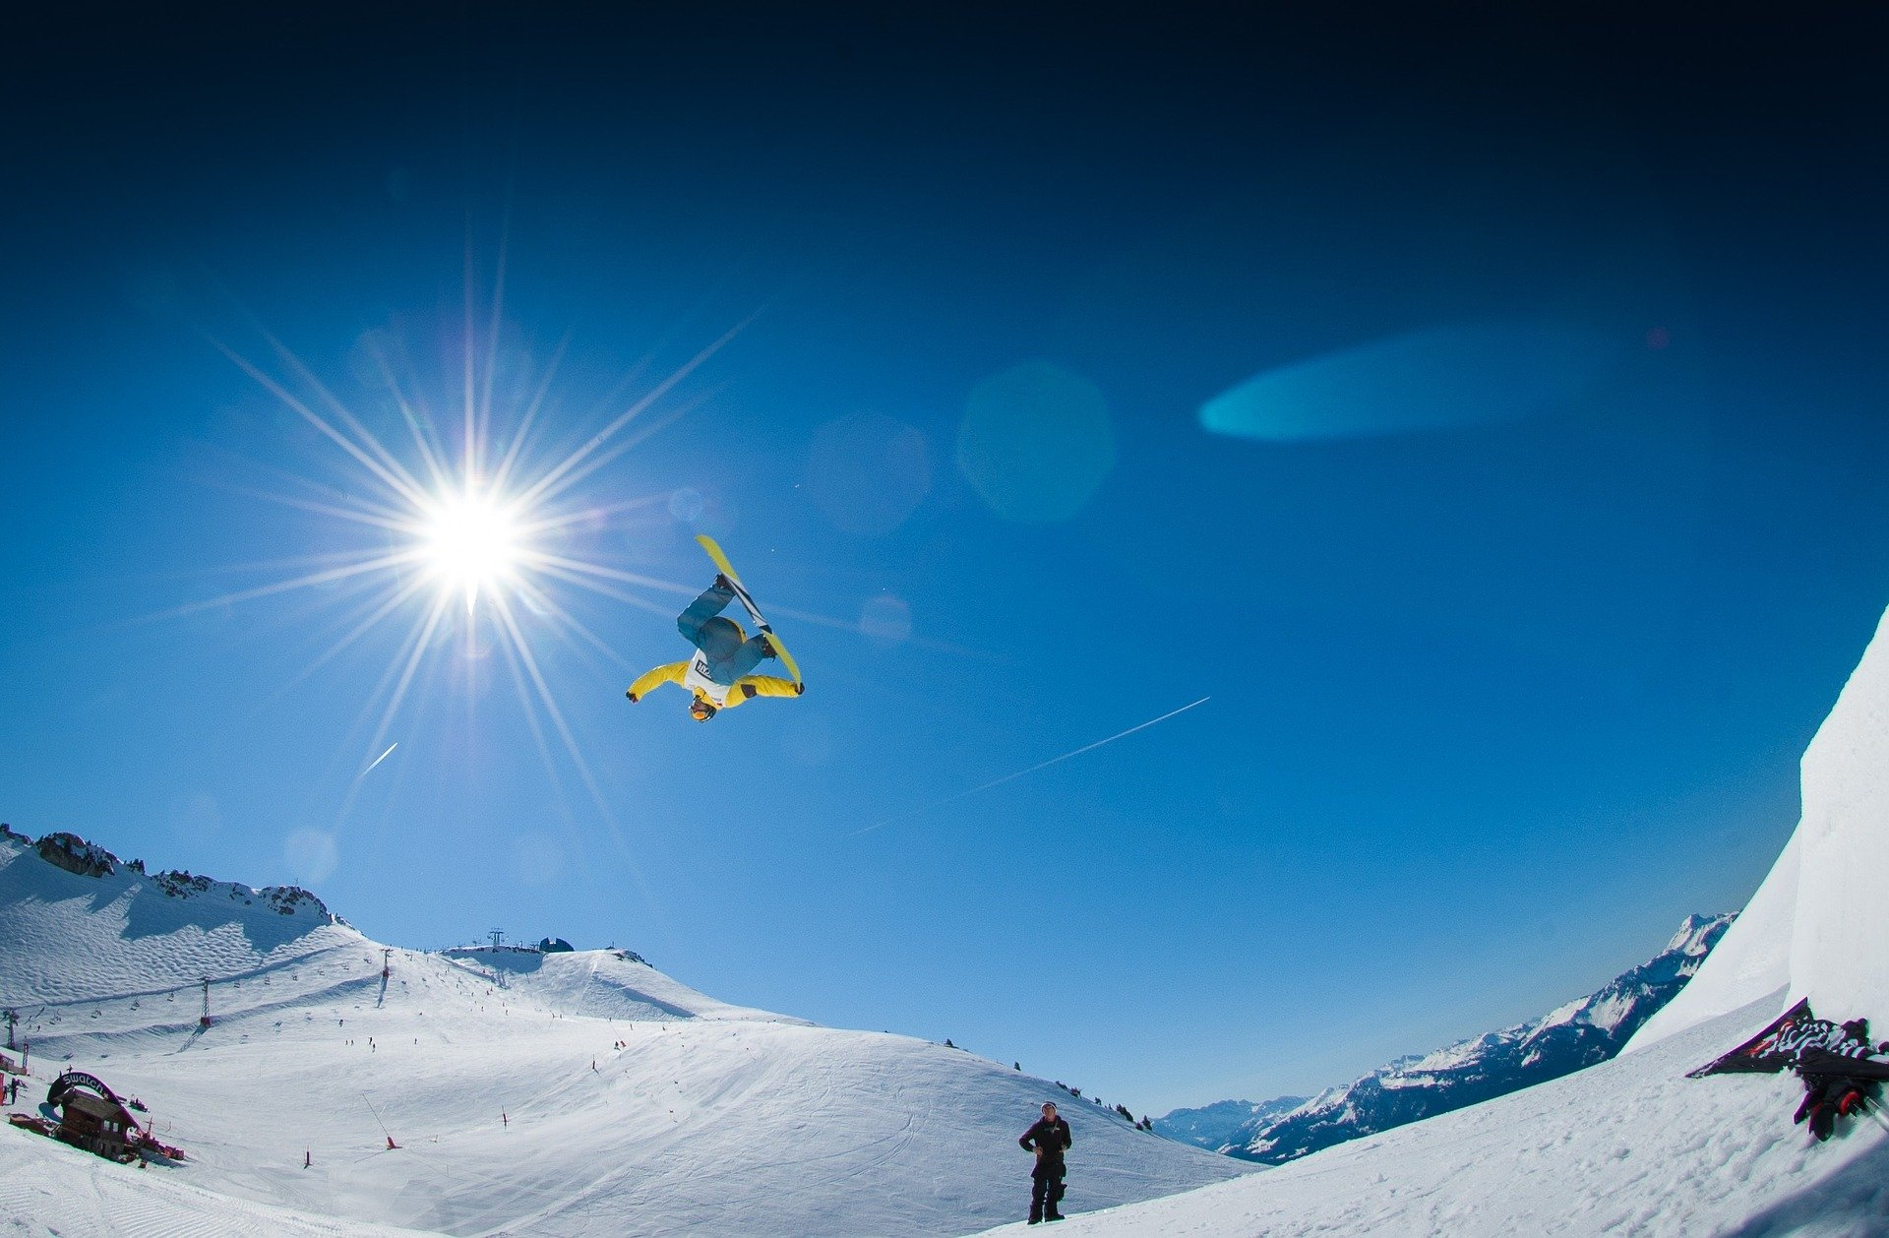
Expand That Noun Phrase!
Use this picture to write three of your own expanded noun phrases.

Slide 13
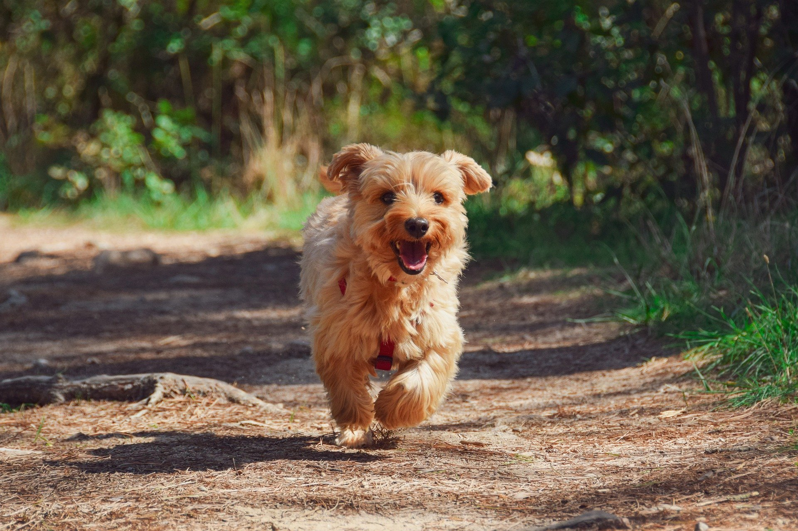
Expand That Noun Phrase!
Use this picture to write three of your own expanded noun phrases.

Slide 14
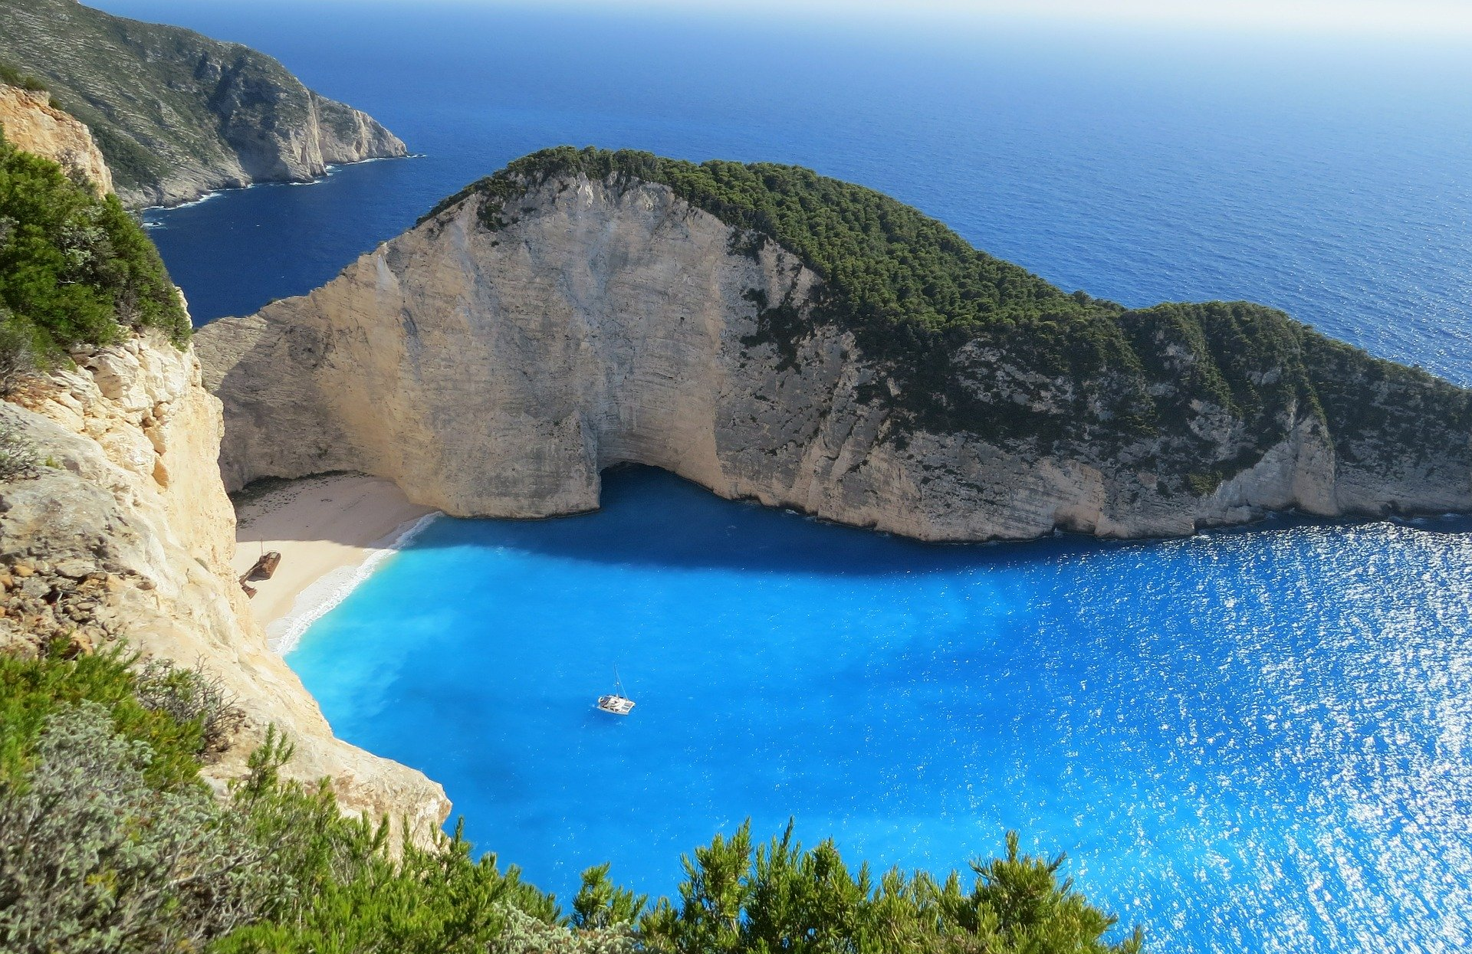
Expand That Noun Phrase!
Use this picture to write three of your own expanded noun phrases.

Slide 15
Beetle Drive
The aim of the game is to be the first to write an expanded noun phrase. Work in teams. Roll the dice. For each number you roll, add the correct part of the sentence. Who will win?
The Number Rolled | The Part You’ve Won
1 | A simple noun
2 | One adjective
3 | A noun to modify
4 | One adjective
5 | A prepositional phrase
6 | A determiner
If you roll it and you don’t need it, you don’t get anything!
You must roll the number 1 to start!

