Slide 1
Let’s Learn About Fractions!

Slide 2
WALT
Today we are going to learn about how to divide a shape into equal parts.
For the parts to be equal, we need to make sure they are all the same size.

Slide 3
2 Equal Parts
Let’s pretend 2 friends want to share this pizza. If we cut it right down the middle, then both friends get equal parts.
When we cut the pizza into two parts, we can say we cut the pizza into halves.

Slide 4
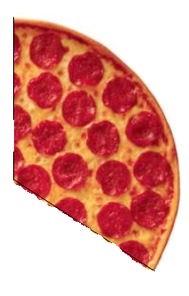
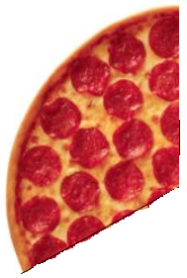
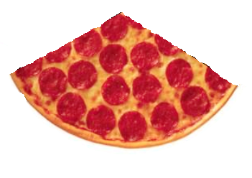
3 Equal Parts
Let’s pretend 3 friends want to share this pizza. We want to make sure that all three friends get equal parts.
When we cut the pizza into three parts, we can say we cut the pizza into thirds.

Slide 5
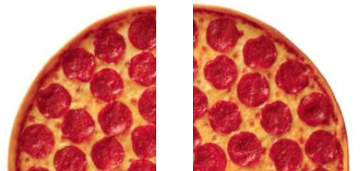
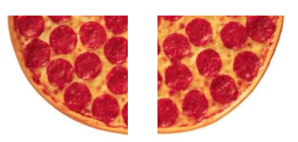
4 Equal Parts
Let’s pretend 4 friends want to share this pizza. We want to make sure that each friend gets the same size piece.
When we cut the pizza into four parts, we can say we cut the pizza into fourths.

Slide 6
Let’s Look for Shapes Divided into Equal Parts!
Is this circle divided into equal parts?
Yes!

Slide 7
Let’s Look for Shapes Divided into Equal Parts!
Is this square divided into equal parts?
No!

Slide 8
Let’s Look for Shapes Divided into Equal Parts!
Is this rectangle divided into equal parts?
NO!

Slide 9
Let’s Look for Shapes Divided into Equal Parts!
Is this diamond divided into two equal parts?
Yes!

Slide 10
Let’s Look for Shapes Divided into Equal Parts!
Is this triangle divided into equal parts?
No!

Slide 11
Let’s Look for Shapes Divided into Equal Parts!
Is this hexagon divided into equal parts?
Yes!

