Slide 1
5.2 Light travels in straight lines

Slide 2
Our Objectives
Determine how light travels.
Identify ray diagram
Determine how to draw a ray diagram.

Slide 3
Our new vocabulary:
Proof:
ray
prove
ray diagram

Slide 4
Name the source of light in the photographs Describe how the light in these photographs travels – in a curved line or a straight line?

Slide 5
You can see in pictures that light travels in straight lines. But as a scientist you need to get evidence to prove (show) that this is true
The next investigation will give you proof – evidence that shows that this is true.

Slide 6
Can light travel round corners?!!!
He went outside the door and walked along the corridor….
Can we see him now?
How can we see this person?!

Slide 7
So……….
Can light travel round corners or only travel in straight lines?

Slide 8
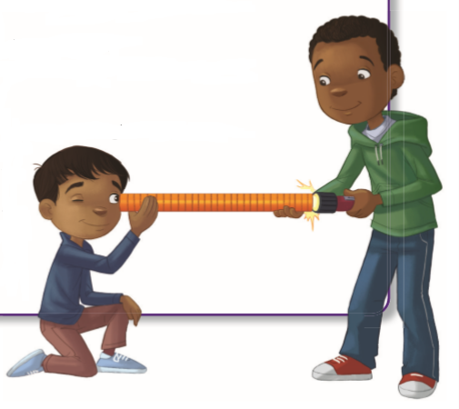
Lets Prove again that light travels in straight lines….

Slide 9
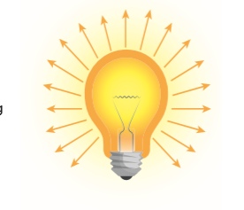
Light Rays
Light travels in straight lines.
Each narrow beam of light is called a ray.
Light rays travel from the source of light in all directions until they hit something.

Slide 10
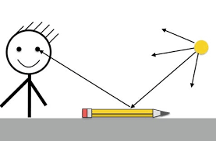
Ray Diagrams
We can show how light travels with a ray diagram.
On the diagram, we draw straight lines for the rays of light.
We draw an arrowhead to show the direction the light ray is moving.

Slide 11
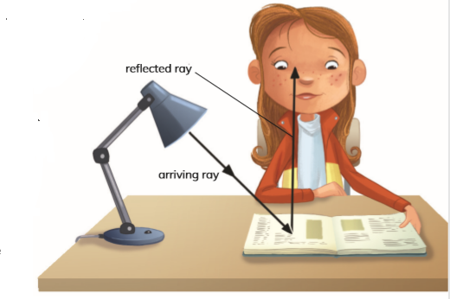
In ray diagrams we have: 1-arriving ray 2-reflected ray
Light ray from the lamp hits an object such as a book.
This light ray is an arriving ray.
Light rays that bounce or reflect off the book.
These rays are called reflected rays.
If the reflected rays enter our eyes we will see the book

Slide 12
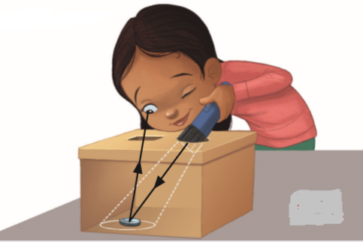
Identify the: arriving ray reflected ray

Slide 13
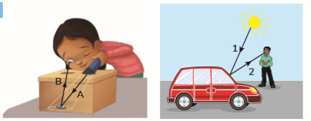
2 Look at the ray diagram of the person seeing the car. Identify the arriving ray and the reﬂected ray labelled 1 and 2.
3 Draw a ray diagram to show how you see the person sitting next to you.
Label the arriving ray and the reﬂected ray.
1- In the ray diagram of the coin in the box, which is the reﬂected ray, A or B?
Lb.p 102

Slide 14
Thank you

