Slide 1
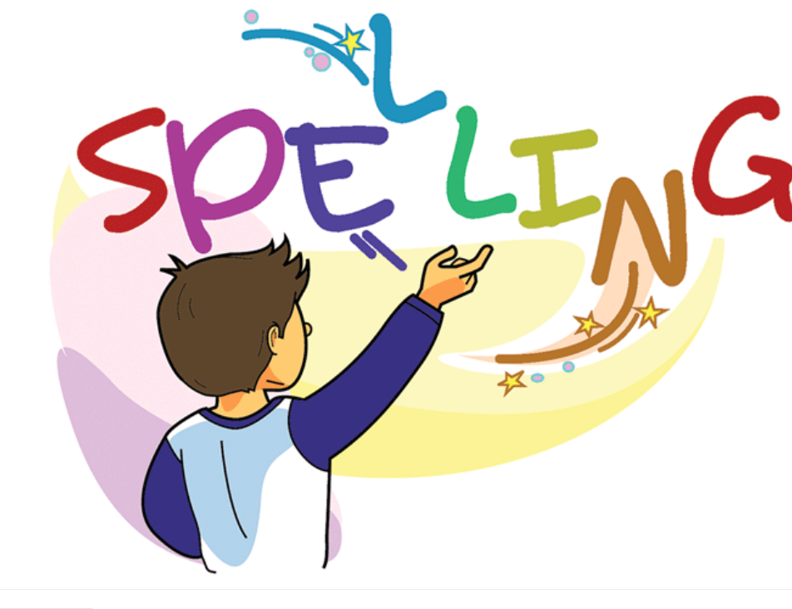

Slide 2
Spelling Words y with the long sound /i/
dry
If something is dry, there is no water or moisture on it or in it.
I am drying my hair.

Slide 3
fly:
When something such as a birds, insects, or aircrafts fly, it moves through the air.
The planes fly through the clouds.
The birds fly away

Slide 4
shy
A shy person is nervous and uncomfortable in the company of other people.
He is a shy, quiet-spoken boy.

Slide 5
cry
When you cry, tears come from your eyes, usually because you are unhappy or hurt.
Please don't cry.

Slide 6
spy
A spy is a person whose job is to find out secret information about another country or organization.
The spy passed secrets to the enemy.

Slide 7
sky
The sky is the space around the Earth which you can see when you stand outside and look upwards.
The sun is already high in the sky.

Slide 8
fry
When you fry food, you cook it in a pan that contains hot fat or oil.
Fry the doughnuts until golden brown.

Slide 9
try
If you try to do something, you want to do it, and you take action which you hope will help you to do it.
Try this salad you might like it.

Slide 10
my
A speaker or writer uses my to indicate that something belongs or relates to himself or herself.
John is my best friend.

Slide 11
by
Someone or something that is by something else is beside it and close to it.
Judith was sitting by the boxes.

