Slide 1
Counting in 2s

Slide 2
1) What is missing? 1, 2, 3, __ , 5 , 6 , 7, __
2) How do you spell 2?
3) What is missing? 10, 11, ___, 13, ___
4) You have only 1 nose and 1 mouth. What do you have 2 of?

Slide 3
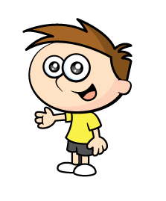
1) What is missing? 1, 2, 3, __ , 5 , 6 , 7, __
2) How do you spell 2?
3) What is missing? 10, 11, ___, 13, ___
4) You have only 1 nose and 1 mouth.
What do you have 2 of?
4
8
two
12
14

Slide 4
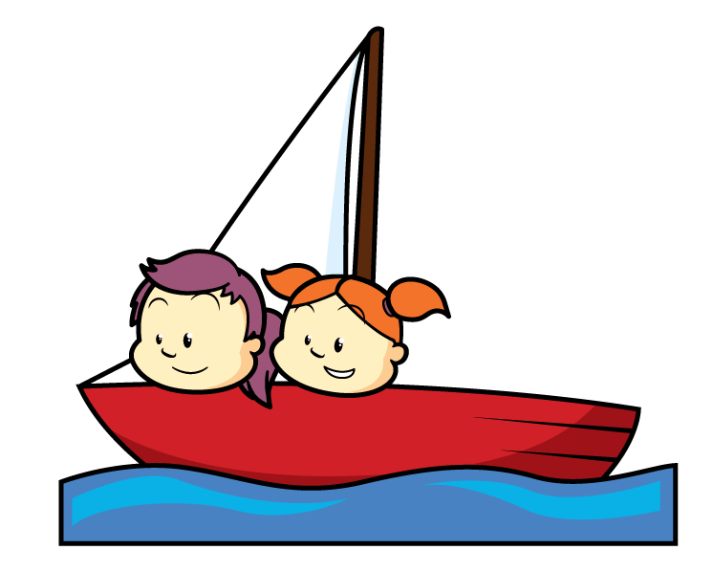
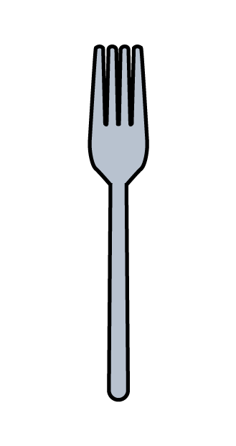
What do you notice?
They are all in twos.
Another word for being in a group of two is a pair.

Slide 5
What can you find that you can count in 2s?

Slide 6
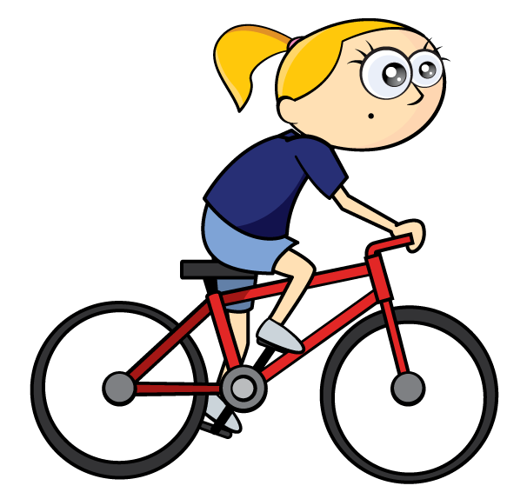
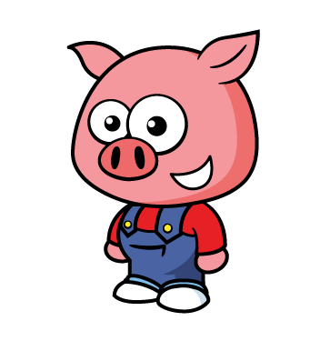
Why do we count in 2s?

Slide 7
Grouping objects into twos helps us to count more efficiently (more quickly) and accurately (counting carefully).

Slide 8
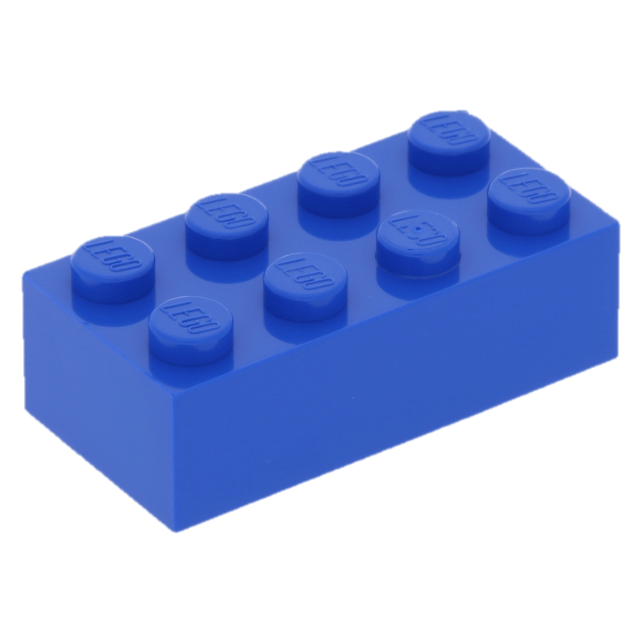
Get 8 objects.
Count them in 1s
1 2 3 4 5 6 7 8
Now count them in 2s
2 4 6 8
Which way was quicker or more efficient?

Slide 9
Now we need to practise counting in steps of 2 to help us count efficiently and accurately.
It is not any good counting in steps if we can’t count accurately.

Slide 10
Can you count in 2s using the number line to help you?

Slide 11
What did you notice?

Slide 12
When we count in 2s we miss out a number each time.

Slide 13
So we can begin to count in twos by counting in ones, but we whisper the number we don’t need to say so we understand that it is still there.
Try “Whisper… Shout”

Slide 14
So we can begin to count in twos by counting in ones, but we whisper the number we don’t need to say so we understand that it is still there.
Now try “number in your head… Say me out loud”

Slide 15
Can you count to 10 now in 2s?
Can you count backwards from 10 to 0 in twos?
If you can move on, if not keep practising!!

Slide 16
Now lets try counting to 20 in 2s.
1 | 2 | 3 | 4 | 5 | 6 | 7 | 8 | 9 | 10
11 | 12 | 13 | 14 | 15 | 16 | 17 | 18 | 19 | 20

Slide 17
What do you notice?
Are there any patterns?
1 | 2 | 3 | 4 | 5 | 6 | 7 | 8 | 9 | 10
11 | 12 | 13 | 14 | 15 | 16 | 17 | 18 | 19 | 20

Slide 18
Can you count to 20 now in 2s?
How does the pattern help you?
Can you count backwards from 20 to 0 in twos?
If you can move on, if not keep practising!!

Slide 19
Well done, now we are going to use what we know about counting in 2s to help us count up to 50!!
You will need the 50 grid from the resource pack in todays folder on the School web site.

Slide 20
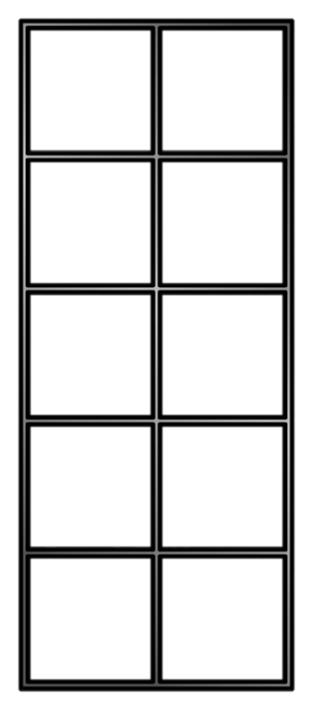
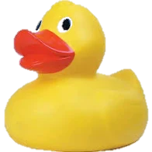
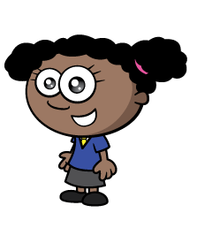
You can also use your tens frames to help you.
How many ducks?
Now I can count in 2s!
2 , 4 , 6 , 8
There are 8 ducks.

Slide 21
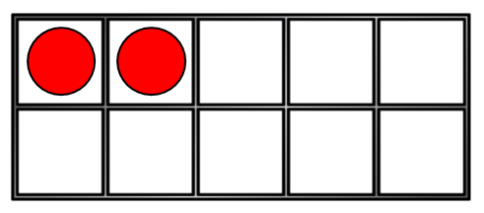
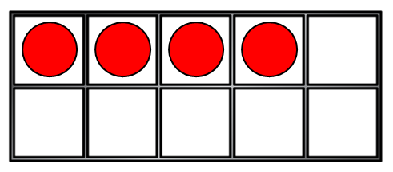
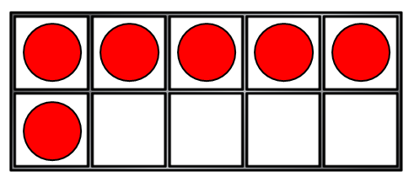
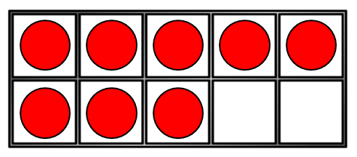
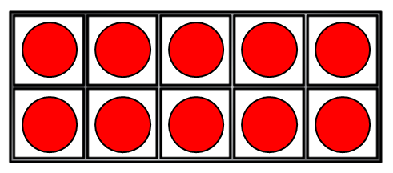
How many counters?
0
2
4
6
8
10

Slide 22
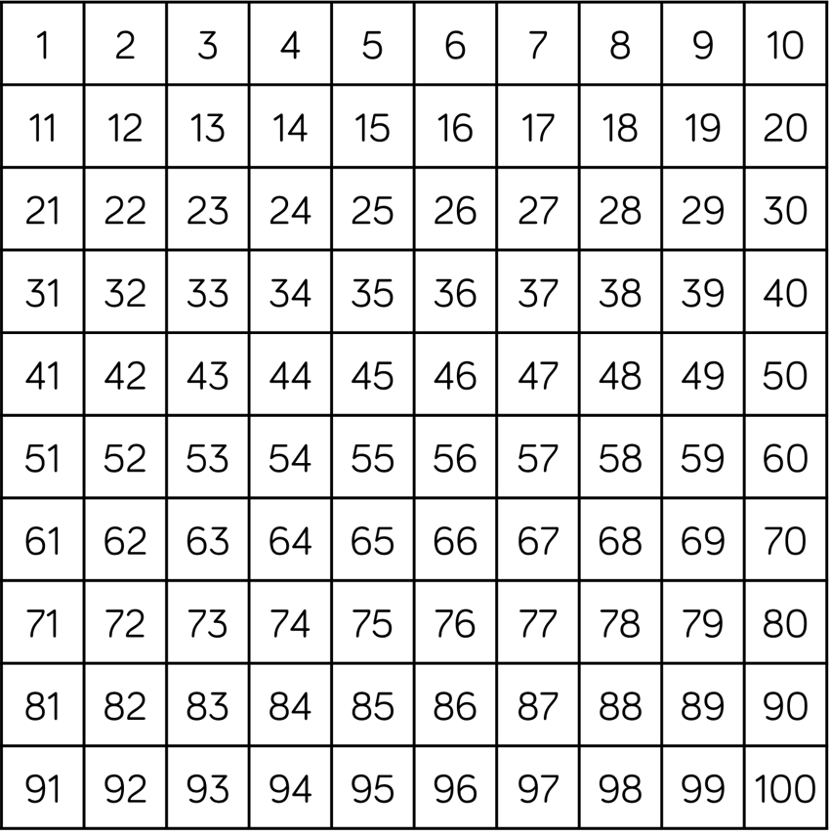
Have a think
How many gloves?
There are 20 gloves.

Slide 23
Have a think
Can you count in 2s starting at 8?
There are 20 eyes!

Slide 24
Have a think
How many pencils?
16
How many cans of pop?
12

Slide 25
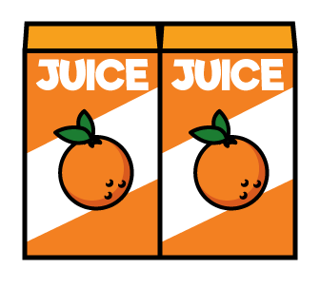
Let’s count backwards in 2s!
There were 12 boxes of juice.
After playtime the children were thirsty.

Slide 26
What is missing?
36 | 38 | 40 | ? | 44 | 46 | 48 | ?
36 | 38 | 40 | 42 | 44 | 46 | 48 | 50

Slide 27
Have a go at the questions in the book! ☺

