Slide 2
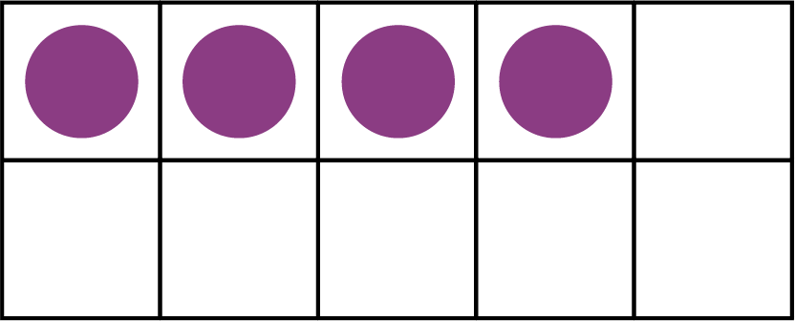
Can you find and click all of the number ones?
1
3
Try again
1
Next number

Slide 3
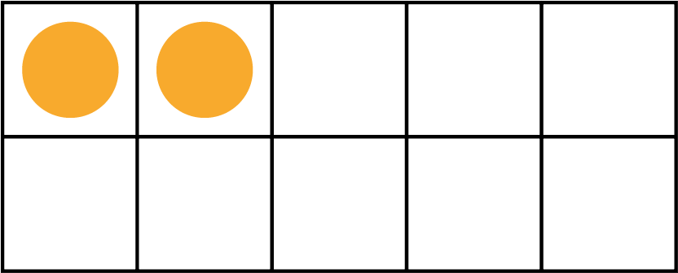
Can you find and click all of the number twos?
2
Try again
2
5
Next number

Slide 4
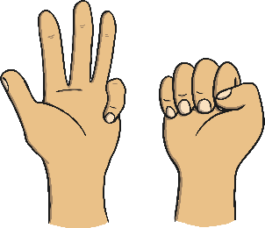
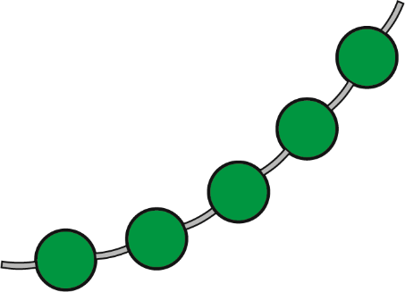
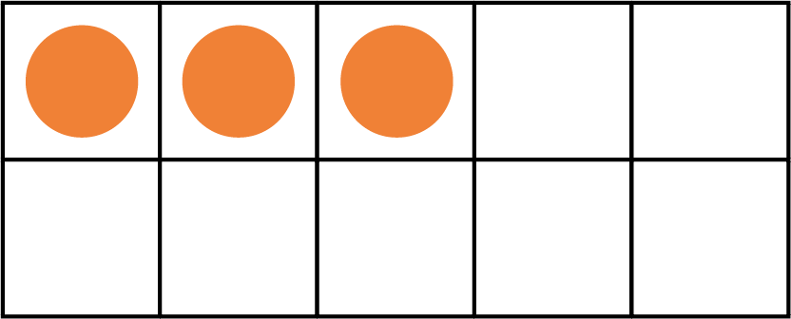
Can you find and click all of the number threes?
3
3
Try again
2
Next number

Slide 5
Can you find and click all of the number fours?
4
1
Try again
4
2
Next number

Slide 6
Can you find and click all of the number fives?
5
3
Try again
2
5
End

