Slide 1
5.1 How we see things

Slide 2
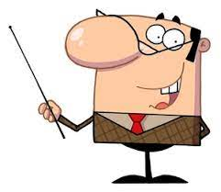
Our objectives:
Determine how can we see things.
Investigate how we see things that are not sources of light

Slide 3
Our New Vocabulary:
reflect
source

Slide 4
When you enter a dark room are you able to see anything?

Slide 5
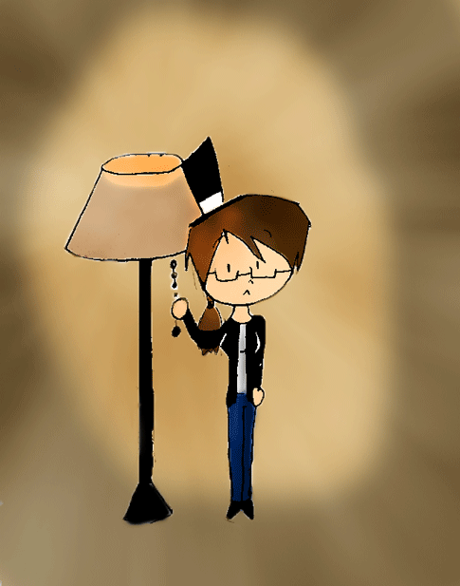
What must you do to be able to see?
You must switch on the light!!!!!!!

Slide 6
What is the source of light in your classroom?
Did you ever ask yourself ………
How do light help us to see our friends, teacher and different objects in the class?!!!!!

Slide 7
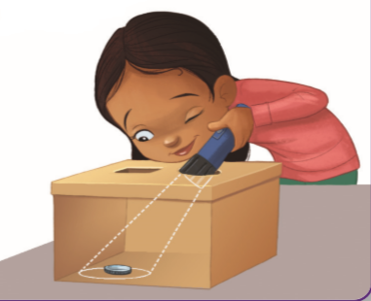
Let’s Investigate how do we see things that are not sources of light?

Slide 8
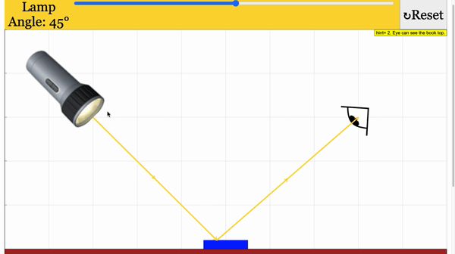
1- Can you see the coin without shining the ﬂashlight?
2 Can you see the coin when you shine the ﬂashlight?
3 What conclusion do you reach about the question:
How do we see things that are not sources of light?
Copy and complete these sentences to help you write your conclusion:
Light travels from the source (the flashlight) to the object (the ).
The light bounces or reflects off the into our . This is how I can see.
Lb. p.98
Light
Coin
Coin
eyes

Slide 9
How could the person see the car?
How could the person see the car at night?

Slide 10
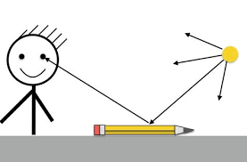
So …….. In order to see an object…..
Light travels from the light source to the object.
Light bounces or reflects off the object into our eyes.

Slide 11
Thank you

