Slide 2
where we can use digital technology

Slide 3
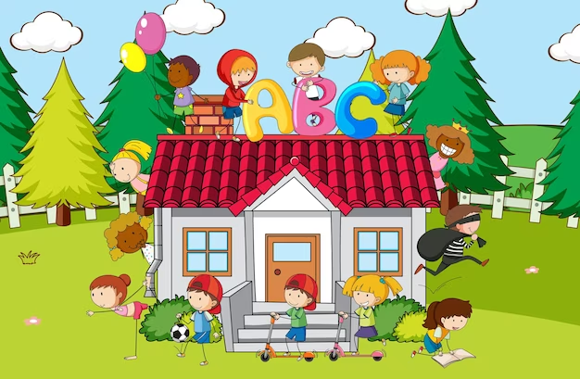
Home
What is the digital devices I can found in my home?

Slide 5
Hospital

Slide 6
Shop

Slide 7
How this technology helps us?

Slide 8
Digital technology makes life easier .

Slide 9
Digital technology makes it easy to stay in touch with friends, family.

Slide 10
Activity

Slide 11
How to use the keyboard?
https://www.kidztype.com/dance-mat-typing-level-1-stage-1_f1117a537.html

Slide 12
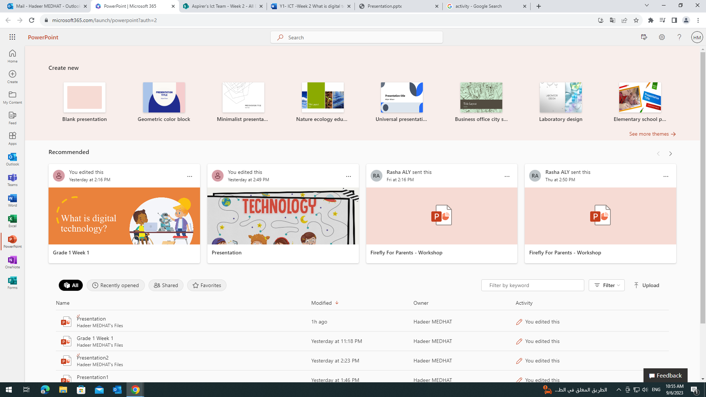
Text Formatting (Size)
Step1 Open power point program
Step 2 Home
Step 3 Font

Slide 13
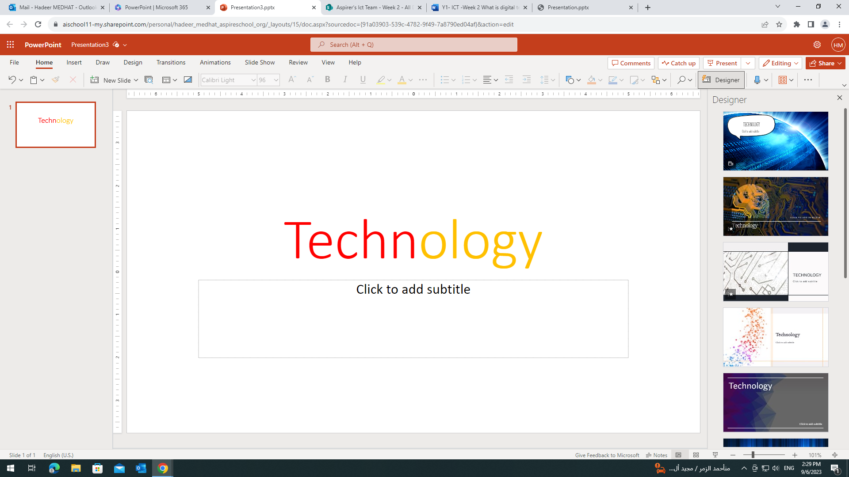
To change the handwriting style

Slide 14
Bye

