Slide 1
Figurative Language

Slide 2
Learning Goal:
I will be able to identify figurative language(simile, metaphor, idiom, personification, onomatopoeia, hyperbole, alliteration, consonance, assonance) within text.

Slide 3
Literal language Figurative language
tells it like it is; means exactly what it says
Examples:
Grass looks green.
The flower smells sweet.
Grasshoppers make a high pitched noise.
creates a picture in the mind of the reader
Examples:
The grass looks like spiky green hair.
The flower has the sweetest smelling petals in the world.
Grasshoppers are fiddlers who play their legs.

Slide 4
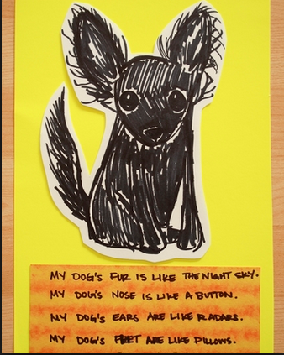
Simile
Compares two unlike things using words such as “like” or “as”
Example>>>>>>>>>>>

Slide 5
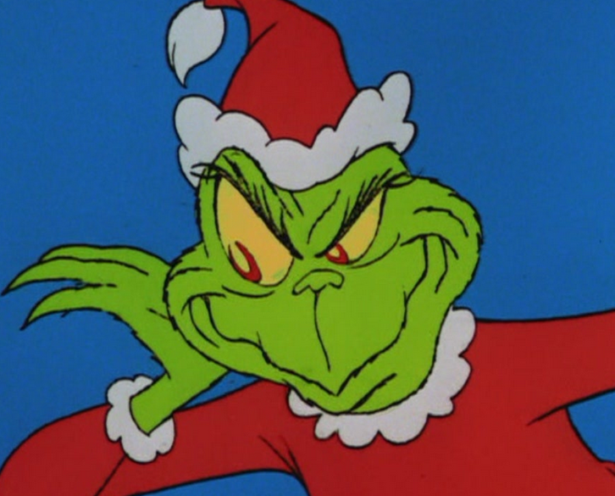
Metaphor
says one thing IS another; does NOT use “like” or “as”
Example:
“You’re a monster, Mr. Grinch. Your heart is an empty hole.”

Slide 6
Hyperbole
An exaggeration or overstatement
Example: “I’ve told you a million times.”
http://safeshare.tv/v/ss56954525873c4

Slide 7
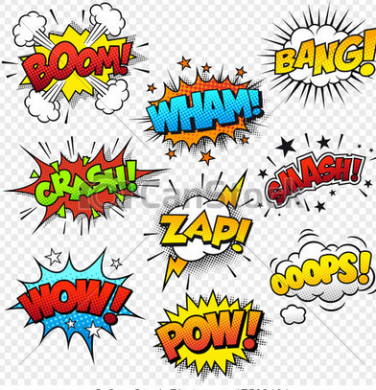
Onomatopoeia
A word that imitates the sound it represents
Example:

Slide 8
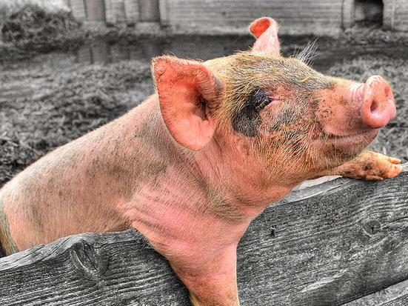
Personification
An object or animal is given human feelings, thoughts, or attitudes
Example: The filthy pig smirked in delight.

Slide 9
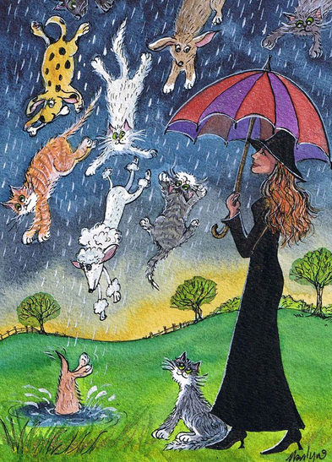
IDIOM
An expression that has a meaning different from the meaning of its individual words
Example: It’s raining cats and dogs.

Slide 10
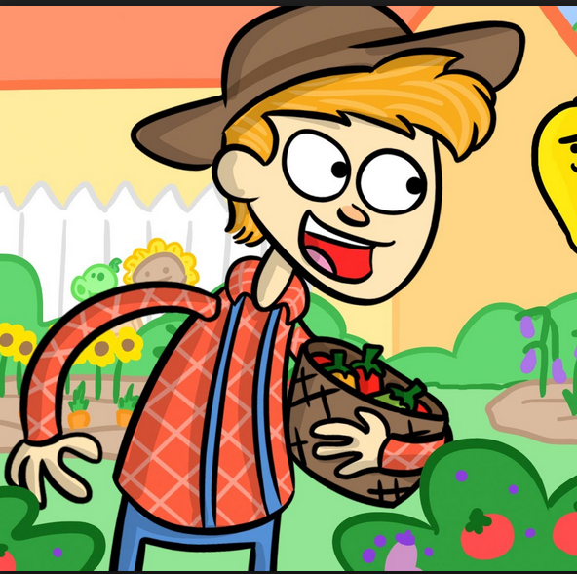
Alliteration
Repetition of the first sound in words that are close to each other
Example: Peter Piper picked a peck of pickled peppers.
Suzy cited super textual evidence.

Slide 11
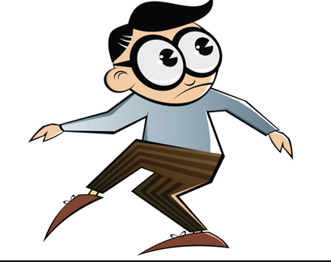
Consonance
Repetition of a consonant sound in words of close proximity
Example: Pitter-patter, pitter-patter

Slide 12
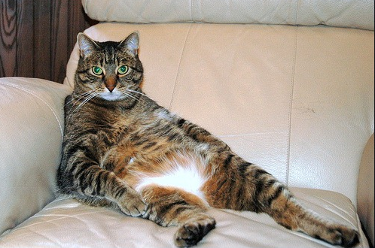
Assonance
Repetition of a vowel sound in words of close proximity
Example: The cat sat back.

