Slide 2
How many shooting stars can you see? Can you click on the matching number?
0
5
3

Slide 3
Correct!
5 shooting stars
next

Slide 4
Try again!
back

Slide 5
How many rockets can you see? Can you click on the matching number?
4
2
6

Slide 6
Correct!
4 rockets
next

Slide 7
Try again!
back

Slide 8
How many astronauts can you see? Can you click on the matching number?
5
8
4

Slide 9
Correct!
4 astronauts
next

Slide 10
Try again!
back

Slide 11
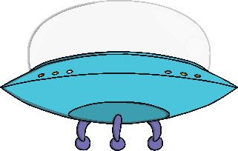
How many spaceships can you see? Can you click on the matching number?
5
4
7

Slide 12
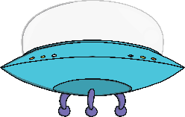
Correct!
5 spaceships
next

Slide 13
Try again!
back

Slide 14
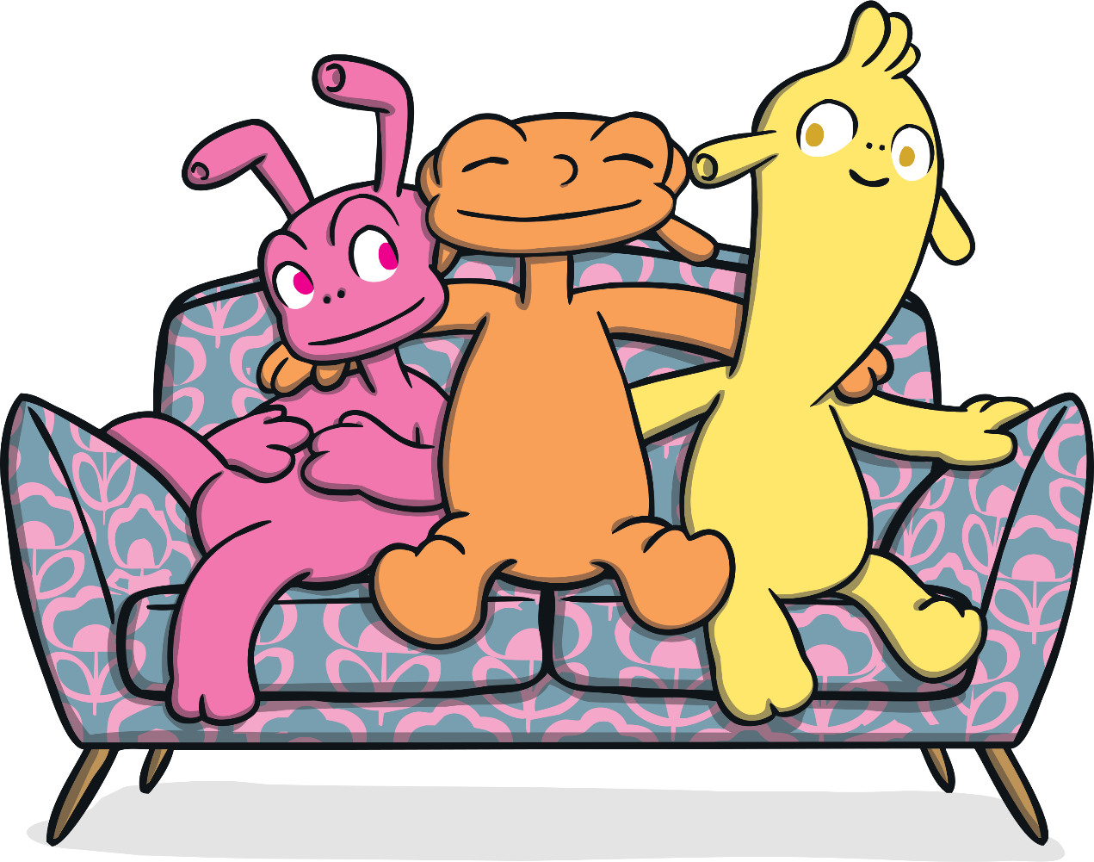
Stellar Job!

