Slide 2
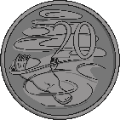
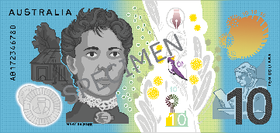
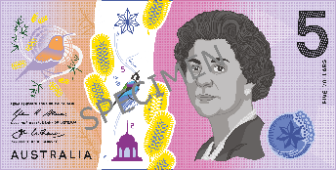
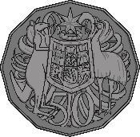
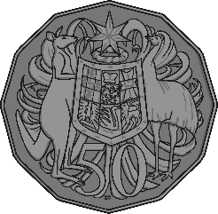
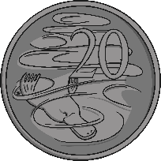
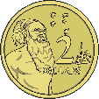
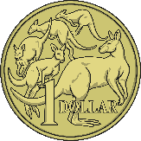
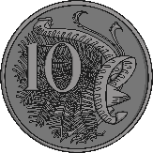
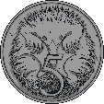
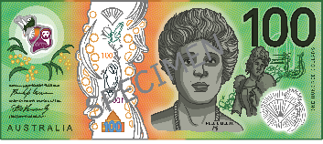
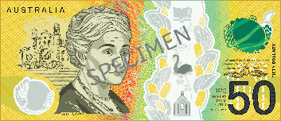
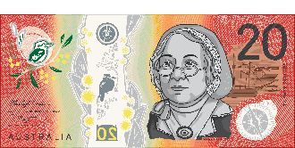
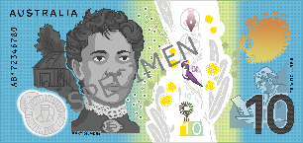
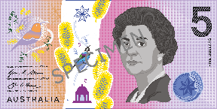
What is Money?
Each coin or banknote has a certain value. This value is written on the coin or banknote so people know what it is worth when they use or receive it.
Money is what people use to buy things.
Money can be metal coins.
Money can be banknotes.

Slide 3
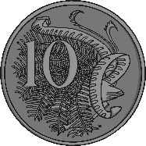
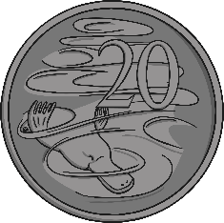
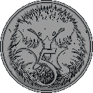
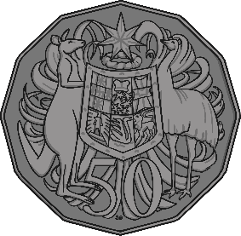
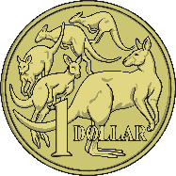
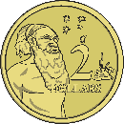
Coins
These are the Australian coins:
5 cents / 5c
10 cents / 10c
20 cents / 20c
50 cents / 50c
1 dollar / $1
2 dollars / $2

Slide 4
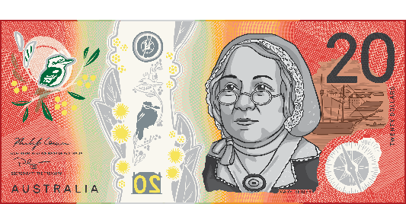
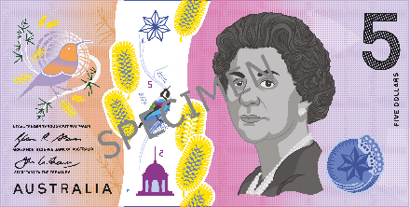
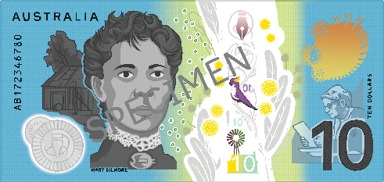
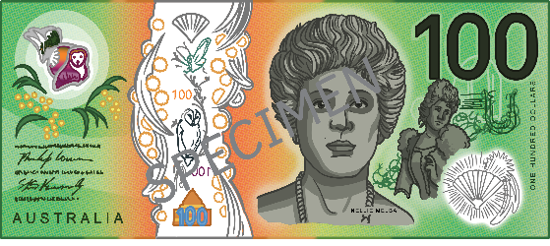
Banknotes
These are the Australian banknotes:
5 dollars / $5
10 dollars /$10
20 dollars / $20
50 dollars / $50
100 dollars / $100

Slide 5
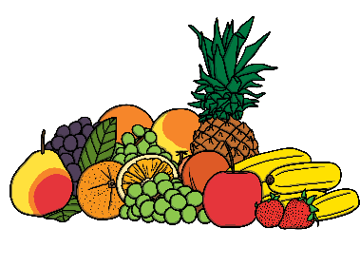
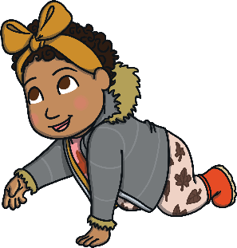
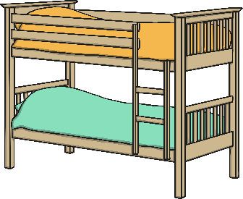
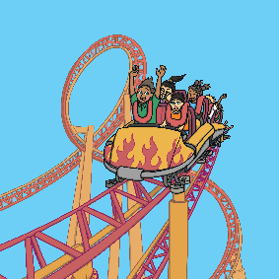
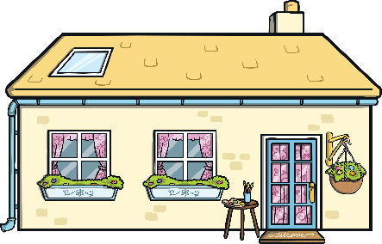
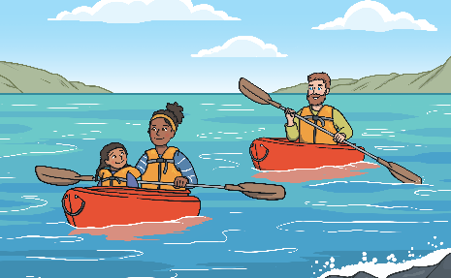
Why Do We Need Money?
Here are a few things we use money to pay for:
food
clothes
things for our home such as furniture
days out
a place to live
leisure activities such as holidays

Slide 6
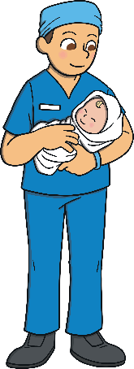
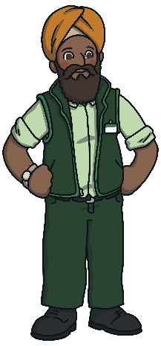
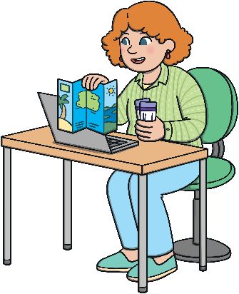
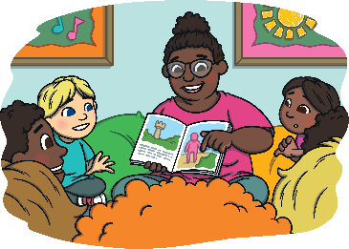
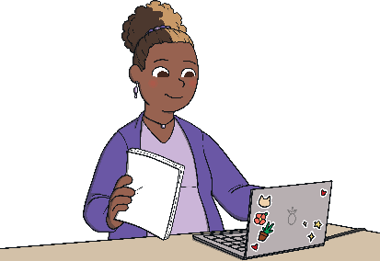
Where Do We Get Money From?
We can get money from lots of places.
Adults often go to work and are paid a salary. A salary is money given to someone for doing their job.
The government sometimes supports families by giving them money.

Slide 7
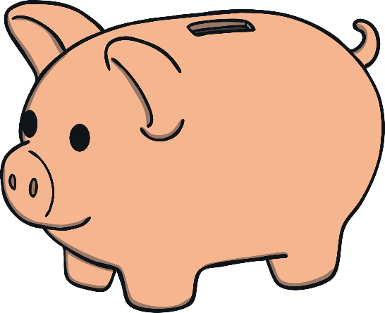
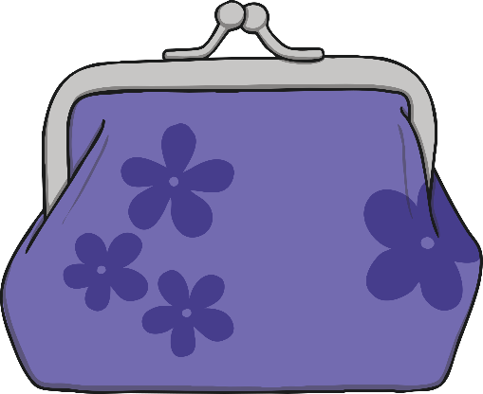
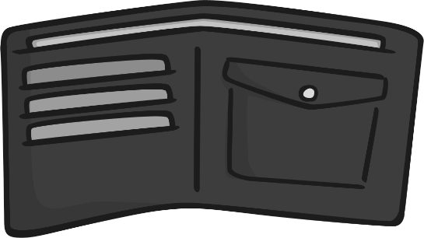
Where Do We Get Money From?
Children can sometimes get money from pocket money, or from gifts.
They might save their money in a piggy bank or a wallet or purse.

Slide 8
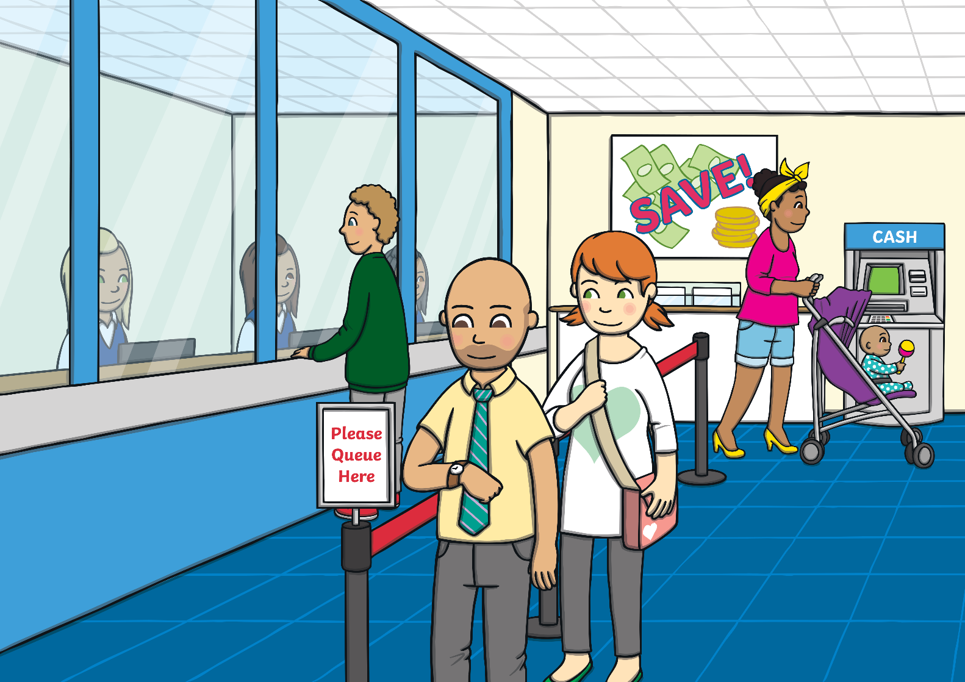
How Do We Keep Money Safe?
Adults keep their money safe by putting it into a bank account so they are not carrying all their money around with them.
Adults can see how much money they have in their bank accounts by using the internet or an app to view their accounts. They can also go into the bank and ask for a statement.

Slide 9
Cards
Adults can use payment cards to pay for different things. These might be ‘debit’ or ‘credit’ cards.
This is a way for adults to store their money in their bank accounts, which means they pay for items using their bank cards rather than coins or notes.
When items are purchased in a shop using a bank card, they are either tapped or a pin code is entered to tell the bank to take the money from the account to pay for the item.

