Slide 1
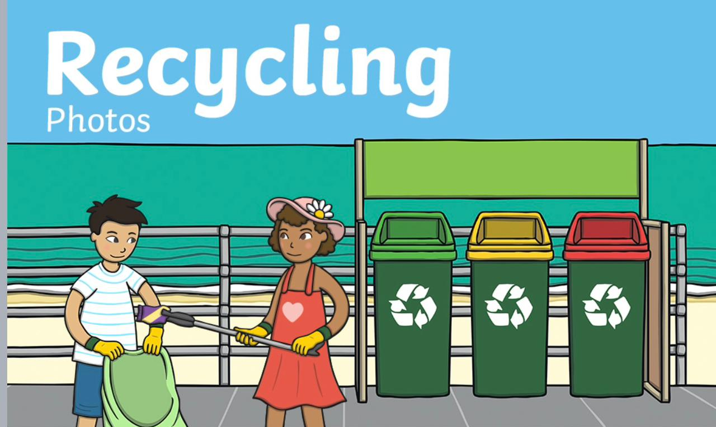

Slide 3
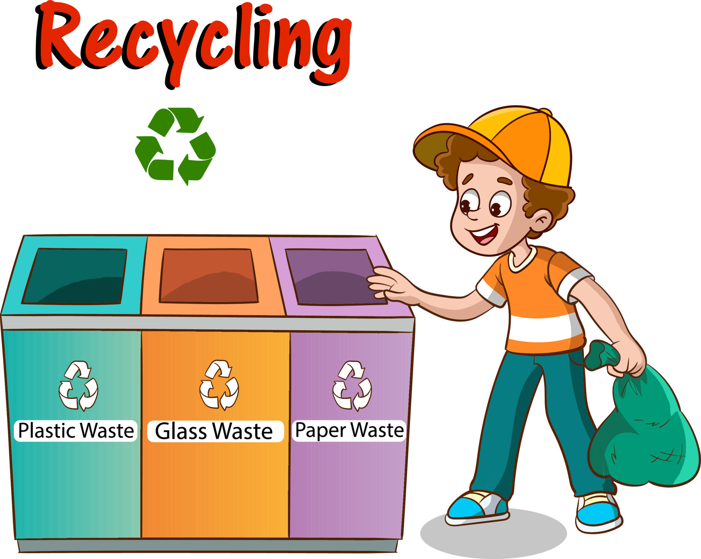
What is recycling? (Think for 30 seconds)

Slide 6
Can you think of one flexible and one rigid material that can recycled?

Slide 7
(Pair work –Think for 1 minute)

Slide 8
Students to solve pages 31, 32, 33 in workbook.

Slide 9
Lesson 2

Slide 10
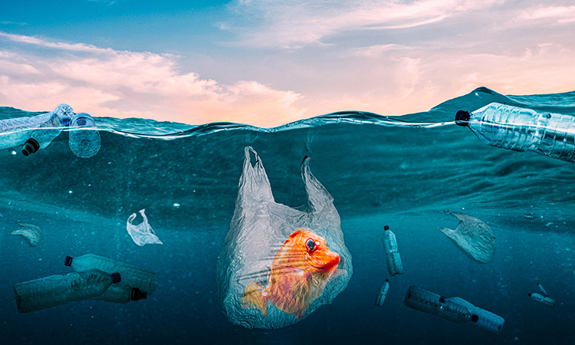
What do you think happened to the fish? Why? (Brainstorm)
j

Slide 13
Interactive game
https://www.twinkl.com.eg/go/resource/recycled-objects-matching-game-tg-au-hu

Slide 14
Lesson 3

Slide 26
What is called compressed?

Slide 29
Think for 30 seconds

Slide 30
Answer:

Slide 32
Guess the materials - compress, twist, bend or stretch (Pair work – Think for 2 minutes)

Slide 36
Students to solve student workbook pages 34, 35, 36

