Slide 2
Circle
Click on the pencil for animation

Slide 3
Circle
Circles only have one side.
Circles have no corners.

Slide 4
Can you find the circle?

Slide 5
Circle
Disc
Clock

Slide 6
Square
Click on the pencil for animation

Slide 7
Square
Squares have 4 straight sides and 4 corners.
All the sides are the same length.

Slide 8
Can you find the square?

Slide 9
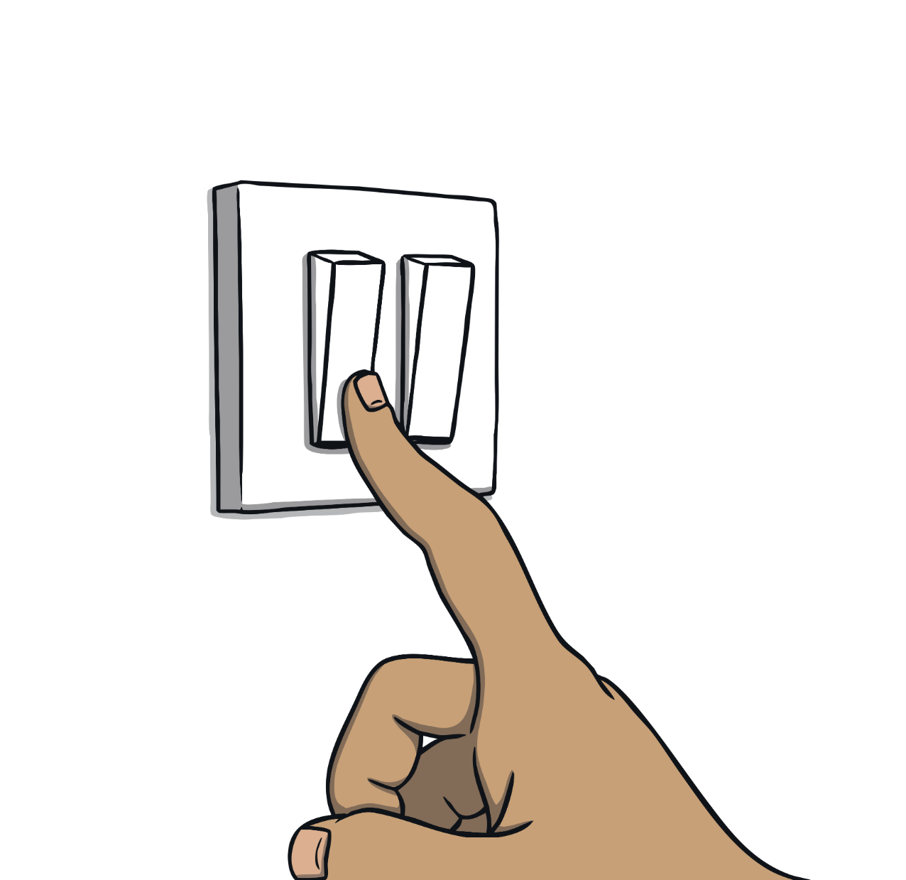
Square
Light Switch
Windows

Slide 10
Triangle
Click on the pencil for animation

Slide 11
Triangle
Triangles have 3 sides and 3 corners

Slide 12
Can you find the triangle?

Slide 13
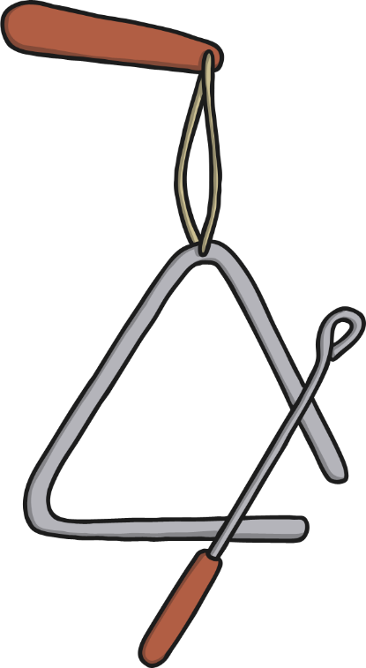
Triangle
Triangle
Road Sign

Slide 14
Rectangle
Click on the pencil for animation

Slide 15
Rectangle
Rectangles have 4 sides and 4 corners.
They have 2 long sides and 2 short sides.

Slide 16
Can you find the rectangle?

Slide 17
Rectangle
Ruler
Envelope

