Slide 1
Animal Habitats

Slide 2
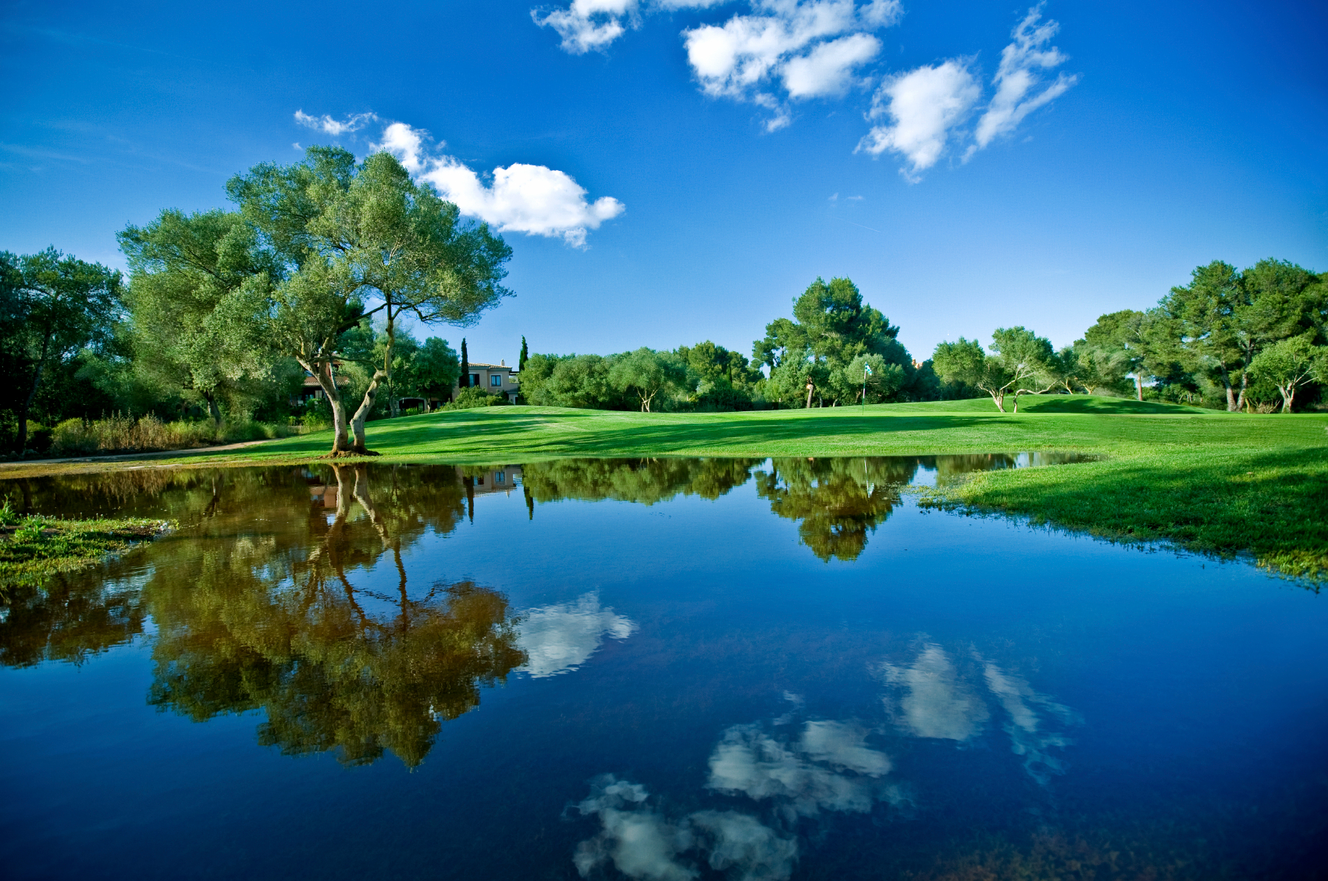
Animal Habitats
Animals live in different environments
Environments are made of living and nonliving things
What type of living and nonliving things do you think are in the picture below?

Slide 3
Animal Habitats
Every animal lives in a habitat
Habitats are places where animals find the things that they need to live
Animals need SWAFS to survive

Slide 4
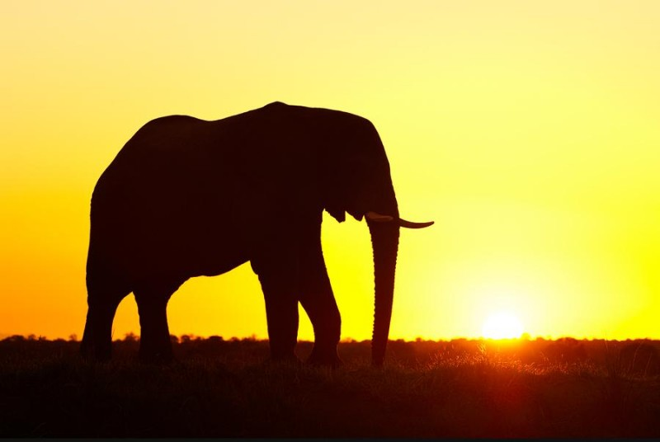
Animal Habitats
Animals need sunlight
Sunlight helps plants grow, which is food for many animals

Slide 5
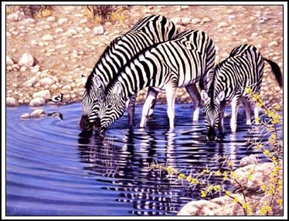
Animal Habitats
Animals need water to survive
Some animals get water from ponds, streams, rivers, or lakes
Other animals get water from foods that they eat

Slide 6
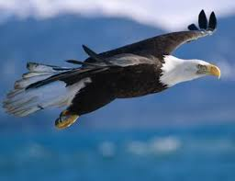
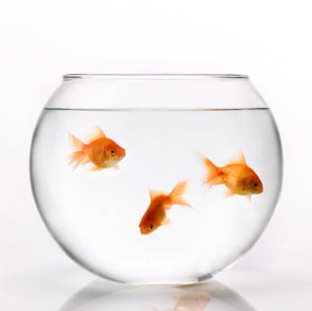
Animal Habitats
Animals need air to survive
Some animals get oxygen from the air around them
Other animals get oxygen from the water around them

Slide 7
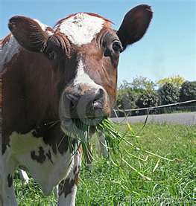
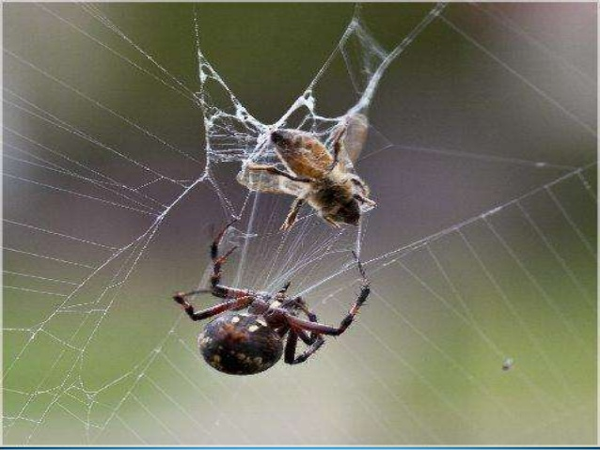
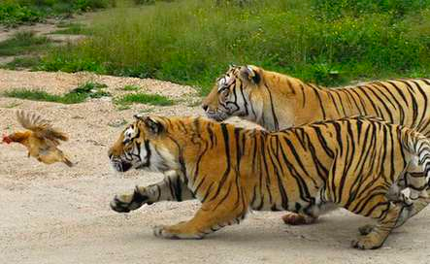
Animal Habitats
Animals need food to survive
Some animals eat other animals or plants
Some animals eat both
Other animals eat insects

Slide 8
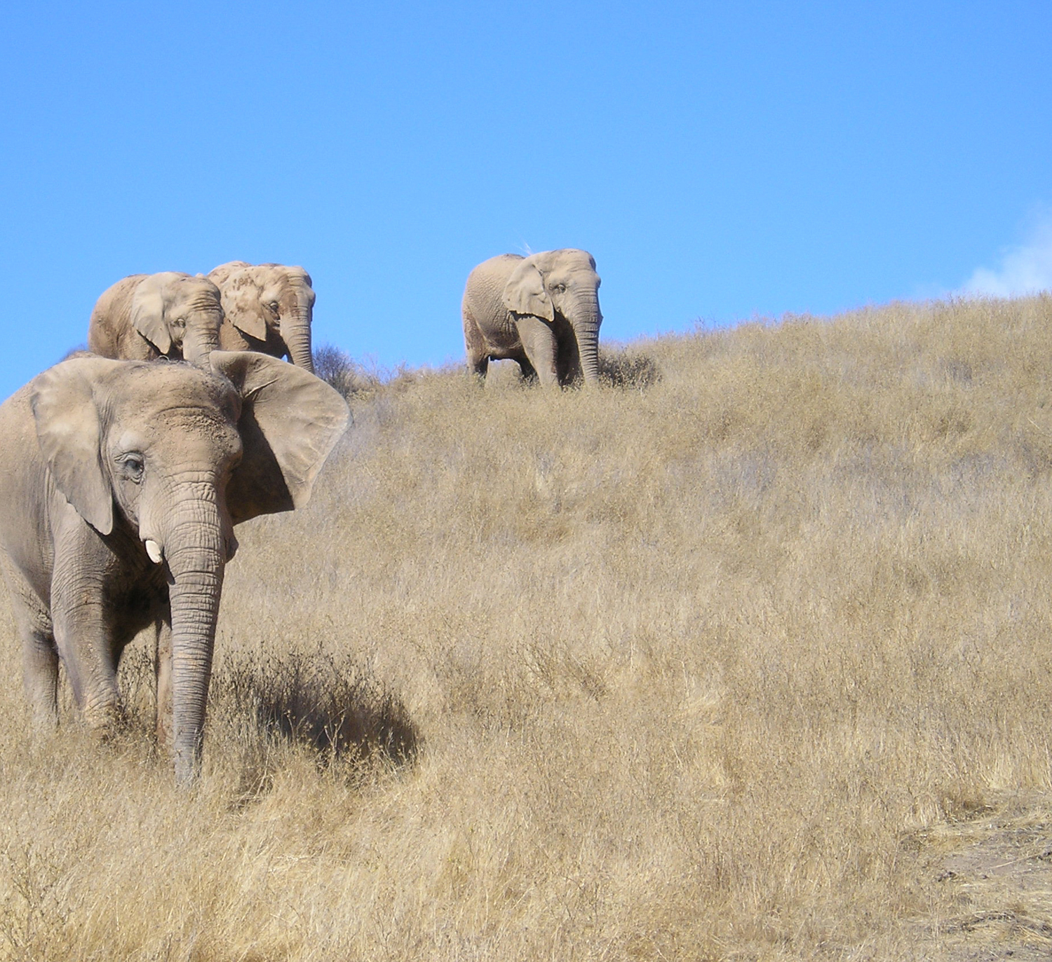
Animal Habitats
Animals need space to survive
If a habitat is too crowded, there won't be enough food, water, or air for them to live

Slide 9
Animal Habitats
What animal habitats can you think of?

