Slide 1
YEAR 1 WORD OBJECTIVE
How the prefix un– changes the meaning of verbs and adjectives

Slide 2
Word Meanings
Think about what these words mean. Discuss the meanings of these words with a partner.
kind afraid
helpful friendly lucky
able

Slide 3
Changing Word Meanings
Think about what these words mean. Discuss the meanings of these words with a partner.
Which letters do each of these word begin with?
unkind unafraid
unhelpful unfriendly unlucky
unable

Slide 4
Adding ‘un’
When ‘un’ is placed in front of a word, it changes the meaning of the word to its opposite. ‘Un’ means not. For example: unhappy means not happy.
Discuss the meanings of the words in this table.
clean | unclean
hurt | unhurt
funny | unfunny
tie | untie
safe | unsafe

Slide 5
Practice 1
Place un in front of these words to make new words.
tidy fair well pick
zip lock

Slide 6
Practice 2
Think of a sentence which uses each of these words.
untied unhappy unkind
unhelpful unzipped

Slide 7
Practice 3
Choose words from the box to fit the sentences below:
Ali was _________________ because he had lost his toy car.
Emma fell over but luckily she was ____________.
The bathroom was dirty and ___________.
My shoelace has come ________________.
unhappy
unclean
unhurt
undone

Slide 8
How did you do?
Ali was unhappy because he had lost his toy car.
Emma fell over but luckily she was unhurt.
The bathroom was dirty and unclean.
My shoelace has come undone.

Slide 9
Practice 4 Can you match each word with its meaning? The first one is done for you.
unkind
unhappy
unclean
unafraid
unwell
ill
not scared
dirty
sad
mean

Slide 10
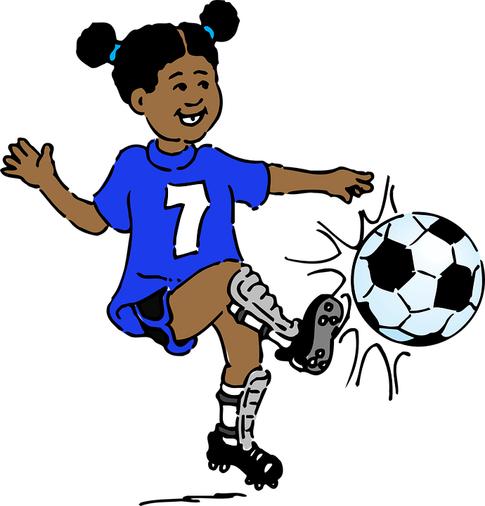
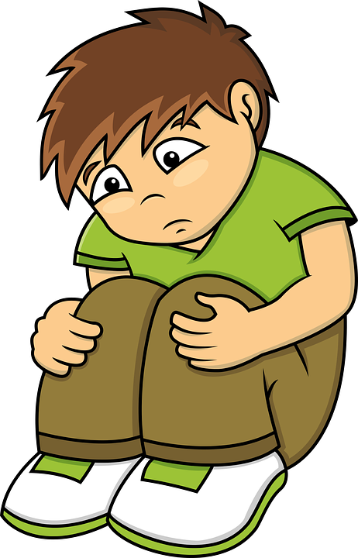
Challenge Read this text. See if you can spot the ‘un’ words.
Kendra and Max were playing football in the park. Max tripped over because his laces had come undone.
‘Unlucky!’ shouted Kendra.
She carried on playing and scored a goal.
‘I win!’ shouted Kendra.
Max was unhurt, but he still felt unhappy. He was upset because Kendra had been unhelpful. She had not come over to check to see if he was okay.
‘Kendra – that was unkind!’ he shouted. ‘It is unfair of you to carry on playing when I have fallen over.’
Kendra felt unhappy that she had upset Max.
‘I’m so sorry Max,’ she said. ‘Are you okay?’

Slide 11
Did you spot all of the ‘un’ words?
Kendra and Max were playing football in the park. Max tripped over because his laces had come undone.
‘Unlucky!’ shouted Kendra.
She carried on playing and scored a goal.
‘I win!’ shouted Kendra.
Max was unhurt, but he still felt unhappy. He was upset because Kendra had been unhelpful. She had not come over to check to see if he was okay.
‘Kendra – that was unkind!’ he shouted. ‘It was unfair of you to carry on playing after I fell over.’
Kendra felt unhappy that she had upset Max.
‘I’m so sorry Max,’ she said. ‘Are you okay?’

Slide 12
Reflect and Discuss
How does a word change when un is placed in front of it?
Describe the difference in meaning between the following words:
-afraid/unafraid
-fair/unfair
-lock/unlock

