Slide 2
to be able to form plurals using ‘s’ and ‘es’
I understand that ‘singular’ means ‘one’.
I understand that ‘plural’ means more than one.
I can change nouns from singular to plural by adding ‘s’ or ‘es’.

Slide 3
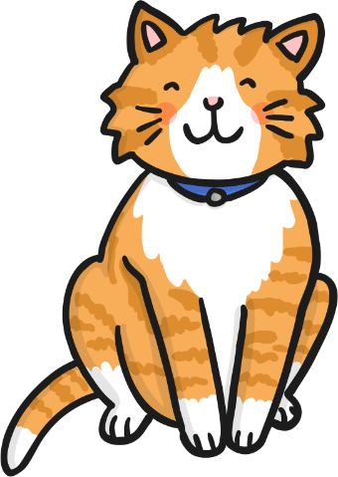
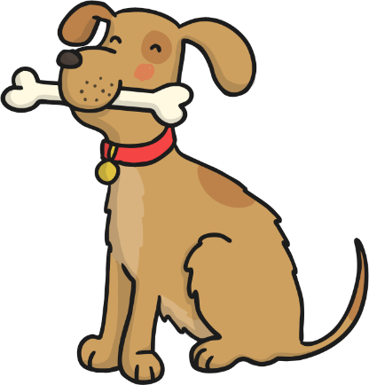
What is a noun?
A noun is a naming word.
dog
pencil
cat

Slide 4
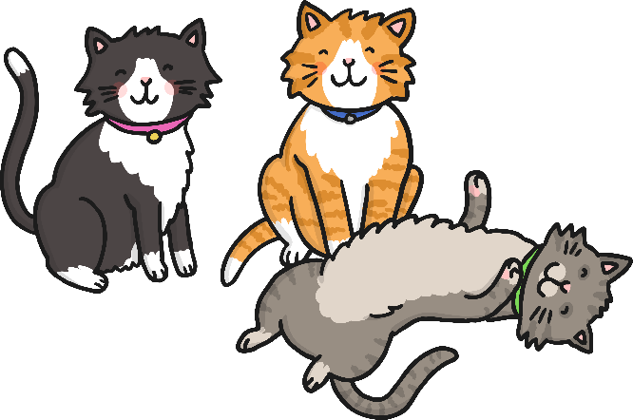
What is a plural?
Plural means ‘more than one’.
one cat
three cats

Slide 5
Singular = 1
Plural = more than 1
One dog
Lots of dogs
One door
Lots of doors
One pencil
Lots of pencils
One lamp
Lots of lamps

Slide 6
There are lots of rules when changing words from singular to plural.
BE CAREFUL!
We are going to look at just two of the rules.

Slide 7
For most words we just add ‘s’ to the end of it to change it into a plural.
one pear
three pears
desk
desks
month
months
book
books
train
trains
pen
pens
dog
dogs

Slide 8
If the word ends with one of these sounds…
sh
ch
ss
s
x
z
…then add ‘es’

Slide 9
To change these words in to plurals, add ‘es’.
one brush
two brushes
box
boxes
dish
dishes
glass
glasses
church
churches

