Slide 1
Lesson 10: Natural and Rational numbers

Slide 2
What’s In A Number?
The Mysterious World of
Number Identity…

Slide 3
Categories of Numbers in the REAL Number System
Natural Numbers
Whole Numbers
Integers
Rational Numbers
Irrational Numbers

Slide 4
Natural numbers
Are the counting numbers
N={1, 2, 3, 4, 5, 6, 7, 8, …}

Slide 5
Whole Numbers
All of the counting numbers and zero.
={0, 1, 2, 3, 4, 5, 6, 7, …}

Slide 6
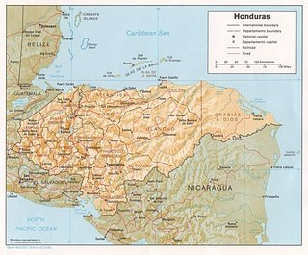
Integers
Are all of the natural numbers, their opposites and zero.
Z={…, -4, -3, -2, -1, 0, 1, 2, 3, 4, …}

Slide 7
Rational Numbers
Numbers that can be expressed as a fraction (a/b).
This set includes the integers, terminating decimals, and repeating decimals.
Some examples:
2 = ²/₁
3 ¼ = ¹³/₄
-0.25 = -²⁵/₁₀₀
1/3 = 0.33333333333333333333333

Slide 8
Irrational Numbers
Numbers that CANNOT be expressed as a fraction of integers.
In decimal form, they are the numbers that go on forever without a repeating pattern.
Some examples:
√2 = 1.4142…
π = 3.1415…
45.9492…

Slide 9
Venn Diagram of REAL Number System
Rational Numbers
Integers
Whole
Natural
Irrational Numbers

Slide 10
Real Number System Tree Diagram
Real Numbers
Rational Numbers
(Fractions & Perfect Squares/Cubes)
Irrational Numbers
Terminating
Decimals
Repeating
Decimals
Integers
Non-Terminating
And
Non-Repeating
Decimals
Whole
Numbers
Negative #’s
Natural #’s
Zero

