Slide 1
Activity Time.

Slide 2
Noun, Verb and Adjective Individual Work
Students are to make up a sentence which consists of :
1. Noun
2. Verb
3. Adjective
Verb
Example: The big, hungry, fat cat ran up the tree.
Adjective Noun

Slide 3
Different types of adjectives sort:
Cut papers and write the following adjective titles:

Slide 4
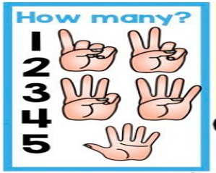

Slide 6
Have students match the following words to the correct titles:
Fast, slow, swift, zoom
One, two, three, four, five, six, seven, eight, nine, ten
Round, square, triangle, rectangle, oval, circle, diamond, heart, star
Short, tall, huge, tiny
Red, yellow, pink, green, purple, orange, blue, white, black, grey
Stinky, fishy, smelly, fresh

Slide 7
loud, soft, quiet, low, high
wet, sticky, sharp, muddy, furry,
soft, rough, smooth
Sad, happy, scared, angry, excited, surpised, tierd
Sweet, sour, bitter, salty,

Slide 8
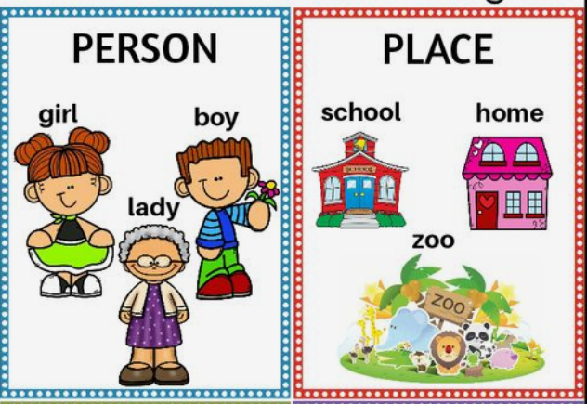

Slide 10
Verbs
A verb is an action word.
Verbs describe what some one or something is doing.

Slide 11
Verbs
A verb is an action word.
Verbs describe what some one or something is doing.

Slide 12
Verbs
A verb is an action word.
Verbs describe what some one or something is doing.

Slide 13
Adjectives
Adjectives are words that describe a noun.
Noun: Suri
Adjectives: Colour (red)
Size (small)
feeling (sad)
age (young)

Slide 18
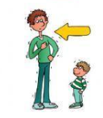
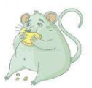
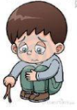
Ben has a red hat.
My dad is tall.
A fat rat is on the rug.
The candy is sweet.
The boy is sad.

