Slide 1
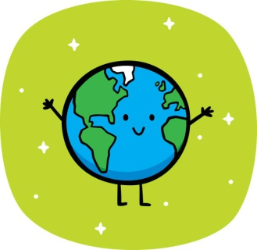
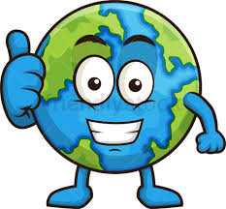

Slide 2
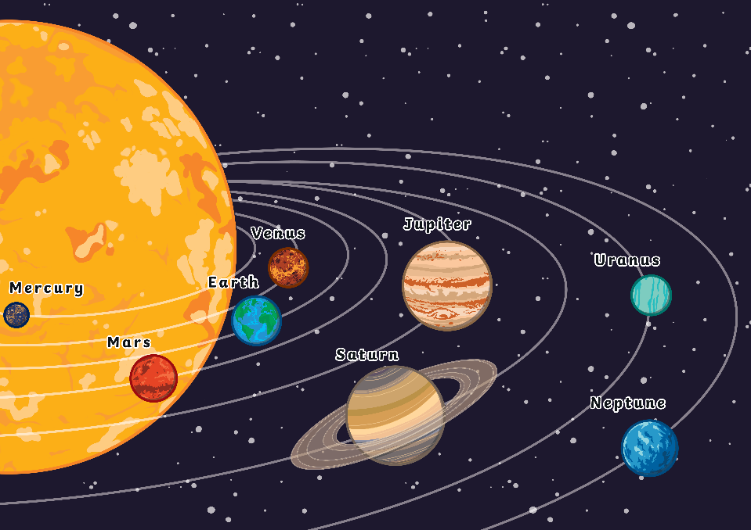
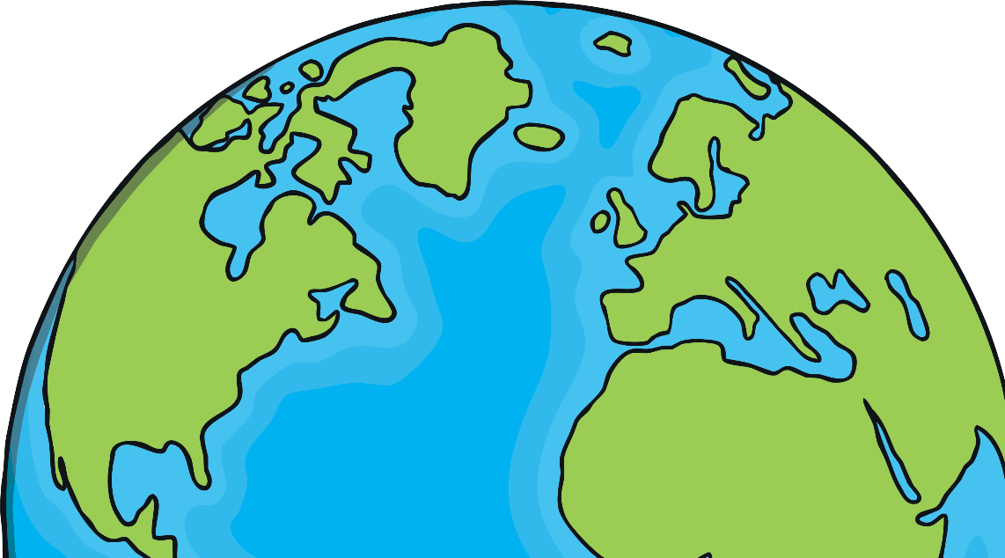
The Solar System
In our Solar System there are 8 planets.
The planet we live on is called Earth. It is the third planet from the Sun.
?
Each planet orbits the Sun.
X
An orbit is the path that one object travels on to move around another object.
Did You Know…?
Scientists believe that the Earth is around 4.6 billion years old!

Slide 3
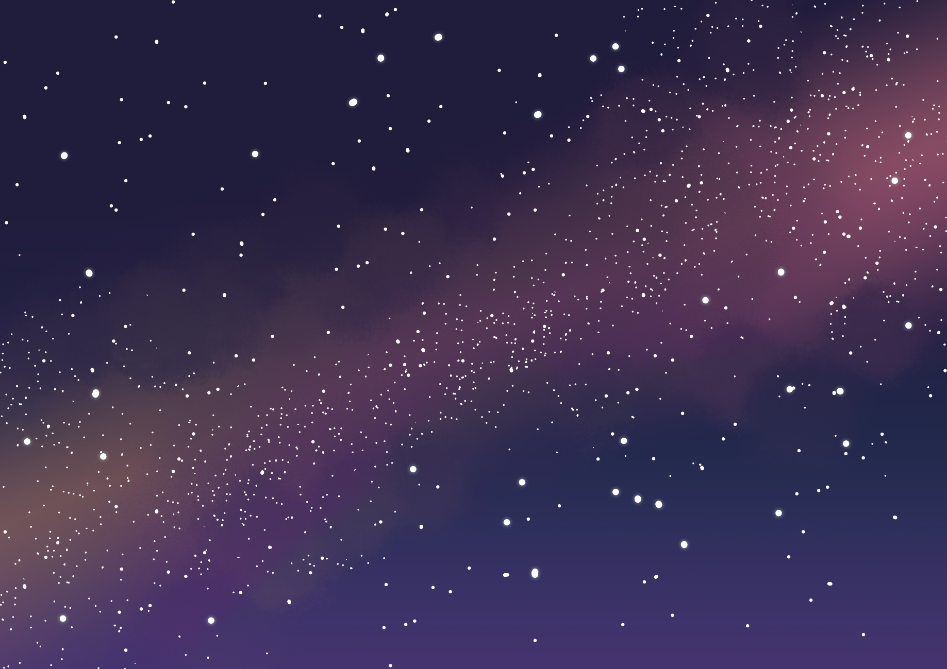
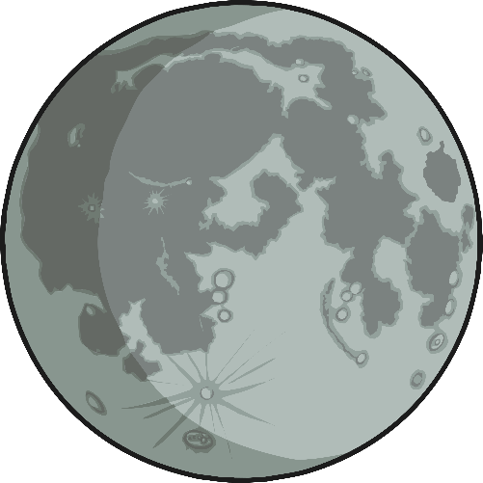
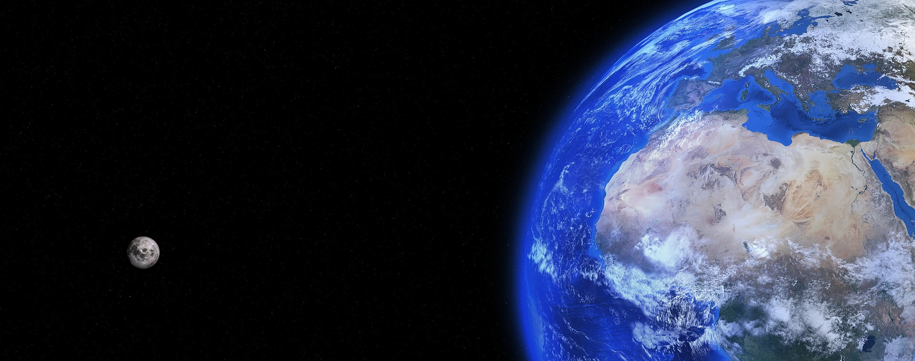
The Moon
Planet Earth has one moon.
Did You Know…?
The Moon and Earth are the only two places in space that humans have stepped foot on.

Slide 4
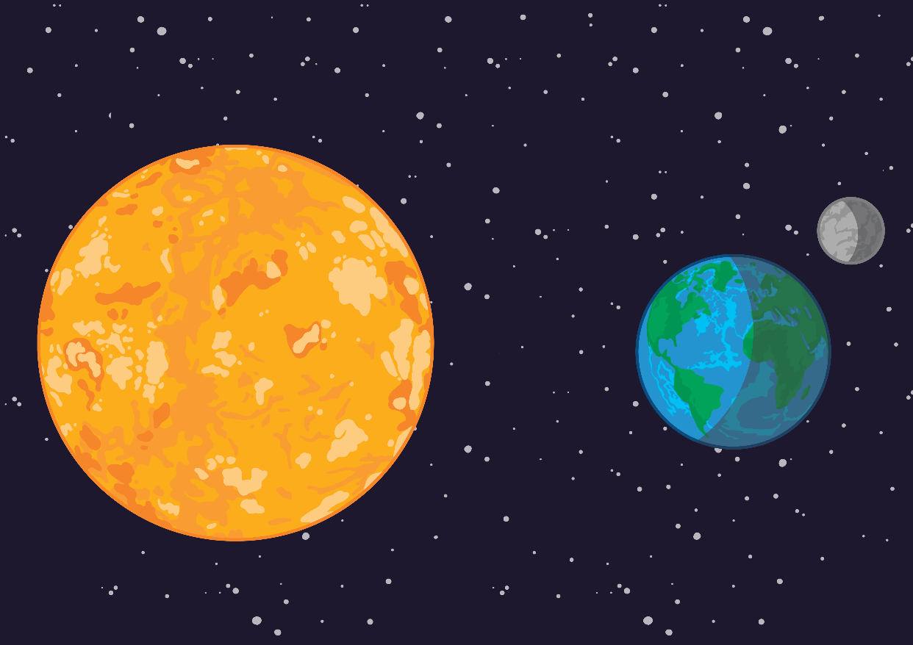
Night and Day
?
Planet Earth rotates. This is why we have night and day.
X
Rotate means to spin or turn. Earth takes about 24 hours to do one full turn. This is why there are 24 hours in one day.
When the side of the Earth you are on is facing the Sun, it will be daytime. On the other side of the Earth, it will be night time.

Slide 5
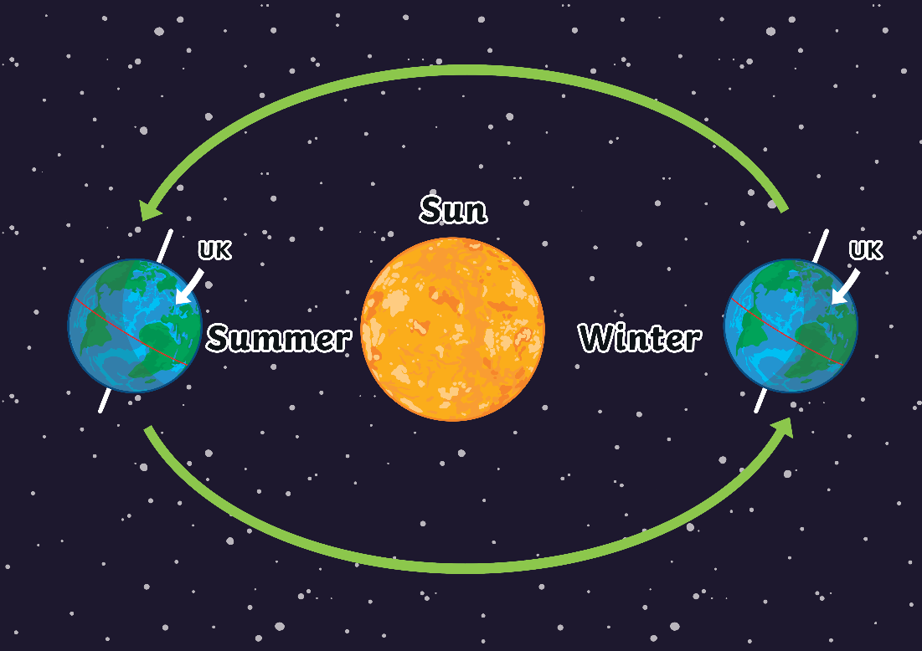
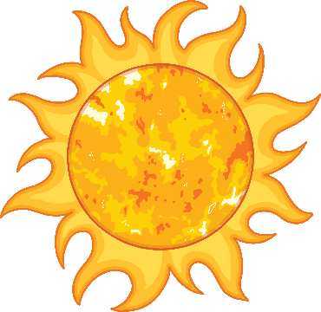
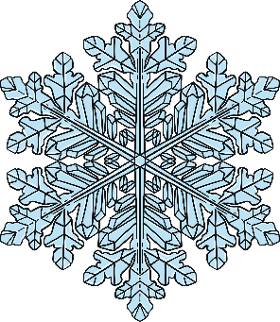
Seasons
Like all planets in our Solar System, Earth travels around the Sun. It takes 365 days for Earth to travel all the way around. This is the length of a year.
Earth tilts to one side. This causes seasons.
When our part of the Earth is tilted towards the Sun, it is summer.
When our part of the Earth is tilted away from the Sun, it is winter.

Slide 6
The Earth’s Surface
What can you see when you look at this photo of Earth?
Earth is covered mostly by water. Huge oceans and seas cover much of the planet, as well as rivers and lakes on land.
Earth tilts to one side. This causes seasons.
The surface of Earth has changed a lot over time.

Slide 7
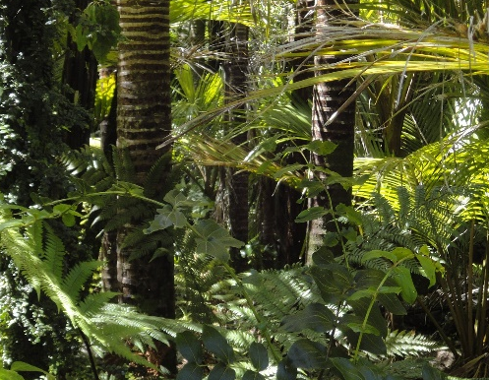
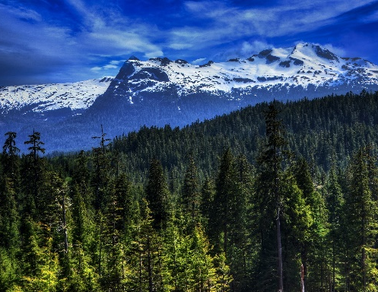
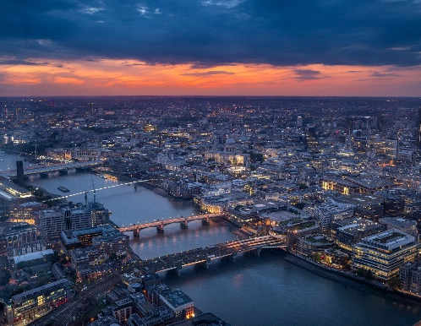
The Earth’s Surface
Land on the Earth varies from sandy, hot, dry deserts to lush, green rainforests to freezing lands of snow and ice.
As the human population grows, towns and cities that have been constructed by humans are also covering more of the planet.
The Earth is home to towering mountains.
What else can you think of that you can find on Earth?

Slide 8
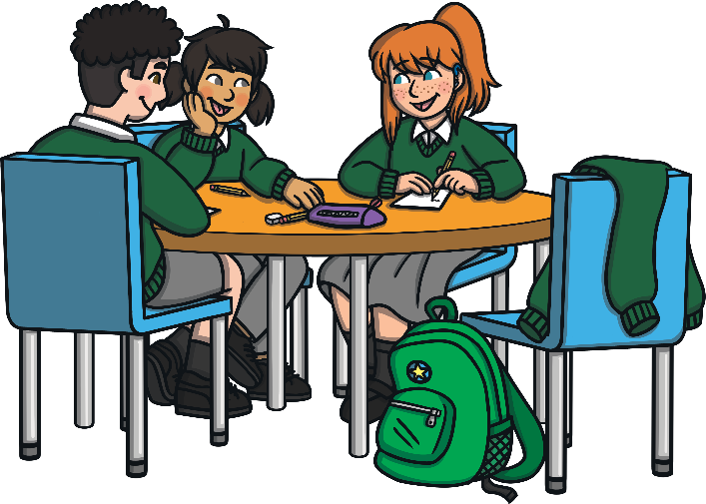
Living Things on Earth
Earth is the only planet in our Solar System that is known to have life on it.
Many living things can survive on our planet if:
it is the correct temperature;
it has the right air that living things need to breathe;
there are water and food sources.
Did You Know…?
Planet Earth is the only planet in the Solar System known to have water in liquid form on its surface.

Slide 9
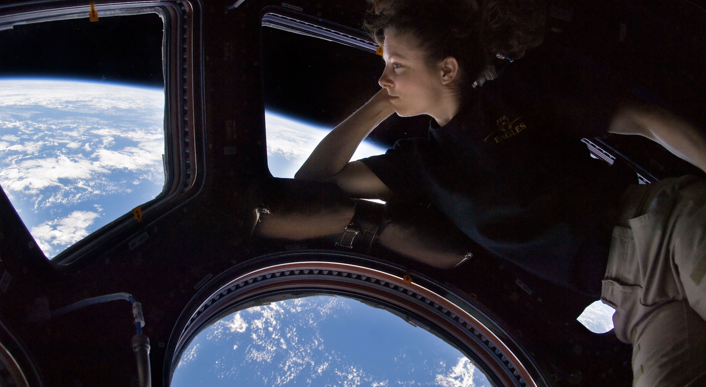
International Space Station
This is the amazing view of Earth from the ISS.
Photos of Earth are taken from the ISS, including photos of city growth and volcanoes. We use them to learn more about Earth.
This is an astronaut called Tracy Caldwell Dyson admiring the view of the Earth.

Slide 10
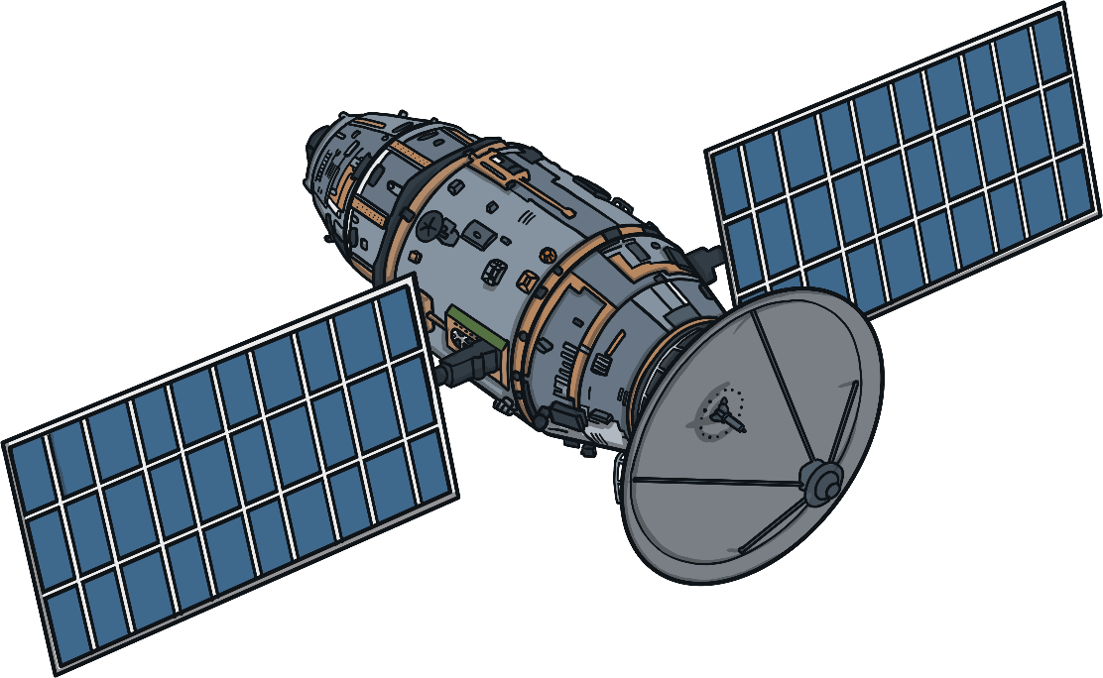
Our Planet
Which 3 words would you use to describe our planet Earth?
What else would you like to find out about Earth?
How do you think it would feel to be an astronaut looking at Earth from space?

Slide 11
