Slide 1
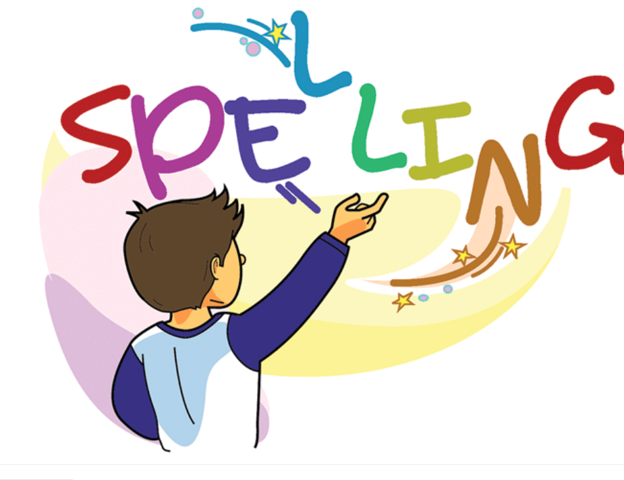

Slide 2
Words with the /ou/ sound
Spelling Group Work:
Activity Groups 1, 2 Prepare word cards with spelling sounds /ou/ and /ow/ Have students read the words and sort them under the correct sound /ou/ and /ow/
ou | ow

Slide 3
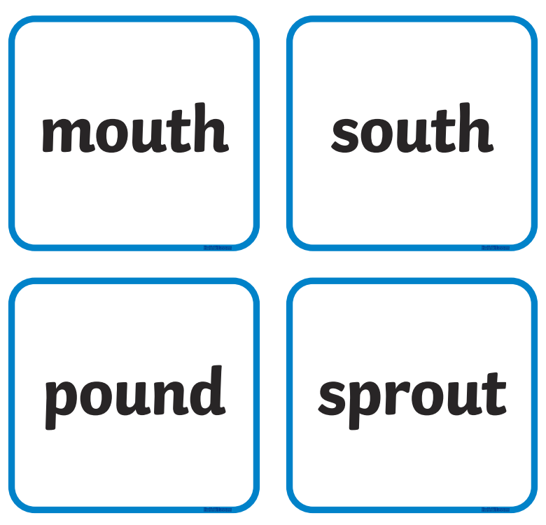
Read the words and sort them into /ow/ and /ou/ sounds.

Slide 4
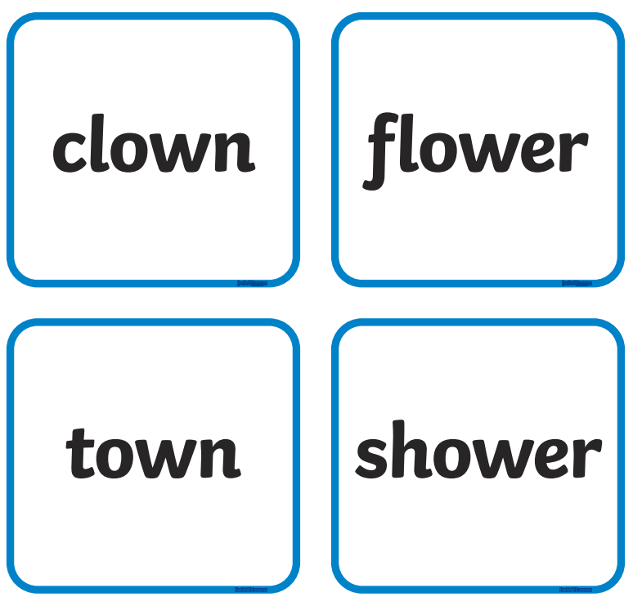

Slide 5
Activity Groups 2 and 4
Write words related to the /ow/ sound on white boards
On the board put a 1-minute timer or transition song so student's transition
Activity Groups 1, 3, and 5
Write words related to the /ow/ sound on white boards.

Slide 6
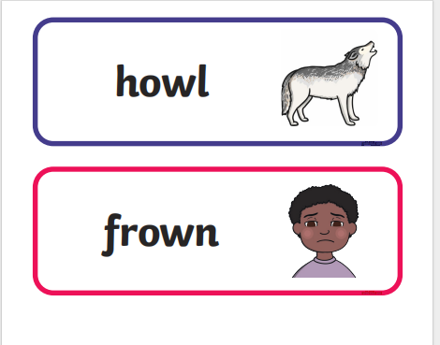

Slide 7
Groups 2 , 4 Match the picture t
Have students look at the words read them and match them to
the correct pictures.

Slide 8
cl

Slide 9
Groups 1, 3, 5
Dominoes Game with Spelling Words
Make 3 copies of the dominoes game.
Give each student domino cards.
Toss a coin to see who would be the first to put their card on the table.
Heads puts the first card.
Give turns by going clock wise

Slide 10
cl

Slide 11
Spelling Words Words with /ow/ sound
owl
An owl is a bird with a flat face, large eyes, and a small sharp beak. Most owls obtain their food by hunting small animals at night..
The owl is one of the smartest birds.

Slide 12
cow
A cow is a large female animal that is kept on farms for its milk. People sometimes refer to male and female animals of this species as cows.
Dad went out to milk the cow.

Slide 13
crown
A crown is a circular ornament, usually made of gold and jewels, which a king or queen wears on their head at official ceremonies
The queen wears a gold crown on her head.

Slide 14
brown
Something that is brown is the colour of earth or of wood.
Brown is my favorite colour.

Slide 15
town
A town is a place with many streets and buildings, where people live and work. Towns are larger than villages and smaller than cities
I walked around town.

Slide 16
clown
A clown is a performer in a circus who wears funny clothes and bright make-up, and does silly things in order to make people laugh.
I saw a clown at the circus.

Slide 17
towel
A towel is a piece of thick soft cloth that you use to dry yourself.
My beach towel is soft and fluffy

Slide 18
gown
A gown is a dress, usually a long dress, which women wear on formal occasions.
She wore a red gown for her birthday party.

Slide 19
frown
When someone frowns, their eyebrows become drawn together, because they are annoyed, worried, or puzzled, or because they are concentrating
Adam frowned at his silly dog.

Slide 20
bow
When you bow to someone, you briefly bend your body towards them as a formal way of greeting them or showing respect.
He bowed slightly to greet the queen.

Slide 21
Thank You

