Slide 1
English

Slide 2
Lessons Objectives
By the end of the lesson, learners will be able to :
read the new words.
read the new words.
read the new words.
understand what conjunctions mean
01
identify the meaning for the new words.
identify the meaning for the new words.
identify the meaning for the new words.
02
use the new vocabulary in their writing.
03
use the new vocabulary in their writing.
04

Slide 3
Describing Animals

Slide 4
grassland
A large area of flat land covered with grass.
.

Slide 5
savvanah
A large, flat area of land covered with grass, usually with few trees

Slide 6
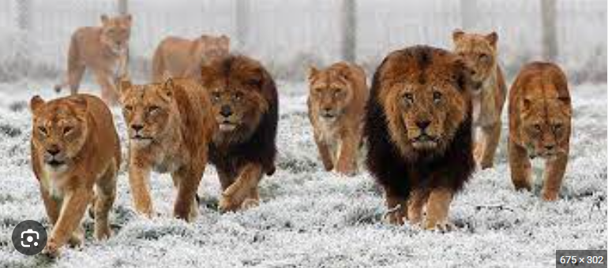
pride
A pride is a group of lions that live together

Slide 7
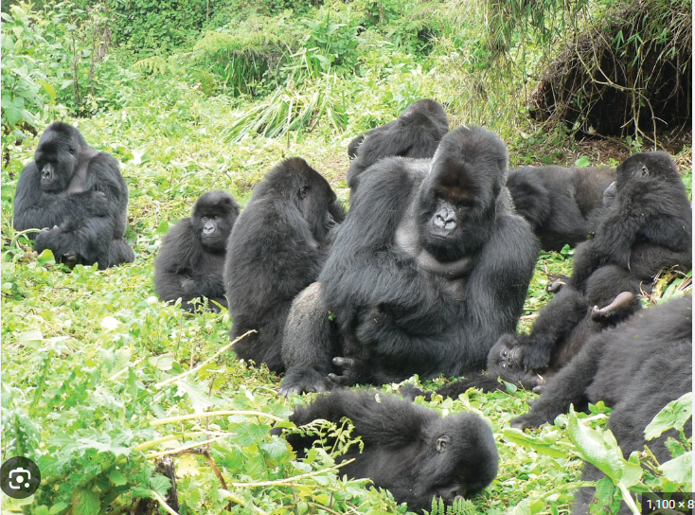
troops
A group of gorillas living together is called a “troop.” There can be 5 to 30 gorillas in a troop.
.

Slide 8
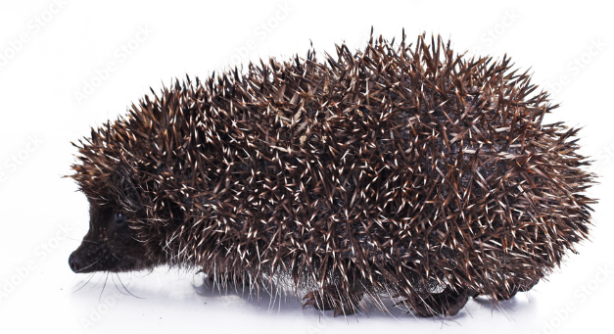
spiky
Sharp

Slide 9
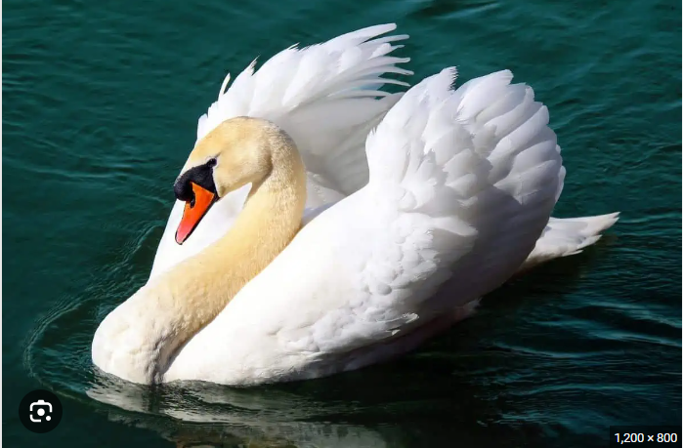
elegant
Beautiful

Slide 10
powerful
Strong

Slide 11
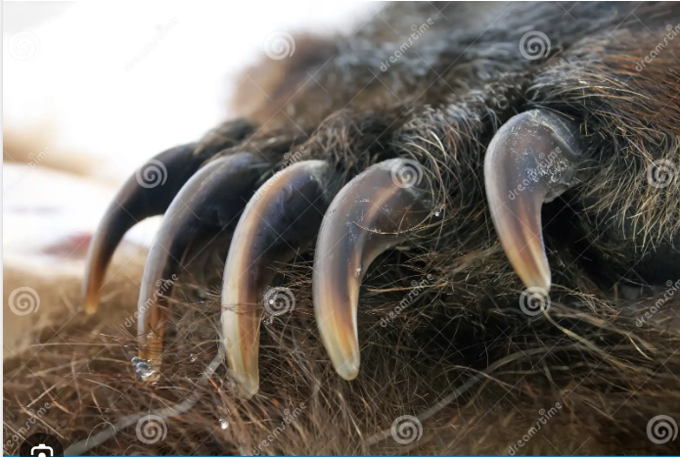
claws
The sharp curved nails at the end of each of the toes of some animals and birds

Slide 12
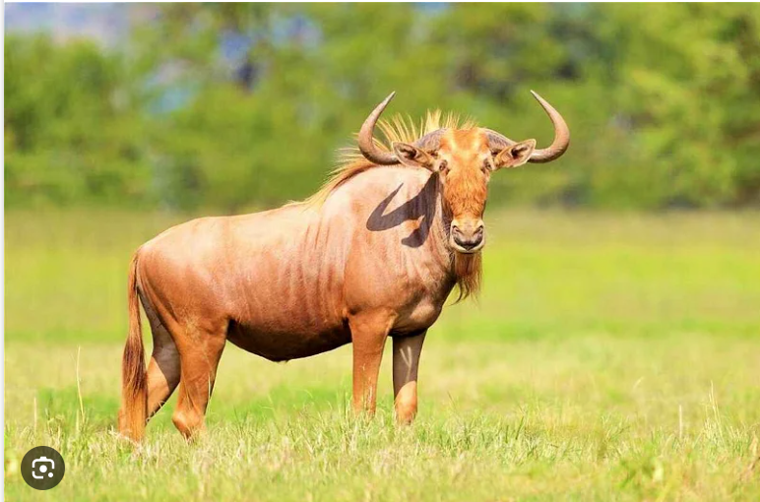
wildebeest
A large African animal with a long
tail and horns that curve to the
sides that lives in areas covered
in grass

Slide 13
hibernate
Some animals spend the winter sleeping:

Slide 14
nests
A structure built by birds or insects to leave their eggs in to develop, and by some other animals to give birth or live in

Slide 15
Write the words and meanings in your copybooks.

Slide 16
Lessons Objectives
Objectives check:
read the new words.
.
01
identify the meaning of the new words.
02
03
use the new vocabulary in their writing.
04

