Slide 4
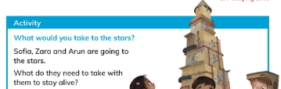
Activity
Students to be in groups and create a poster of what they would need to stay alive if they travel to the stars and present it to the class. .

Slide 5
Students to solve workbook page 61 and 62.

Slide 6
Wednesday

Slide 8
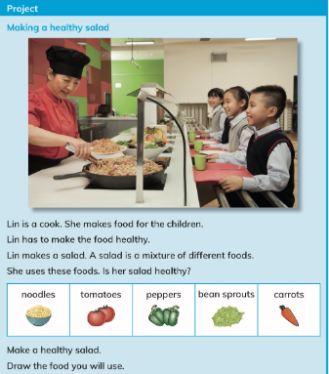
Activity
Students to be in groups and sort out the foods that are healthy and unhealthy.

Slide 9
Homework workbook page 63.

Slide 10
Thursday

Slide 11
Revision

