Slide 1
Flipbook maker

Slide 3
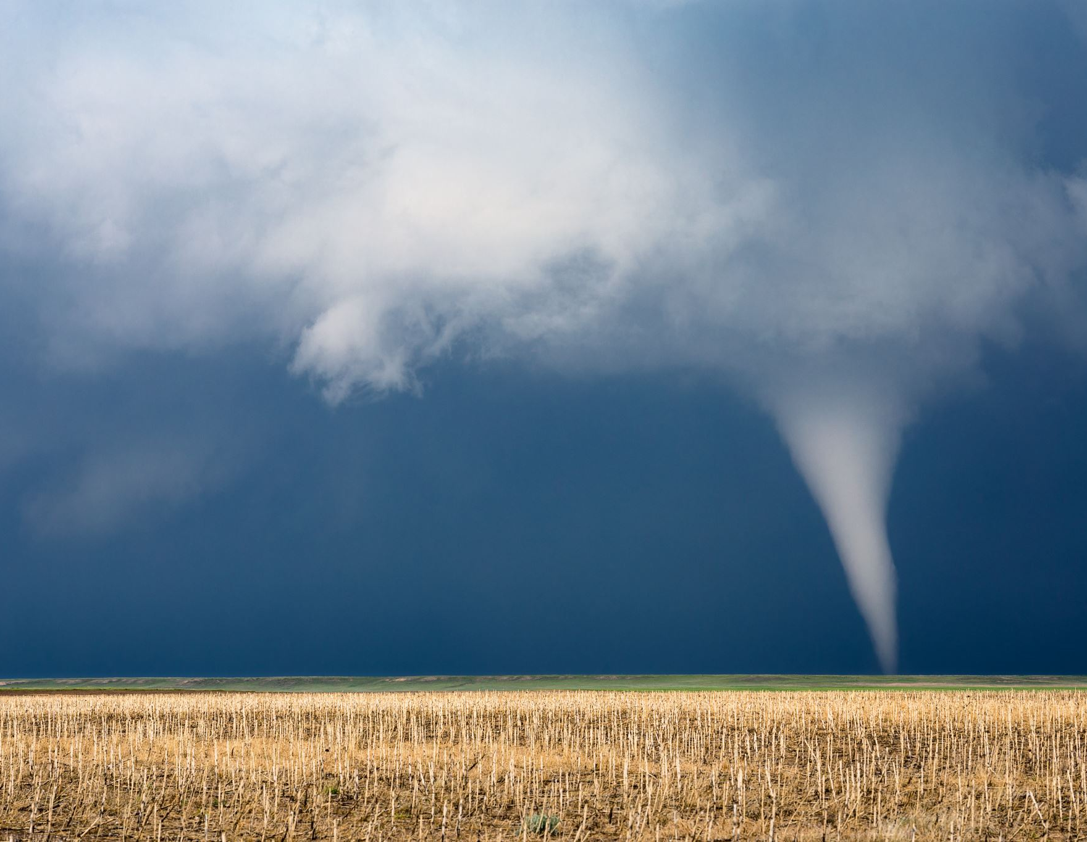
Climate change

Slide 4
Temperature
Temperature is a physical quantity that expresses quantitatively the attribute of hotness or coldness. Temperature is measured with a thermometer.
This Photo by Unknown author is licensed under CC BY.

Slide 5
Rain
Rain is a licensed and trusted crypto exchange in the Middle East with customers worldwide. Buy Bitcoin, Ethereum, and other cryptocurrencies on Rain.

