Slide 1
Putting things in order

Slide 2
Above

Slide 3
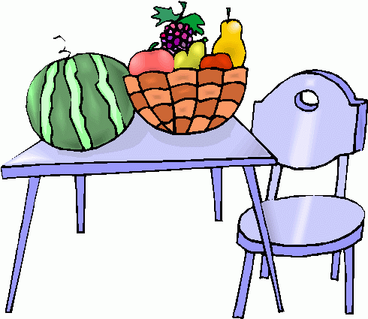
On

Slide 4
Below

Slide 5
Behind

Slide 6
In front of

Slide 7
Next to

Slide 8
Number Words

Slide 9
First

Slide 10
Second

Slide 11
Third

Slide 12
Fourth

Slide 13
Fifth

Slide 14
Let’s practice!

Slide 18
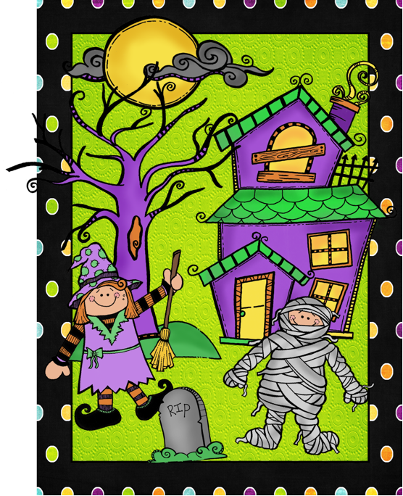

Slide 19
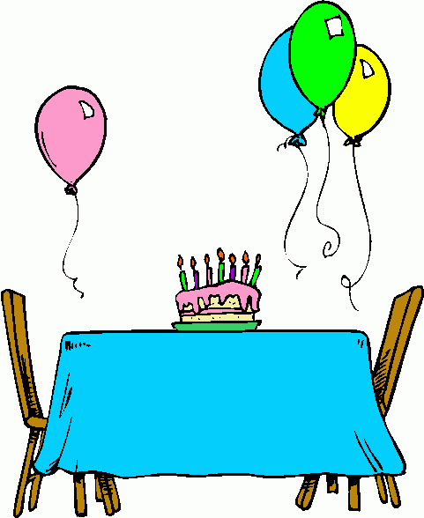

Slide 20
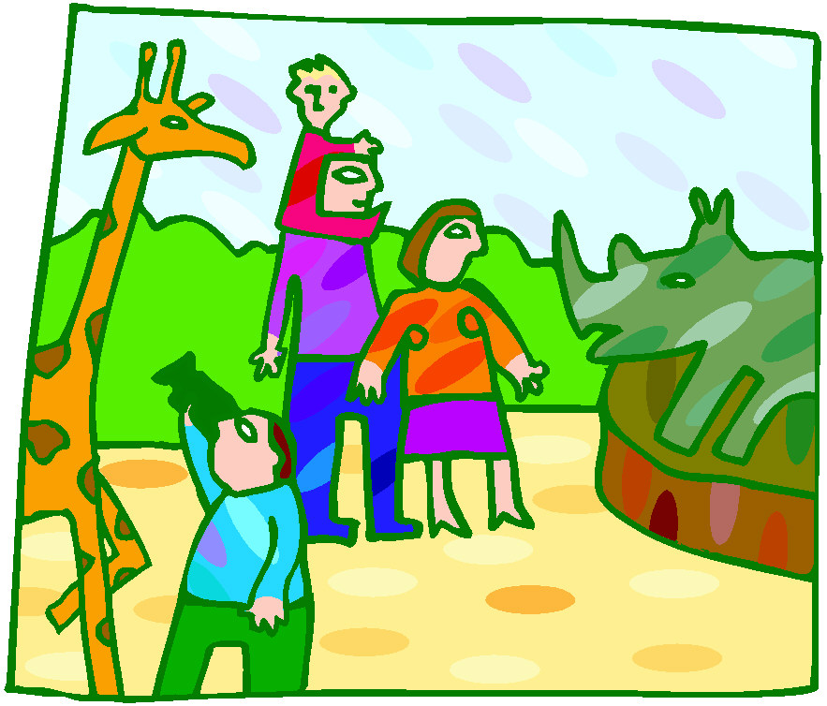

Slide 24
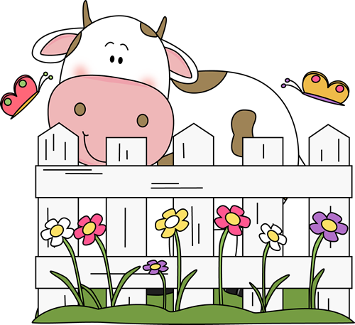

Slide 28
