Slide 11
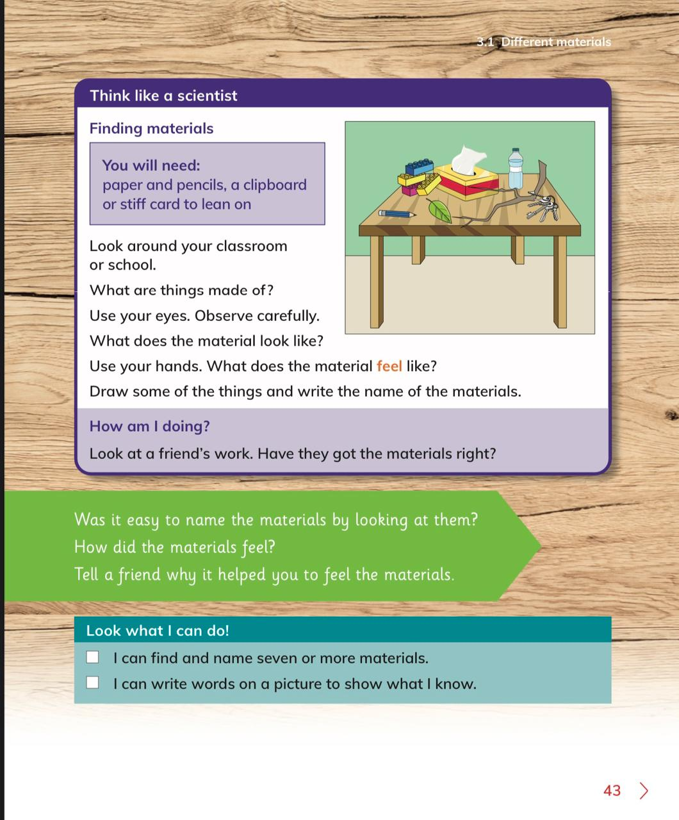

Slide 12
Question 1
What does material mean?

Slide 13
Answer
Everything around us is made from a material.

Slide 14
Question 2
Can you name some different materials?

Slide 15
Answer
Rock, water, metal, glass, plastic, wood

Slide 16
Solve student workbook page in class:
23, 24 and 25

Slide 17
Lesson 2

Slide 20
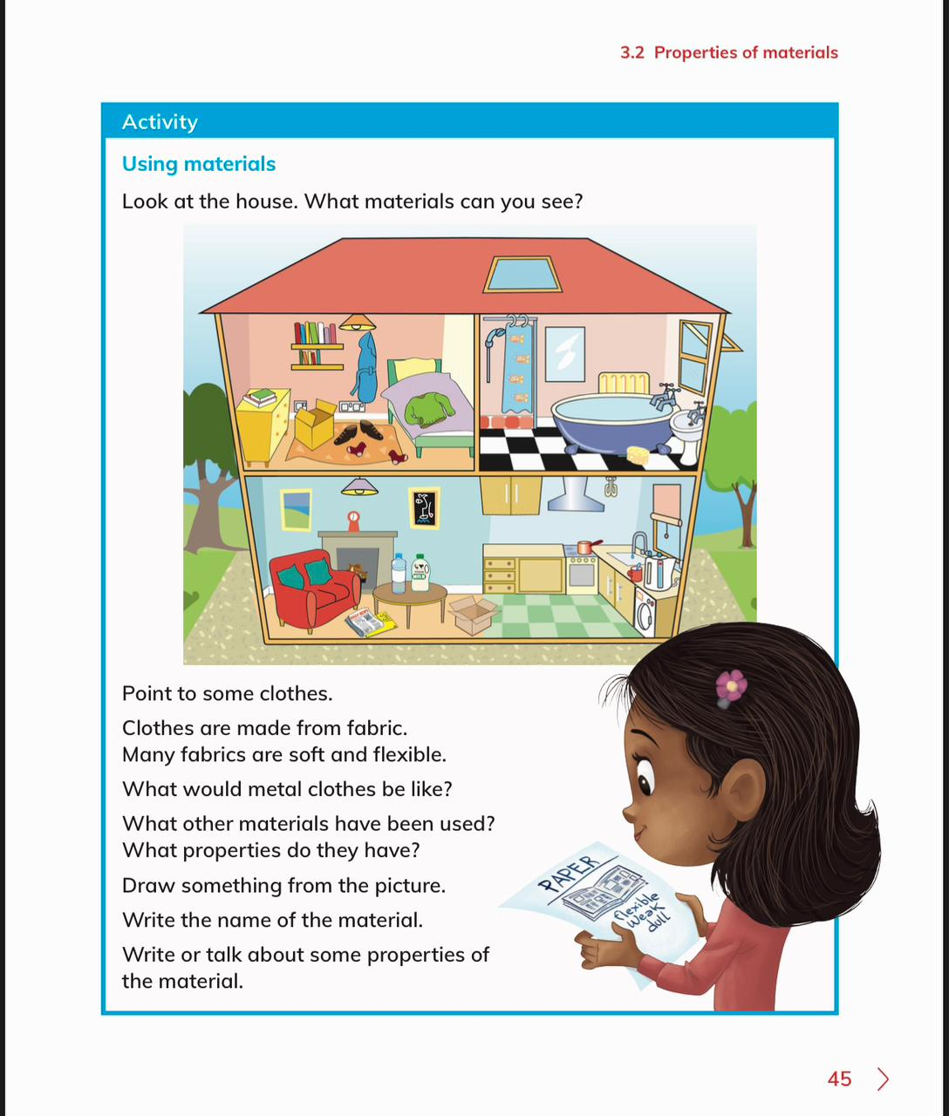

Slide 21
Guess the property of the materials

Slide 29
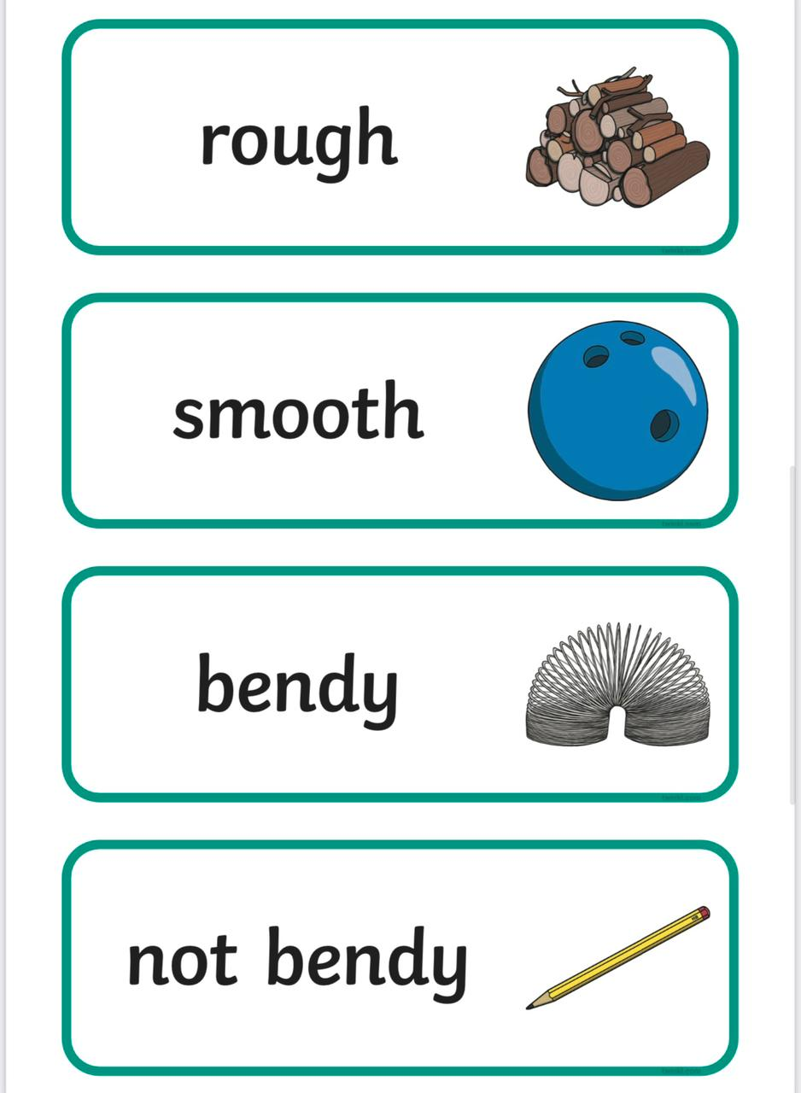

Slide 30
Video

Slide 37
Activity

Slide 38
-Students to solve questions on students workbook in class:
Pages: 26, 27 and 28

Slide 39
Lesson 3
Assessment

Slide 40
Lesson 4

Slide 41
Quiz time!

Slide 56
Homework student workbook pages: 29 and 30

Slide 57
Lesson 5
Interactive game

Slide 58
Interactive game
https://www.twinkl.com.eg/go/resource/materials-and-their-properties-sorting-game-au-sc-2947
https://www.twinkl.com.eg/go/resource/the-suitcase-of-belonging-material-sort-interactive-game-au-sc-1674444407

