Slide 1
Activity Time.

Slide 2
Noun, Verb and Adjective Individual Work
Students are to make up a sentence which consists of :
1. Noun
2. Verb
3. Adjective
Verb
Example: The big, hungry, fat cat ran up the tree.
Adjective Noun

Slide 3
Noun, Verb and Adjective Hats
Once students are done brainstorming sentences in their heads.
Give them a blank white paper and have them write their sentences.
Once they are done with their sentences check it grammatiaclly and spelling.

Slide 4
Noun, Verb and Adjective Words
Once teacher has marked the paper give each student a strip of paper that would fit the students’ head.
Once done have students rewrite their sentences on their hats.
They are to highlight the Adjectives, underline the noun, and circle the verb.

Slide 5
Noun, Verb and Adjective Hat
Once done rewriting their sentences asemble the hats on the studeents’ head and staple them.

Slide 6
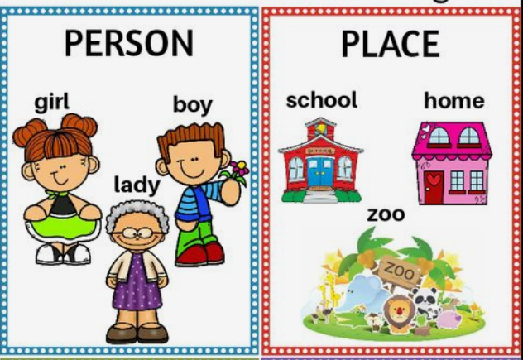

Slide 8
Verbs
A verb is an action word.
Verbs describe what some one or something is doing.

Slide 9
Verbs
A verb is an action word.
Verbs describe what some one or something is doing.

Slide 10
Verbs
A verb is an action word.
Verbs describe what some one or something is doing.

Slide 11
Adjectives
Adjectives are words that describe a noun.
Noun: Suri
Adjectives: Colour (red)
Size (small)
feeling (sad)
age (young)

Slide 15
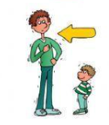
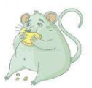
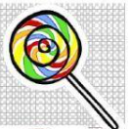
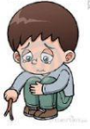
Ben has a red hat.
My dad is tall.
A fat rat is on the rug.
The candy is sweet.
The boy is sad.

