Slide 1
Let’s Count in Twos
Year 1- Number - number and place value
0
2
4
6
8

Slide 2
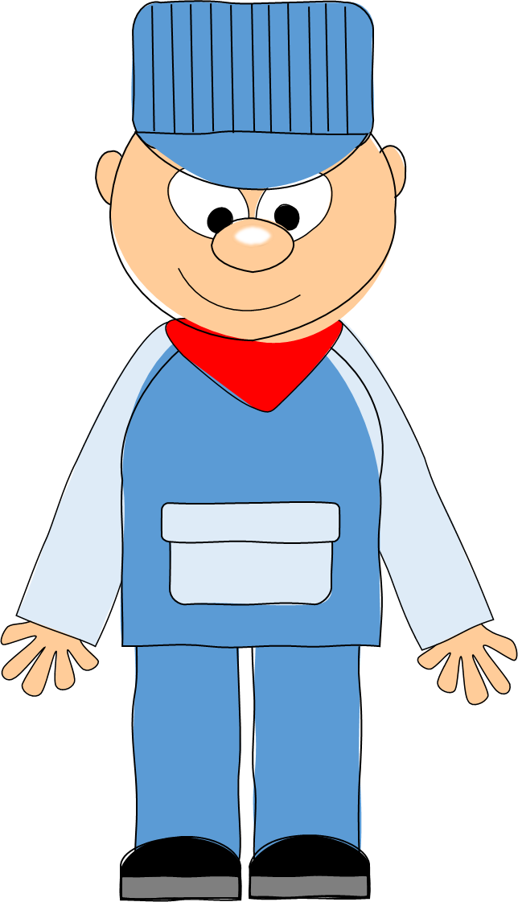
Click here to listen to a song about counting in multiples of two.

Slide 3
Let’s all count to 20 in multiples of two.

Slide 4
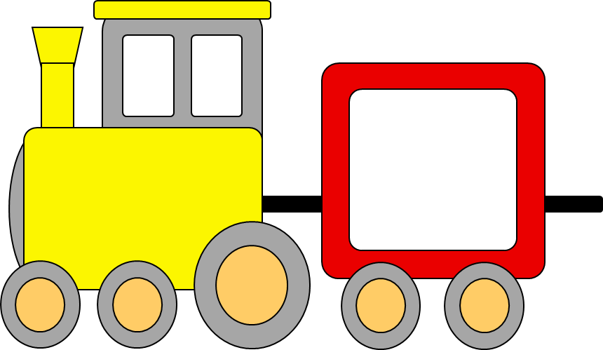
0

Slide 5
2

Slide 6
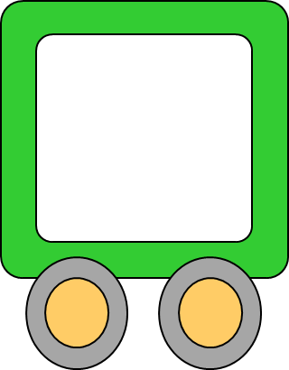
4

Slide 7
6

Slide 8
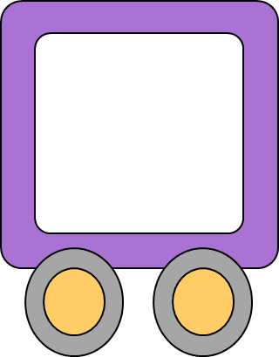
8

Slide 9
10

Slide 10
12

Slide 11
14

Slide 12
16

Slide 13
18

Slide 14
20

Slide 15
Counting in twos, what is the next number in the sequence?

Slide 16
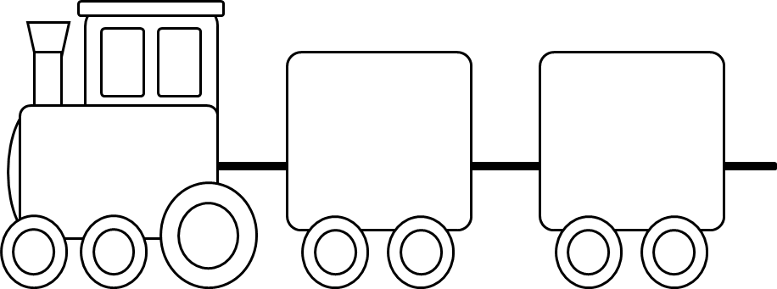
www.Teacher-of-Primary.co.uk
Counting in Multiples of Two Worksheet 1
Counting in twos, what is the next number in the sequence?
1. | 6.
2. | 7.
3. | 8.
4. | 9.
5. | 10.
4
0
8
6
12
18
2
10
16
14
Copyright 2023 Online Teaching Resources Ltd
Notes:
Worksheet.

Slide 17
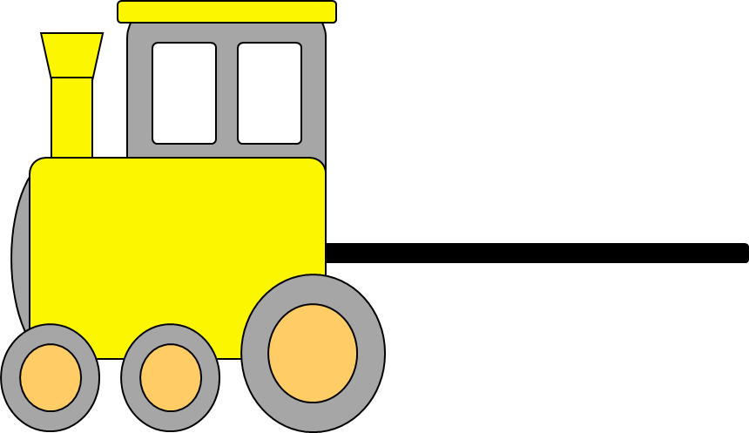
4
6

Slide 18
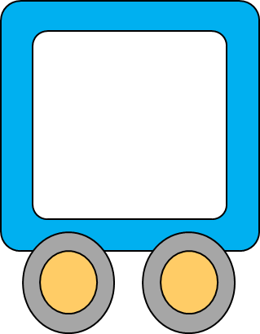
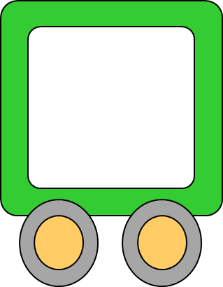
8
10

Slide 19
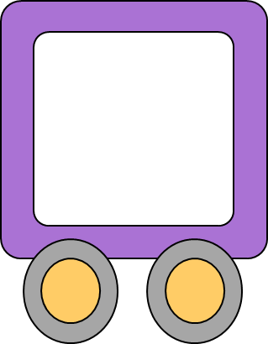
12
14

Slide 20
2
4

Slide 21
16
18

Slide 22
0
2

Slide 23
6
8

Slide 24
18
20

Slide 25
10
12

Slide 26
14
16

