Slide 2
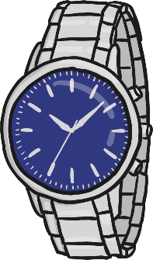
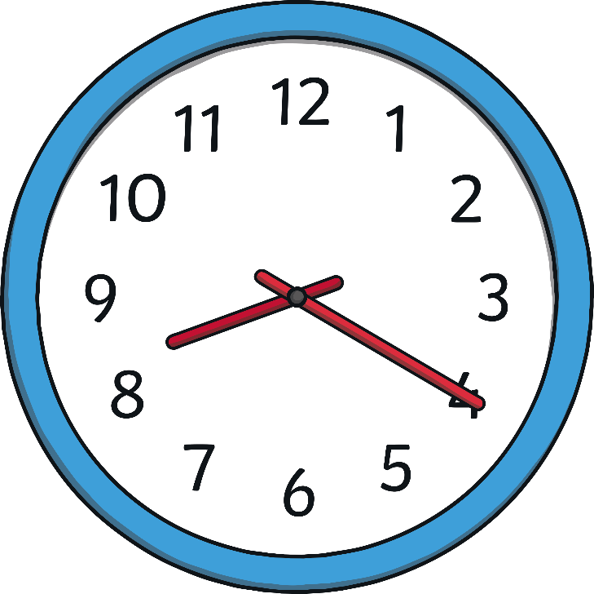
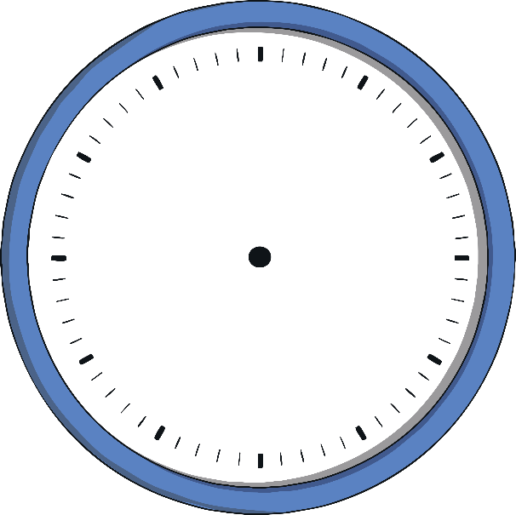
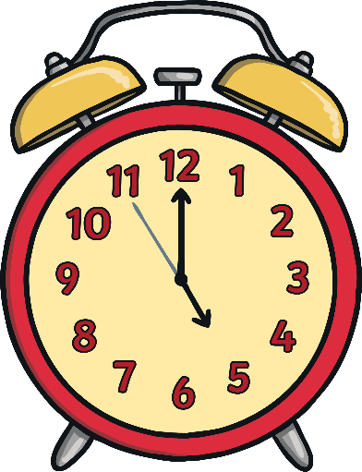
Analog Clocks
These are analog clocks.
You may have one at home or school.
They can be big or small enough to wear on your wrist.
Some have numbers, and some don’t.
No matter the size or shape, all analog clocks help us tell time the same way.

Slide 3
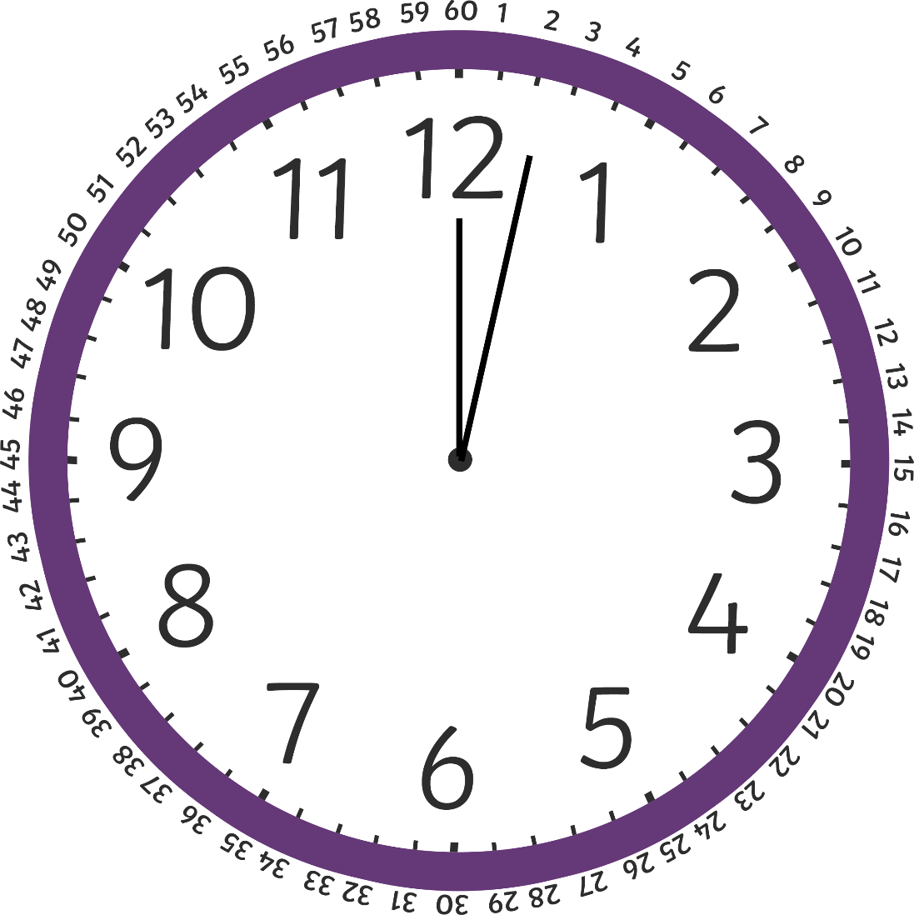
Telling Time on the Hour
A clock face is a full circle.
The full circle has 60 minutes.
There are 60 minutes in an hour.

Slide 4
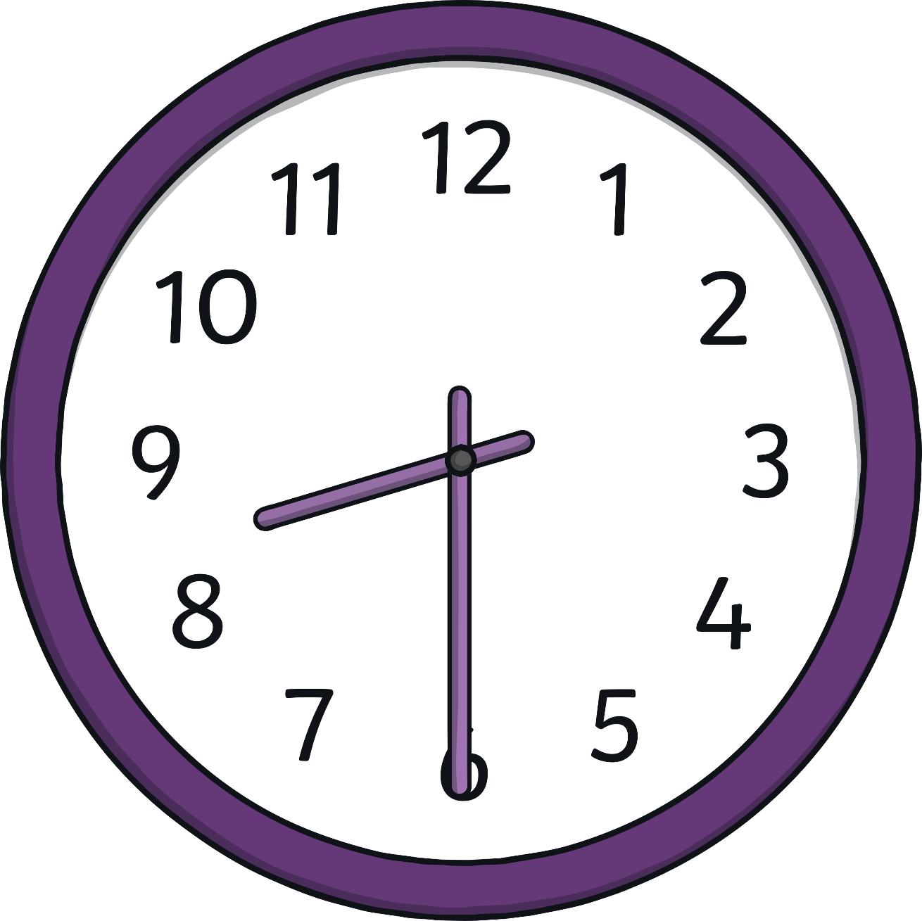
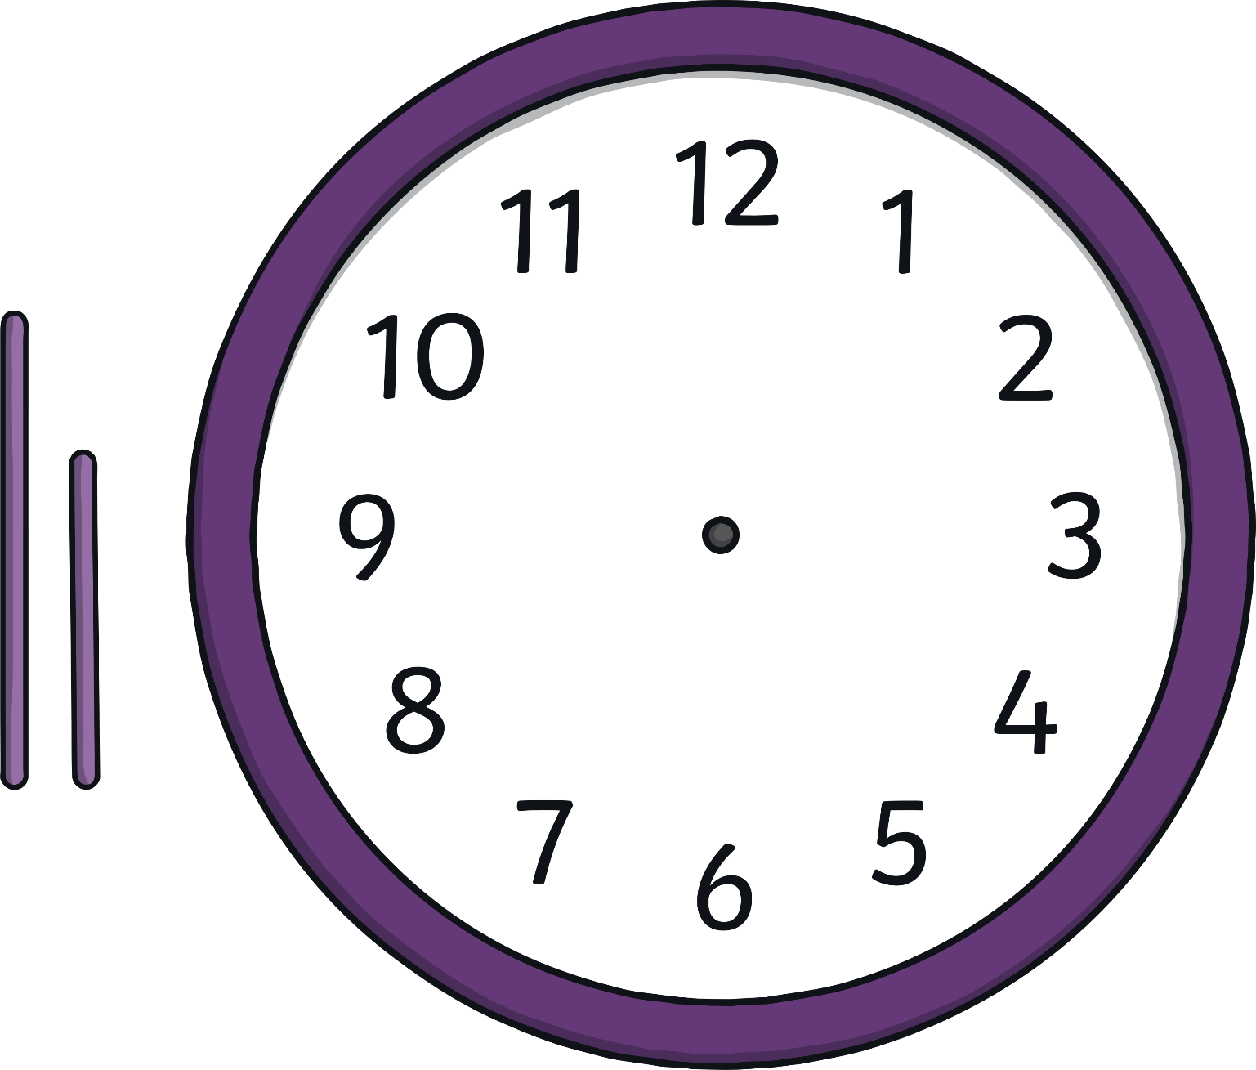
Telling Time on the Hour
This is the hour hand.
This is the minute hand.

Slide 5
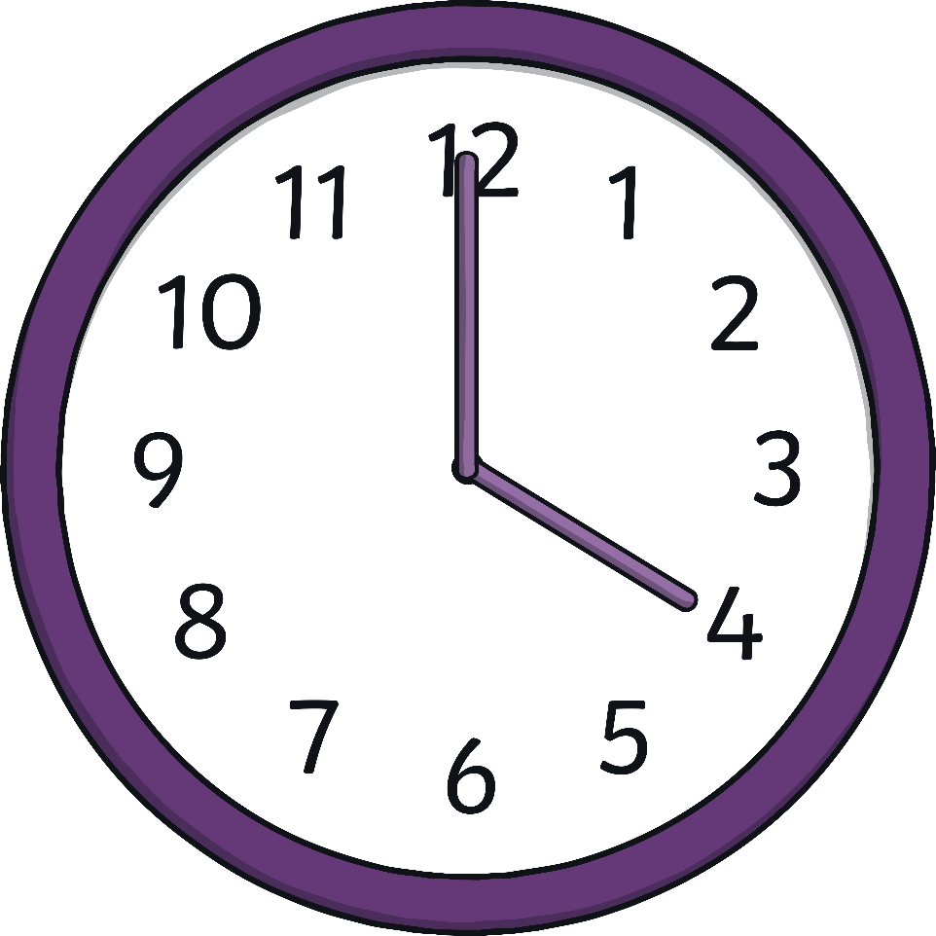
Telling Time on the Hour
The big hand points to the minute.
The small hand on the clock tells the hour.
Look at the clock.
The small hand is on the 4, and the big hand is on the 12.
It is 4 o’clock.

Slide 6
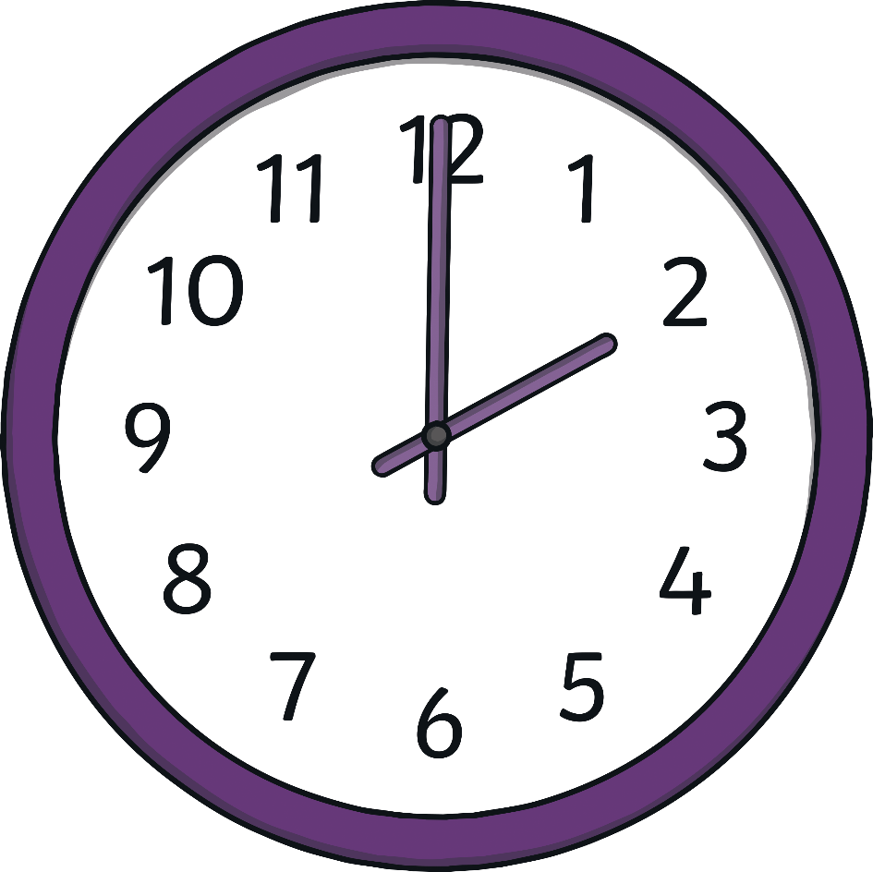
Let’s Practice
What time is it?
Click on the clock to find out!
It is 2 o’clock.

Slide 7
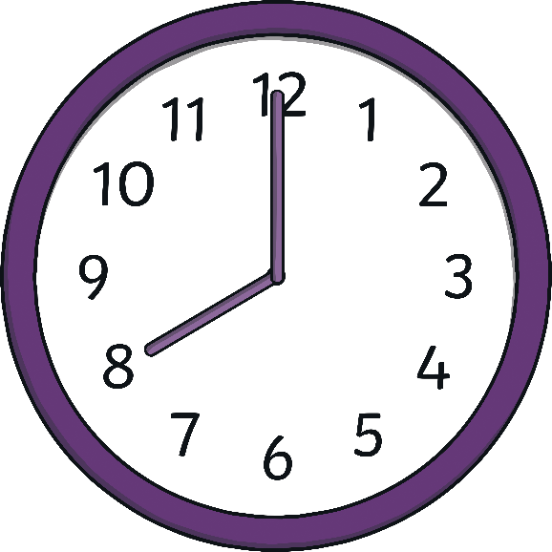
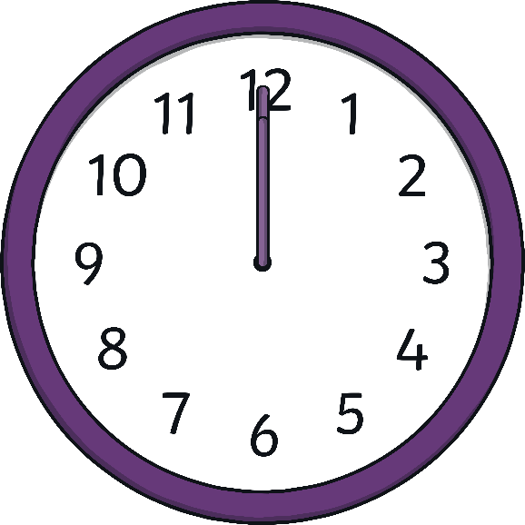
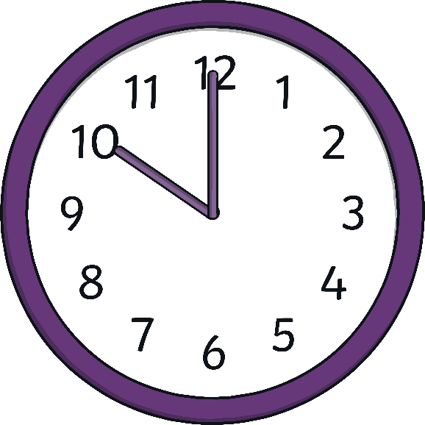
Let’s Practice
10 o’clock
8 o’clock
12 o’clock
Click the times to match them to the correct clocks!

Slide 8
Telling the Time on the Half Hour
We learned that a clock face is a full circle.
It is made up of two halves.
There are 60 minutes in an hour.
How many minutes are in half an hour?

Slide 9
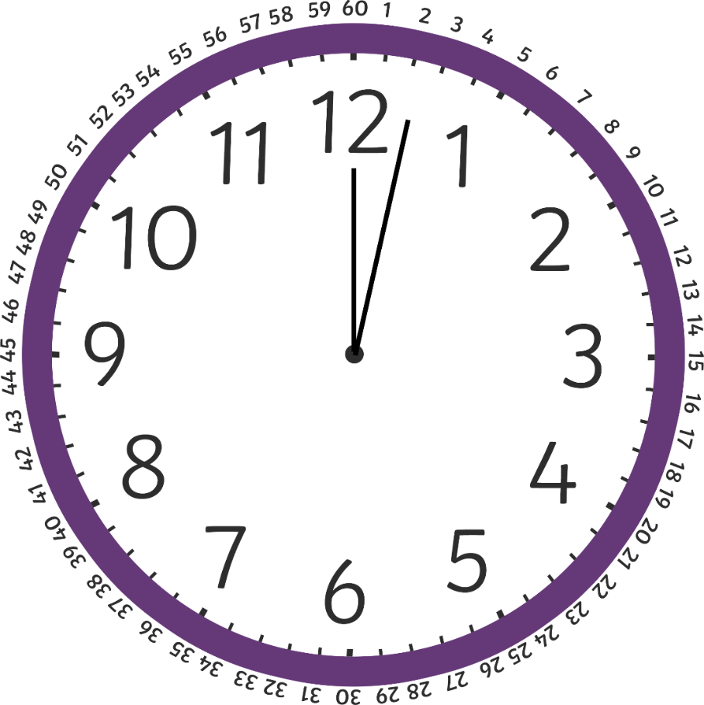
Telling the Time on the Half Hour
There are 30 minutes in half an hour.

Slide 10
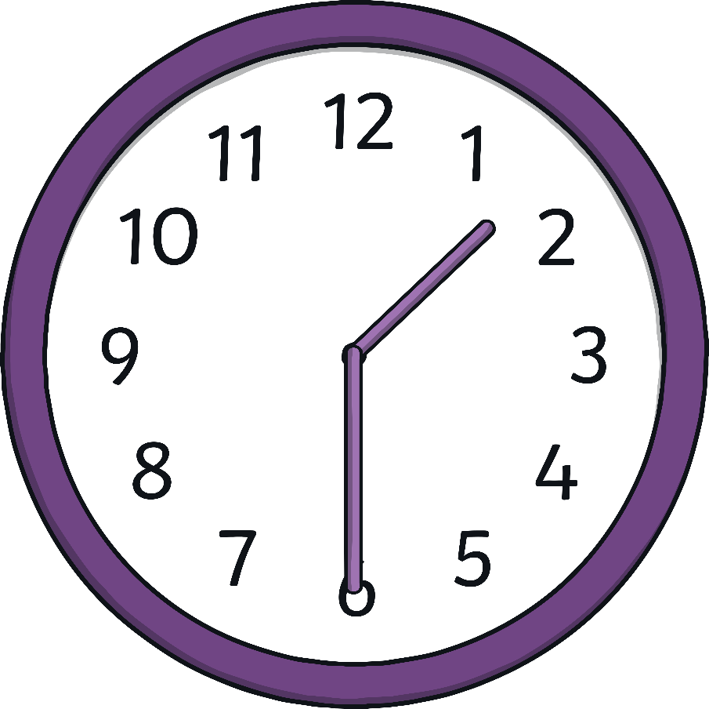
Telling the Time on the Half Hour
When it is 30 minutes past the hour, we say it is “half past” the hour.
It is half past one.

Slide 11
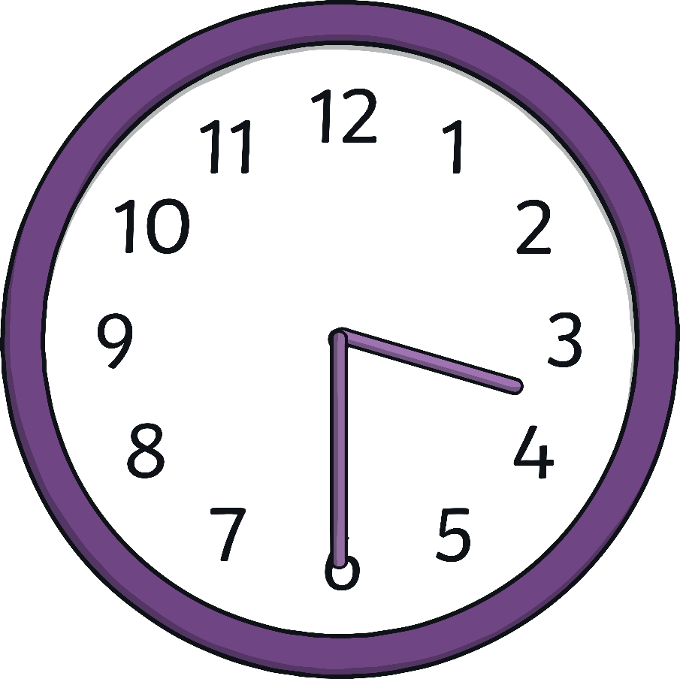
Let’s Practice
What time is it?
Click on the clock to find out!
It is half past three.

Slide 12
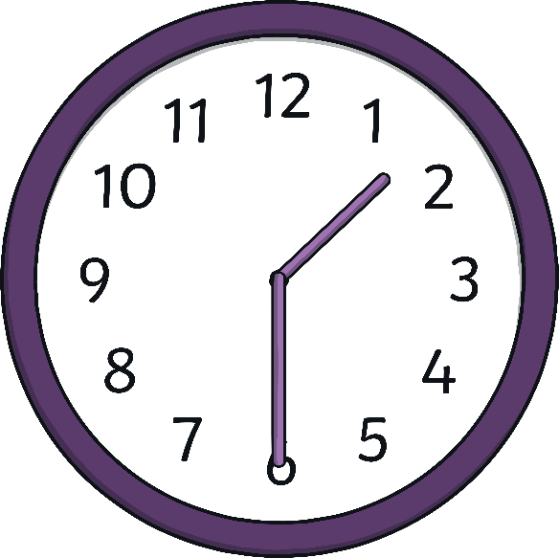
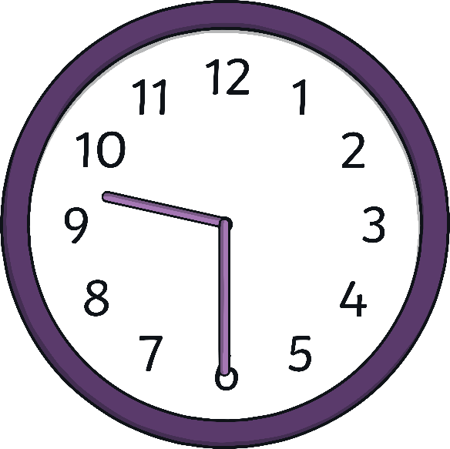
Let’s Practice
half past three
half past nine
half past one
Click the times to match them to the correct clocks!

