Slide 1
Lesson 14.2: Surface Area of a Prism, Pyramid and Cylinder
OBJECTIVES:
Find surface area of prisms, pyramids and cylinders

Slide 2
Prism
Pyramid
Cylinder

Slide 3
Surface Area
sum
the ___________ of the areas of all of the faces or surfaces that enclose the solid

Slide 4
Faces
the top and bottom (bases) and the remaining surfaces (lateral faces or surfaces)

Slide 5
Finding the Surface Area of Prisms & Pyramids:
Step 1: Draw a diagram of each face of the solid as if the solid were cut apart at the edges and laid flat. Label the dimensions.
Step 2: Calculate the area of each face. If some faces are identical, you need only calculate the area of one and multiply by the number of identical faces.
Step 3: Find the total area of all the faces (bases and lateral faces).

Slide 6
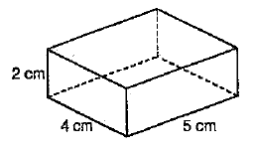
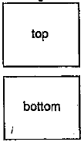
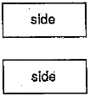
Prism Example
1. Find the surface area of the prism. Each face is a rectangle.
$$4$$
$$2$$
$$2$$
$$5$$
$$5$$
$$4$$
2$∙bh$
2$∙bh$
2$∙bh$
SA= _______________ + _______________ + _______________
SA= _______________ + _______________ + _______________
SA= _______________ + _______________ + _______________
SA = ____________________
$$2∙5∙4$$
$$2∙4∙2$$
$$2∙5∙2$$
$$40$$
$$16$$
$$20$$
$76$ cm²

Slide 7
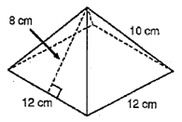
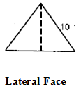
Pyramid Example
2. Find the surface area of the square based pyramid on the right.
How many triangles are there?
4
$$12$$
$$8$$
$$12$$
$$12$$
4$∙\frac{1}{2}bh$
$$s^{2}$$
SA= _______________ + _______________
SA= _______________ + _______________
SA= _______________ + _______________
SA = ____________________
$$\text{4}∙\frac{1}{2}∙12∙8$$
$${12}^{2}$$
$$144$$
$$192$$
$336$ cm²

Slide 8
Finding Surface Area of Cylinders:
The total surface area of a cylinder is the sum of the lateral surface area and the areas of the bases. The lateral surface is the curved surface on a cylinder. You can think of the lateral surface as a wrapper. You can slice the wrapper and lay it flat to get a rectangular region.

Slide 9
Cylinder’s Lateral Surface
The height of the rectangle is the height of the cylinder.
The base of the rectangle is the circumference of the circular base of the cylinder.
The lateral surface area is the area of the rectangular region.
$$πd$$
Area of a Rectangle:
A=bh
H
$$A=bh$$
H
$$LA=$$
$$πd$$
H

Slide 10
Surface Area of a Cylinder
Area of Rectangle:
$$A=bh$$
SA = 2$∙$Area of Circle + Area of Rectangle
Area of Circle:
$$A=πr^{2}$$
$$H$$
r
$$πd$$
r
$$H$$
SA = 2πr² + πdH

Slide 11
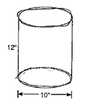
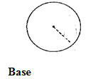
EXAMPLES CONTINUED…
How many circles are there?
3. Find the surface area of the cylinder in terms of $π$ AND to the nearest square inch (using 3.14 for $π$).
2
$$5$$
$$12$$
$$πd$$
$$π∙10$$
$${2∙πr}^{2}$$
$$πdH$$
SA= _______________ + _______________
SA= _______________ + _______________
SA= _______________ + _______________
SA = ____________________
$${2π5}^{2}$$
$π∙10∙$12
$$170(3.14)$$
$$50π$$
$$120π$$
$534$ in²
$170π$ in²

