Slide 1
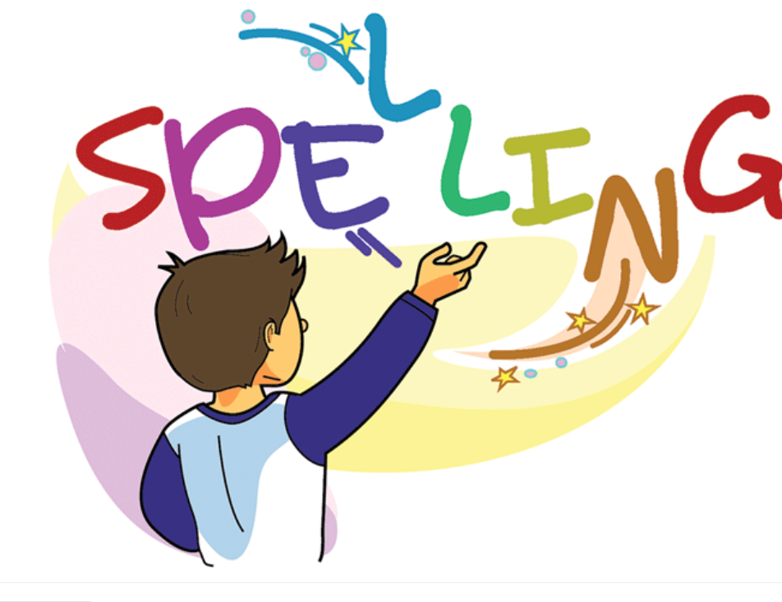

Slide 2
Sunday Weekly Tasks
1. Spelling test “ur” words.
2. Writing Pop up Quiz “Describe the Pictures”

Slide 3
Activity Group
Match the (ur) word sounds to the pictures.
Divide students into groups have them match the (ur) words to their pictures.
PS.
Please don’t forget to take pictures to post of FireFly.
Thanks.

Slide 4
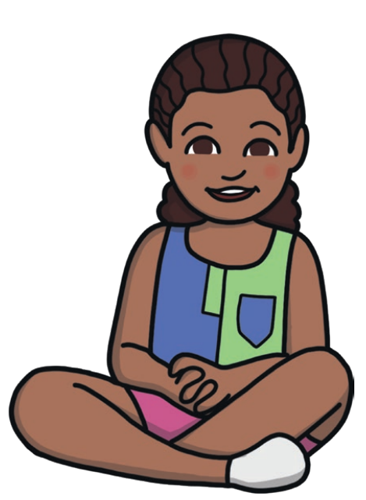
Spelling Words ir words
girl
Girl:
A girl is a female child.
I must have been a cute little girl.

Slide 5
skirt:
skirt:
A skirt is a piece of clothing that fastens at the waist and hangs down around the legs.
Girls love wearing skirts.

Slide 6
dirt
dirt:
You can refer to the earth on the ground as dirt, especially when it is dusty.
They all sat on the dirt under the shade of a tree.

Slide 7
third
third:
The third item in a series is the one that you count as number three.
In the swimming tornment he came in third place.

Slide 8
bird
bird:
A bird is a creature with feathers and wings. Female birds lay eggs. Most birds can fly..
A parrot is a very colourful bird.

Slide 9
twirl:
twirl:
If you twirl, you turn around and around quickly, for example when you are dancing.
The pretty girl is twirling around the dance floor.

Slide 10
stir
stir:
If you stir a liquid or other substance, you move it around or mix it in a container using something such as a spoon
Stir the soup for a few seconds.

Slide 11
birthday
birthday:
Your birthday is the anniversary of the date on which you were born.
It is his birthday today.

Slide 12
first
first:
The first thing, person, event, or period of time is the one that happens or comes before all the others of the same kind.
John came first in the one hundred metres.

Slide 13
shirt
shirt:
A shirt is a piece of clothing that you wear on the upper part of your body. Shirts have a collar, sleeves, and buttons down the front.
He got a new shirt for school.

Slide 14
Thank You!

