Slide 1
English

Slide 2
Lessons Objectives
By the end of the lesson, learners will be able to :
recognize and read the sounds.
01
blend and segment the words.
02
Write words related to these sounds.
03
04

Slide 3
Warm- up Activity

Slide 4
Warm- up Activity
Level 3
Warm- up Activity

Slide 5
Listen to the video

Slide 6
High Frequency Words Mat

Slide 7
Time to read

Slide 9
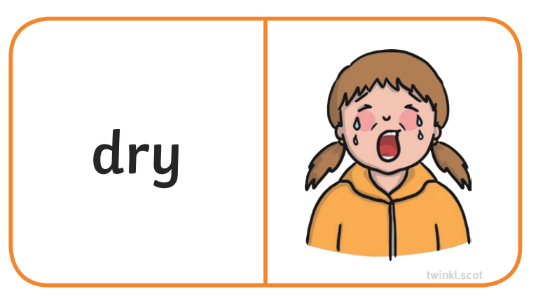

Slide 10
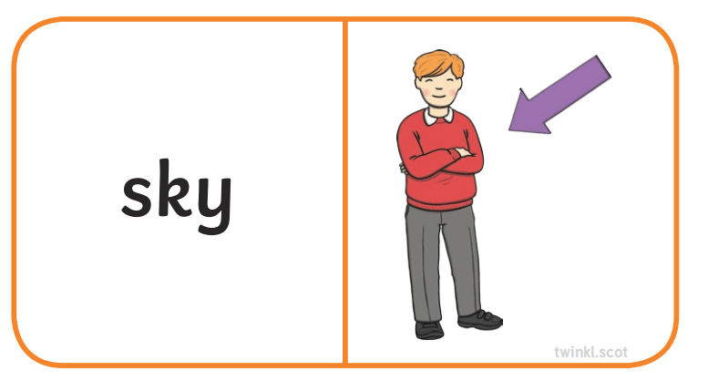

Slide 11
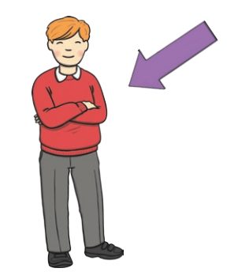

Slide 12
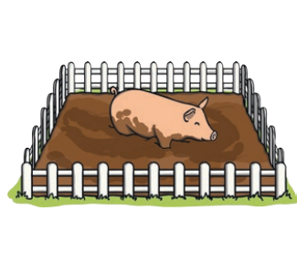

Slide 14
Practice time
Say some words with these sounds
z, , zz, qu, ch, sh, th, th

Slide 15
Lessons Objectives
Objectives check:
recognize and read the sounds.
01
blend and segment the words.
02
Write words related to these sounds.
03
04

