Slide 1
Grammar Revision Term 1
4th Grade
Year 4

Slide 2
Capitalization: The first word of a sentence should always be capitalized. Example: "The sun is shining brightly.“ Proper nouns, such as names of people, places, and organizations, should be capitalized. Example: "I visited Paris last summer.“ Titles of books, movies, and songs are capitalized. Example: "I just finished reading 'To Kill a Mockingbird.’” The pronoun "I" should always be capitalized. Example: "I am going to the store."

Slide 3
Powerful adjectives: These are strong adjectives we can use instead of overused adjectives, to make our writing more interesting. For example: Magnificent: "The view from the mountaintop was absolutely magnificent." Exquisite: "She wore an exquisite gown to the gala." Enormous: "The elephant had an enormous presence." Devastating: "The news of the accident was devastating."

Slide 4
Powerful verbs: These are strong verbs we can use instead of overused verbs, to make our writing more interesting. For example: Conquer: "He managed to conquer his fear and deliver the speech." Illuminate: "The fireworks illuminated the night sky." Transform: "The caterpillar transformed into a beautiful butterfly." Inspire: "Her story inspired others to pursue their dreams."

Slide 5
Speech marks and exclamation: Speech marks are used to indicate direct speech. Example: She said, "I love chocolate.“ Exclamation marks are used to express strong emotions or surprise. Example: "What an incredible performance!“ Direct speech: She said, "I'll be there in five minutes." "Stop right there!" he shouted.

Slide 6
Speech marks
https://www.youtube.com/watch?v=s8a19kuole0

Slide 7
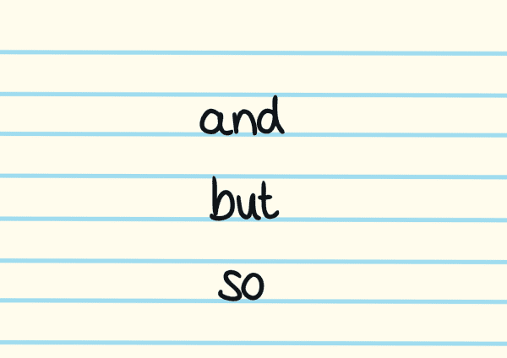
Connectives: Connectives are words or phrases that link sentences (or clauses) together. Connectives can be conjunctions, prepositions or adverbs. Connectives include transitional words or phrases like therefore, however, in addition, on the other hand, for example. However: "He wanted to go out, however, it started raining.“ Moreover: "The hotel has excellent amenities. Moreover, it offers stunning views."

Slide 8
Connective devices can serve various purposes,
including:
Sequencing | first, next, then, finally Help organise ideas in a specific order.
Addition | and, also, furthermore Indicate that more information is being added.
Comparison | similarly, likewise, in the same way Show similarities between ideas.
Contrast | but, however, on the other hand Highlight differences or contrasts between ideas.

Slide 9
Cause and Effect | because, therefore, so Indicate reasons and consequences.
Conclusion | in conclusion, to sum up, overall Signal the end of a discussion or a summary.
Emphasis | especially, above all, notably Emphasise particular points.
Illustration | for example, in particular, such as Provide specific examples.
Purpose | in order to, so that, to Show the intention behind an action.
Time | meanwhile, subsequently, before Help indicate when events occurred.

Slide 10
Apostrophes Possession and contraction apostrophes: Possession: "The dog's tail wagged happily." Contraction: "I can't wait to see you.“ Possession: "The cat's tail was fluffy." Contractions: "I won’t do it."

Slide 11
Using imperatives (orders) with exclamation marks: Imperatives: "Please close the door behind you." Exclamation marks: “Look! What a stunning sunset!"

Slide 12
Using commas: To separate items in a list: "I bought apples, oranges, and bananas at the grocery store.“ To separate clauses in a sentence: "She went to the store, but she forgot to buy milk.“ To set off introductory phrases or words: "After finishing his work, he went for a walk."

Slide 13
Adverbs: they describe the verb; the way in which the action was carried out. Quickly: "She ran quickly to catch the bus." Carefully: "He handled the fragile vase carefully." Joyfully: "The children laughed joyfully at the funny movie."

Slide 14
Adverbial phrases: In the morning: "He goes for a jog in the morning." With great effort: "She completed the project with great effort." At the top of the mountain: "They enjoyed the breathtaking view at the top of the mountain."

Slide 15
Verb simple tenses:
Present: "I eat an apple every day."
Past: "She danced at the party last night."
Future: "We will travel to Europe next year."

Slide 16
Subject-verb agreement: The dog barks. (singular subject) The dogs bark. (plural subject) She sings beautifully. (singular subject) They sing beautifully. (plural subject)

