Slide 1
Lesson: 2D shapes
WALT:
-Identify, describe, and sort 2D by their characteristics, or properties, including reference to the number of sides, and whether the sides are curved or straight.
-Differentiate between 2D and 3D shapes.
2D circle curved rectangle square straight triangle

Slide 2
https://youtu.be/lcl8uB2AWM0

Slide 3
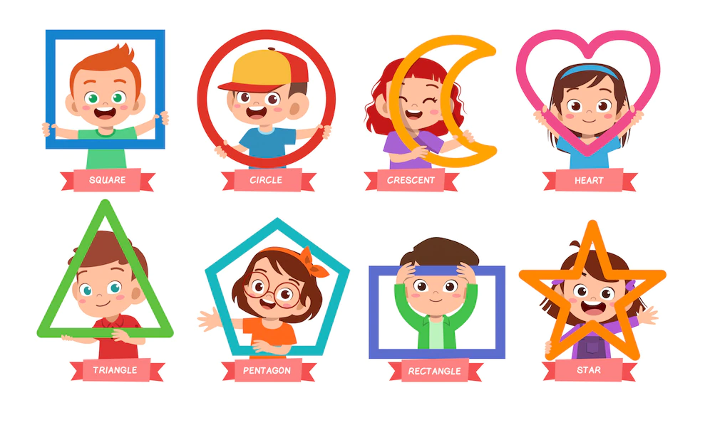
Rhombus is more "mathematical" term while diamond is more general But in Geometry, they mean the same.

Slide 4
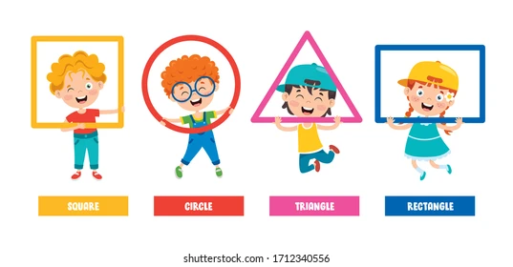
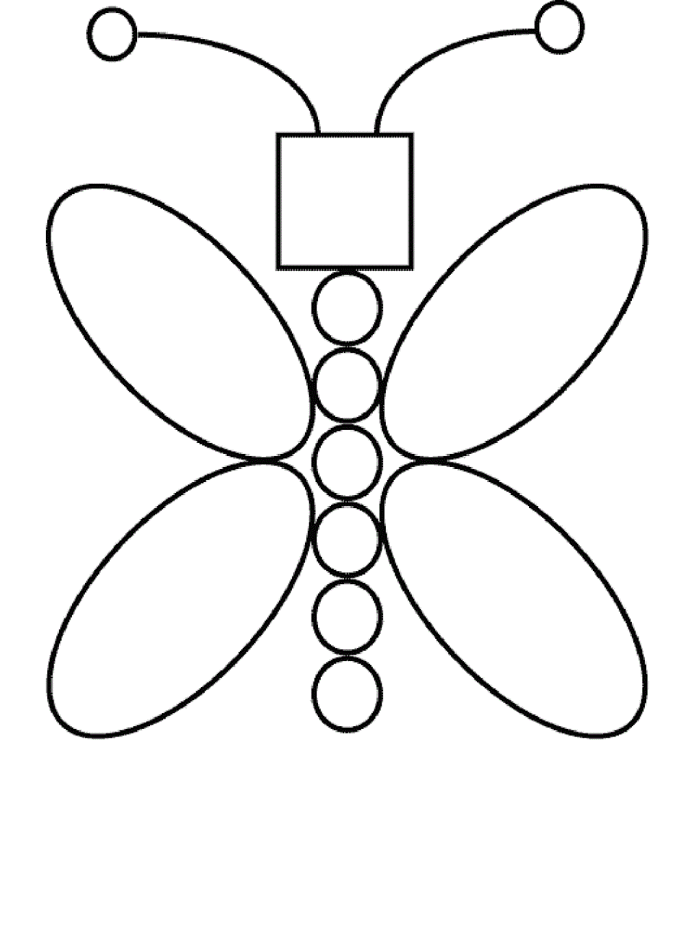
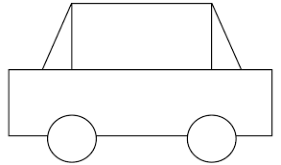
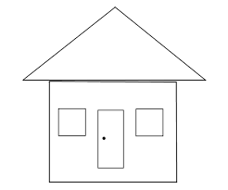
https://youtu.be/A9EemNxrVro
Can you draw different objects using 2D shapes?

Slide 5
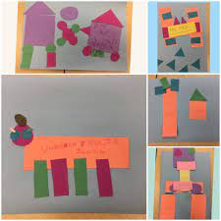
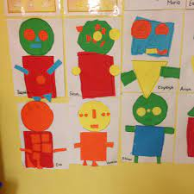
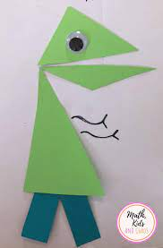
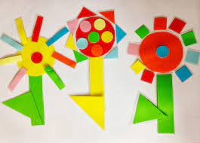

Slide 6
https://youtu.be/jbxXG6hwcRk

Slide 7
Circle
Triangle
Square
Rectangle

Slide 8
Square - star
Star - heart

Slide 9
Circle
0 side
Square
4 sides
Triangle
3 sides

Slide 10
Rectangle
4 sides
Star
5 sides

Slide 11
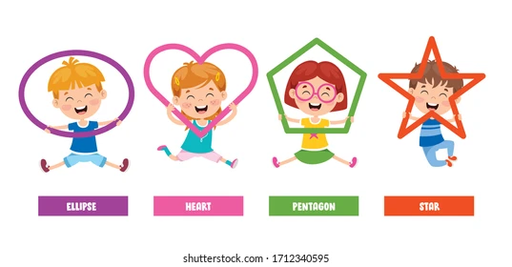
Can you make patterns using shapes?

Slide 12
https://youtu.be/CEkU7Ctq3Qk
https://youtu.be/azuNEmwI0MQ

Slide 13
https://youtu.be/tRC_4IMOTSQ

Slide 14
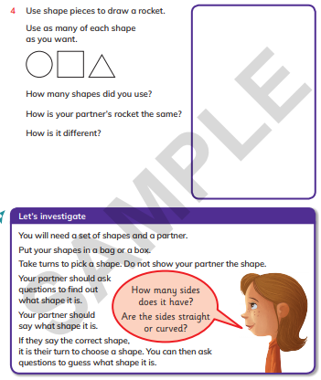
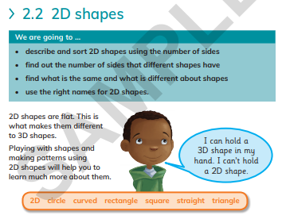
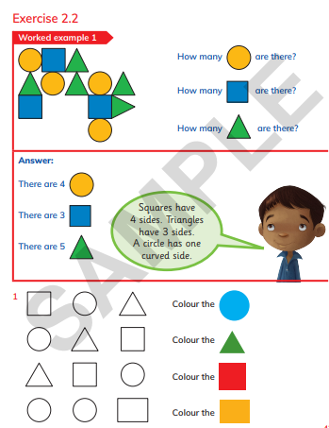
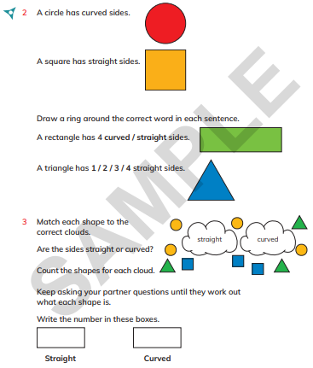
Learners book page 42 to 47

Slide 15
https://youtu.be/YY6YGQy9fEE
https://youtu.be/XmT3d-khryE

Slide 16
https://youtu.be/0B6Ge0FzHG0

Slide 17
Online games
https://wordwall.net/resource/5583081
https://wordwall.net/resource/28992733
https://wordwall.net/resource/22068381
https://wordwall.net/resource/21805416

Slide 18
https://youtu.be/Sjx2BNyN1HQ
https://youtu.be/w6eTDfkvPmo

Slide 19
https://youtu.be/OEbRDtCAFdU
https://youtu.be/svrkthG2950

Slide 20
https://youtu.be/XikvuPl3y_8

