Slide 1
Science Y2 W12 L3

Slide 2
Aim
I can explain that I need light to see things, and that dark is the absence of light.
Success Criteria
I can identify a range of light sources.
I can explain that dark is caused by the absence of light.
I can explain that I need light to see things.

Slide 3
What Is Light?
Can you name some things that give out light?
How does light help us to see?
What is dark?
How do mirrors work?
What is reflection?
How are shadows made?

Slide 4
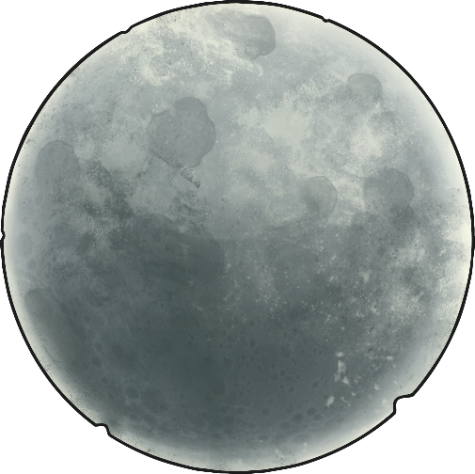
Light Source Sorting Game
The Tricky Ones!
Some of the cards were tricky to sort - the moon, the window and the mirror are some examples.
These objects look like light sources, but they are not!

Slide 5
Light Source Sorting Game
The Tricky Ones!
The moon is not a light source because it does not make its own light.
We can see the moon because light from the sun reflects off it
(bounces off it) back to the earth.

Slide 6
Light Source Sorting Game
The Tricky Ones!
The window is not a light source. It is an opening that lets the light from the sun or other light source into the room.

Slide 7
Light Source Sorting Game
The Tricky Ones!
The mirror is not a source of light because it does not make its own light. It reflects light from other sources.

Slide 8
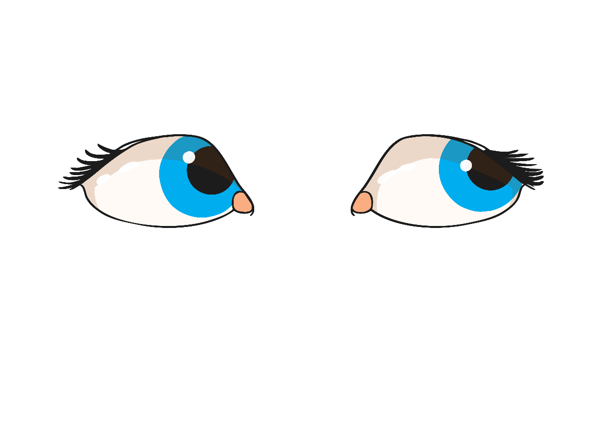
What Is Dark?
Dark is the absence of light.
If there is no light from a light source, it will be dark.
Think about times when it is dark, or places where it is dark. Which sources of light are absent, or switched off?
Can we see in the dark?

Slide 9
What’s In the Bag?
Is it hard to tell what was in the bags?
It is much easier to use our eyes to see, but for this we need light.
How can we get light into the bags?

Slide 10
What’s In the Bag?
Open up the bags.
The light can get inside now.
Which light source is illuminating the objects?
Visit each bag again now they are open to the light.
Use your Activity Sheet to draw or write about the objects
that are really inside!
It is much easier to tell now because you can use the light to see.

