Slide 1
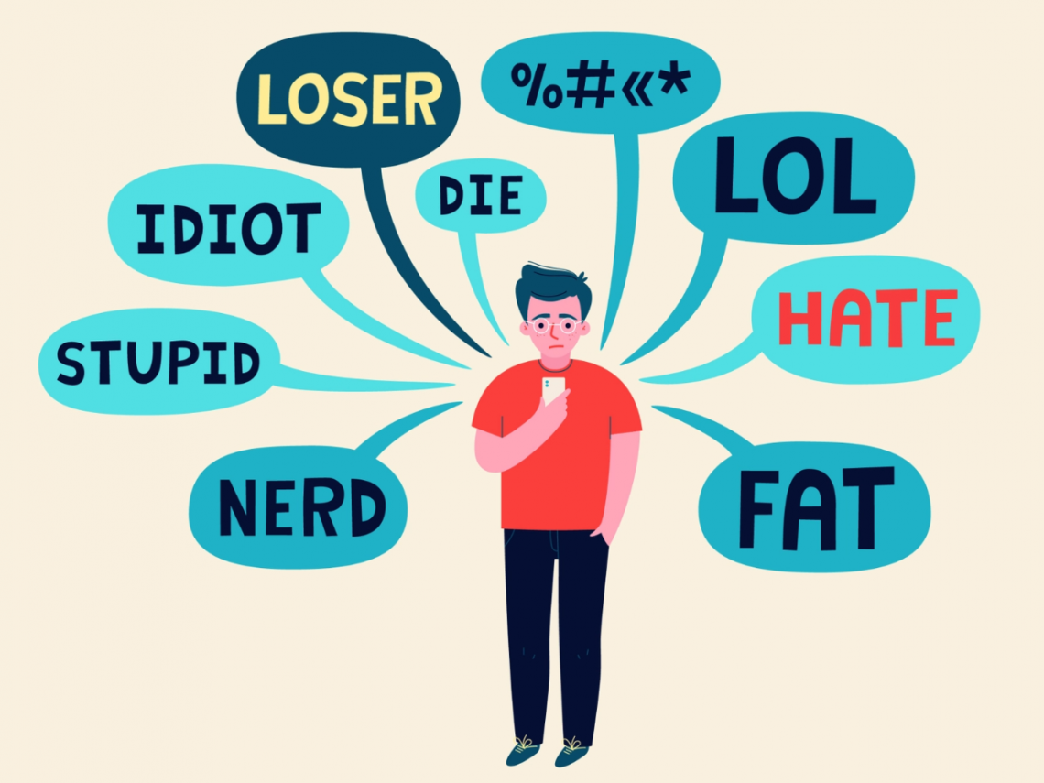
Cyberbullying
This Photo by Unknown author is licensed under CC BY-SA-NC.

Slide 2
Cyberbullying
Cyberbullying is bullying that takes place over digital devices like cell phones, computers, and tablets.
Cyberbullying can occur through SMS, Text, and apps, or online in social media, forums, or gaming where people can view, participate in, or share content. Cyberbullying includes sending, posting, or sharing negative, harmful, false, or mean content about someone else.
It can include sharing personal or private information about someone else causing embarrassment or humiliation.

Slide 3
Bystander and upstander
Upstander
a person who speaks or acts in support of an individual or cause, particularly someone who intervenes on behalf of a person being attacked or bullied.
"encourage your daughter to be an upstander, not a bystander".
Bystander
a person who is present at an event or incident but does not take part.
"water cannons were turned on marchers and innocent bystanders alike"

Slide 4
This Photo by Unknown author is licensed under CC BY-SA.

