Slide 1
2.3 Planning a solubility investigation

Slide 2
Objectives

Slide 3
Keywords
control variables
Dependent variable
Independent variable
interval
range
variables

Slide 4
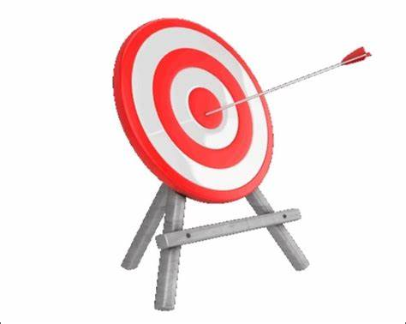

Slide 5
Dependent VS independent Variables
How does the volume of water affect the number of days it takes for a tomato plant to flower?
What we change in an investigation
What we measure
The type of seeds
The type of soil
The light source
The humidity in the room
The type of container (e.g., plastic pots vs. clay pots)
The Temperature
Control variable:
Things that are kept the same to make sure it is a fair test

Slide 6
Determine the independent, dependant and the potential controlled variables
Overall, largest leaf, all leaves
-Source of light
-quantity of water
-type of soil, depth of the seed, room temperature
c
Days needed for the first flower
-Source of light
-quantity of water
-type of soil, depth of the seed, room temperature
Single type of seeds, same type of soil, same volume of soil, same type of pots, same source of light, same duration of light, temperature of the room, same time of day for watering, etc
Independent variable
Dependent variable
Control variable

Slide 7
Dissolving salt in water
The students have identified the following variables:
the volume of water used,
the temperature of the water
the number of spatulas of the solute used.
Different volume of water will make the results not reliable.
The change could be due to the volume of water or to the temperature; would not be able to tell which, so the results would be of no use.

Slide 8
The variable they change is The temperature of water
Independent variable
They will count the number of spatulas of salt that will dissolve.
This is the variable that depends on the temperature of the water.
Dependant variable
The volume of water is the variable that the students keep the same,
To ensure that the test is fair.
control variable

Slide 9
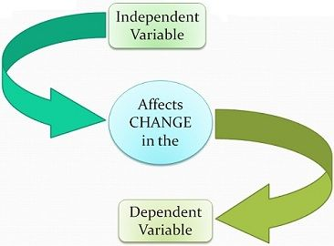
Dependant variable
Think I,I,I…
What do I measure in this experiment?
I Measure this variable

Slide 10
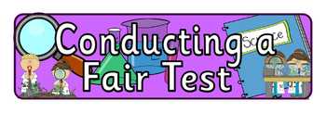
Control variable
Think I,I,I…
What do I not change in this experiment?
I keep this variable the same

Slide 11
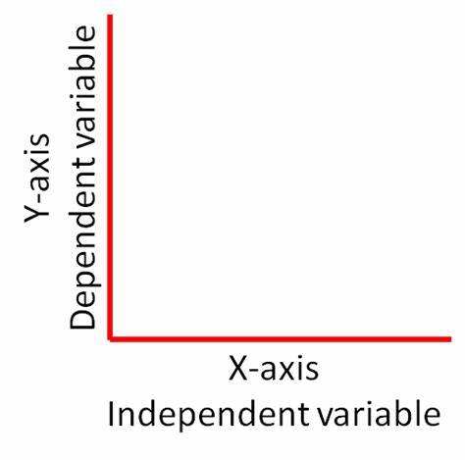
Independent versus dependant variable on a graph
Dependent variable
Independent variable

Slide 12
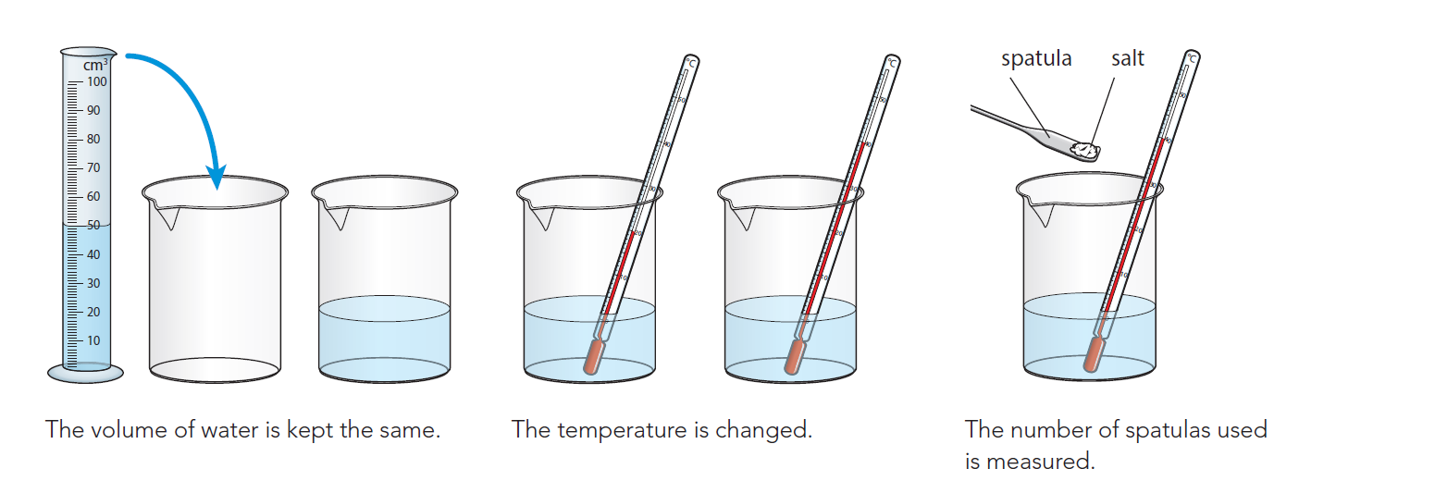
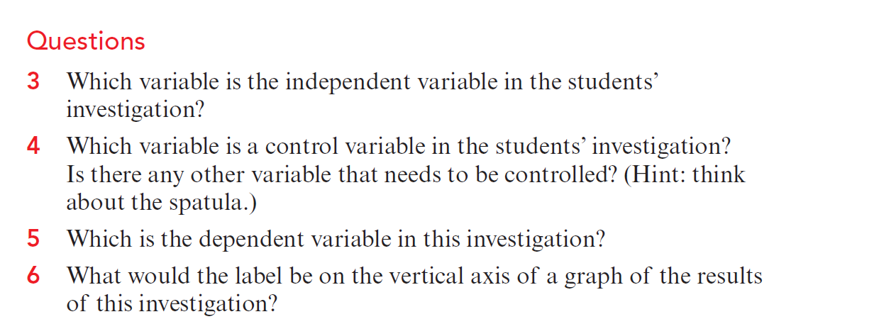
3- temperature
4- The volume of water is a control variable.
Another control variable is the size of the spatula and how full each spatula is.
5- The dependent variable is the number of spatulas of sodium chloride that will dissolve.
6- The number of spatulas of sodium chloride that dissolves in 50 cm3 of water.

