Slide 2
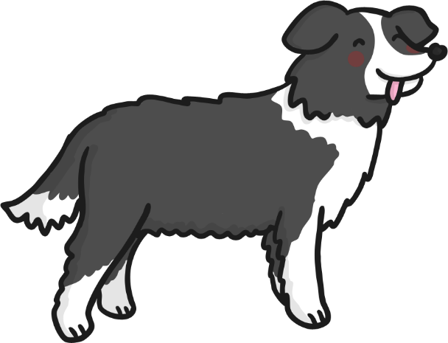
Introduction
Welcome to my farm!
My sheepdog, Sheppy, would like some help as my sheep keep hiding!
Can you help Sheppy to find and count all of my sheep?
Play

Slide 3
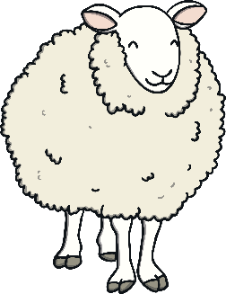
Click on Sheppy the sheepdog to round up the sheep.
Four sheep are hiding near the top of the field and two are at the bottom of the field. How many altogether?
Well done! 4+2= 6
next

Slide 4
Click on Sheppy the sheepdog to round up the sheep.
I have 3 on top of the field and 2 at the bottom. How many are there altogether?
I have nine sheep on my farm.
Well done!
3+2= 5
next

Slide 5
Click on Sheppy the sheepdog to round up the sheep.
Two sheep at the bottom. How many sheep are at the top of the field? Now, How many altogether?
Well done! 6+2= 8
next

Slide 6
Click on Sheppy the sheepdog to round up the sheep.
Three sheep are hiding near the top of the field and four are in the middle of the field. How many are there altogether?
Well done! 3+4= 7
next

Slide 7
Click on Sheppy the sheepdog to round up the sheep.
Three sheep are near me. How many are far away? Now, How many altogether?
Well done! 3+6= 9
next

Slide 8
Click on Sheppy the sheepdog to round up the sheep.
Did Sheppy find all of my sheep?
How do you know?
Yes, he did! Good boy Sheppy!
The end

Slide 9
Thank you for helping to find and count the sheep.
Play again!

