Slide 1
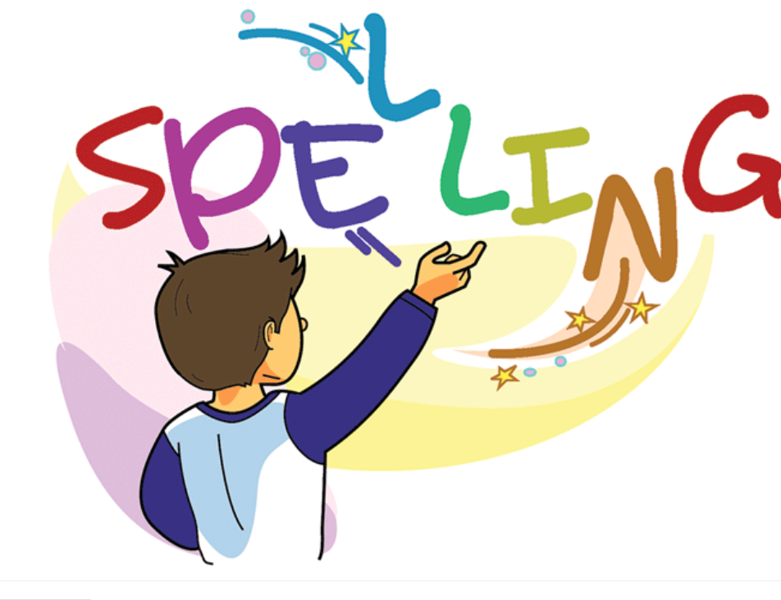

Slide 2
Words with the /air/ sound
Activity 1: Pair Work (5 mins)
Match sentences with /air/ word sounds with the correct picture.
The team that works quietly, efficiently without the teacher’s or Ta’s help is the winning team.

Slide 3
Read the sentences and match them to the correct picture.

Slide 6
Activity 2 Group work. (5 mins) Prepare picture cards with spelling sounds /air/ and /ow/. Have students look at the pictures and try to place them under the correct sound.
air | ow
Set Timer for both activities for 5 min each.

Slide 9
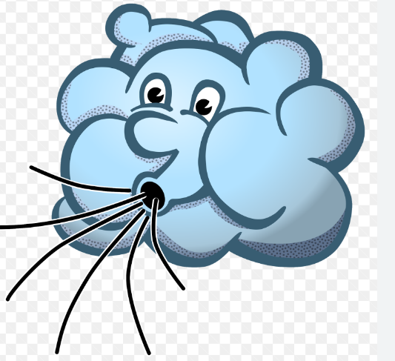
Spelling Words Words with /air/ sound
air
Air is the mixture of gases which forms the Earth's atmosphere and which we breathe.
All living things need food, water, air, and sheletrs to survive.

Slide 10
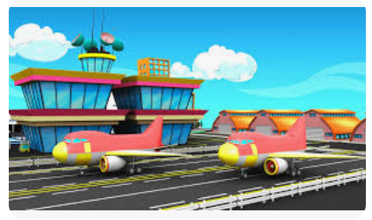
airport
An airport is a place where aircraft land and take off, which has buildings and facilities for passengers.
We are at the airport waiting for our plane.

Slide 11
chair
A chair is a piece of furniture for one person to sit on. Chairs have a back and four legs.
Tuck your chair in before leaving the class.

Slide 12
hair
Your hair is the fine threads that grow in a mass on your head.
Hair is the short, fine threads that grow on different parts of your body.
Hair is the threads that cover the body of an animal such as a dog, or make up a horse's mane and tail.
He has short black hair.

Slide 13
fair
A county, state, or country fair is an event where there are, for example, displays of goods and animals, and amusements, games, and competitions.
I went to the fair with my family.

Slide 14
pair
A pair of things are two things of the same size and shape that are used together or are both part of something, for example shoes, earrings, or parts of the body.
I have a pair of red shoes.

Slide 15
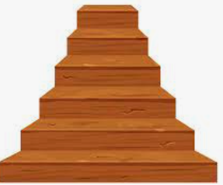
stair
Stairs are a set of steps inside a building which go from one floor to another.
Nancy began to climb the stairs.

Slide 16
fairy
A fairy is an imaginary creature with magical powers. Fairies are often represented as small people with wings.
The tooth fairy took my baby tooth away, and put a coin under my pillow.

Slide 17
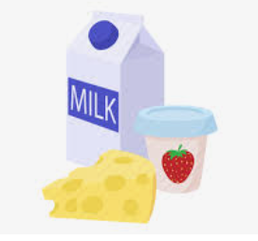
dairy
Dairy is used to refer to foods such as butter and cheese that are made from milk.
She can’t eat dairy food.

Slide 18
hairy
Someone or something that is hairy is covered with hairs.
My dad has hairy arms.

Slide 19
Thank You

