Slide 2
Meet Number Ten
Hello, I am Number Ten. What do you notice about me? I’m off to the zoo today with my friend Number Two and I need to take some bananas with me.
How many bananas did you count?

Slide 3
Meet Number Two
I’m off to the zoo today with my friend Number Ten and I need to take some bananas with me. How many bananas do I have?
Hello, I am Number Two. What do you notice about me?

Slide 4
Number Ten and Number Two arrived at the zoo at the same time. They were so excited to see each other, they both had a funny feeling. There were was a loud bang and…

Slide 5
…something magical happened!
I am Number Twelve.

Slide 6
Cube Towers
This is the number 12 shown as towers of cubes
Can you check that there are 12? How can you be sure?

Slide 7
Number Twelve looked at the sign. He had to pay 12p to enter the zoo.
Can you help me work out which purse I need?
Let’s have fun at the zoo!
Try again.
Entry 12p
Next

Slide 8
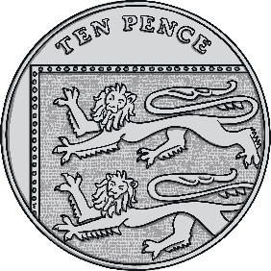
That’s right! There are 12 pennies in this purse.
We can make 12p another way - click me to take a look. Talk about what you can see this time.

Slide 9
The first place Number Twelve visited was the monkey enclosure. He loved to take the monkeys some bananas as a treat.
When we were getting ready for our trip to the zoo, we packed our bananas! Can you remember how many bananas Number Ten packed?
Choose the correct ten-frame that shows the number of bananas Number Ten had.

Slide 10
Can you remember how many bananas Number Two packed? Choose the correct ten-frame.

Slide 11
How many bananas do you think we have altogether? Can you a tell a partner? Click me to check.

Slide 12
Yum, yum!
We make 12!
I am 2.
I am one 10.

Slide 13
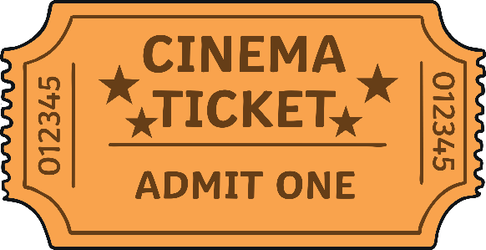
Number Twelve wanted to go and watch the seals. He had to get a ticket. What number can you see on the ticket?
TICKET
12
Try again.
Try again.
Try again.
Try again.
Try again.
Try again.
Try again.
Try again.
Try again.
1
10
Oh no, some of the seats are missing their numbers! Which seat do I need to sit on? How do you know? Click it for me.

Slide 14
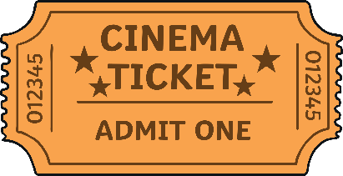
TICKET
12
Thank you for helping me find my seat! Click me to count the chairs.
1
2
3
4
5
6
7
8
9
10
11

Slide 15
Number Twelve went to visit the butterfly house. Look at all the beautiful butterflies flying around!
How many butterflies can you see?

Slide 16
How many butterflies can you see on the bush? How do you know?
How many can you see flying? How many can you see altogether?

Slide 17
We make 12!
I am 2.
I am one 10.

Slide 18
It was time for Number Twelve to go home. He started to have a funny feeling!

Slide 19
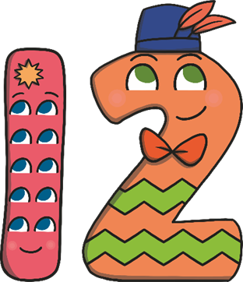
Suddenly, there was another loud bang!
What do you think is going to happen to me now?

Slide 20
Number Ten and Number Two said goodbye to each other and made their way home.

Slide 21
Number Lines
Can you spot the number 12 on the number line? Which numbers are next to number 12?
Click the hand to reveal the answer!
0
1
2
3
4
5
6
7
8
9
10
11
12
13
14
15
16
17
18
19
20

Slide 22
Number Lines
20
How about this number line?
Can you spot the number 12?
Is it in the same place?
19
18
17
16
15
14
13
12
11
10
9
8
7
6
5
4
3
2
Click the hand to reveal the answer!
1
0

Slide 23
Can you find 12 on the number track? Click on Number Twelve to move him onto the number track.
20
19
18
17
Which number comes before number 12? Which number comes after number 12? Can you spot any patterns when you look at the number track?
16
15
14
13
11
10

