Slide 1
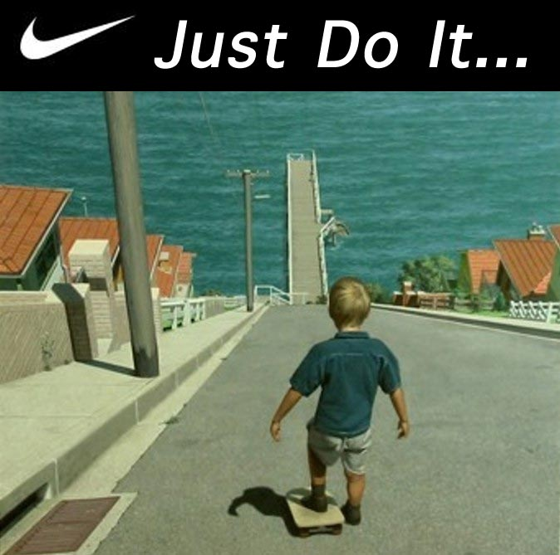
Persuasive Writing :1
Lesson Objectives:
By the end of the lesson, you should be able to:
Identify the elements of persuasive writing
Identify examples of persuasive texts
Get acquainted and apply hooks
Produce a solid thesis

Slide 2
Persuasive Writing
Warm up:
What do you already know?
Watch those ads in the following link and identify the persuasive devices that you already know:
https://www.youtube.com/watch?v=azttKmT0rVc

Slide 3
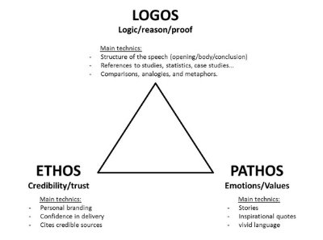
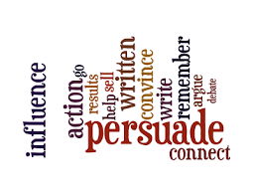
Persuasive writing is writing that tries to convince a reader to do something or to believe what you believe about a certain topic.
It takes a position for or against something.

Slide 4
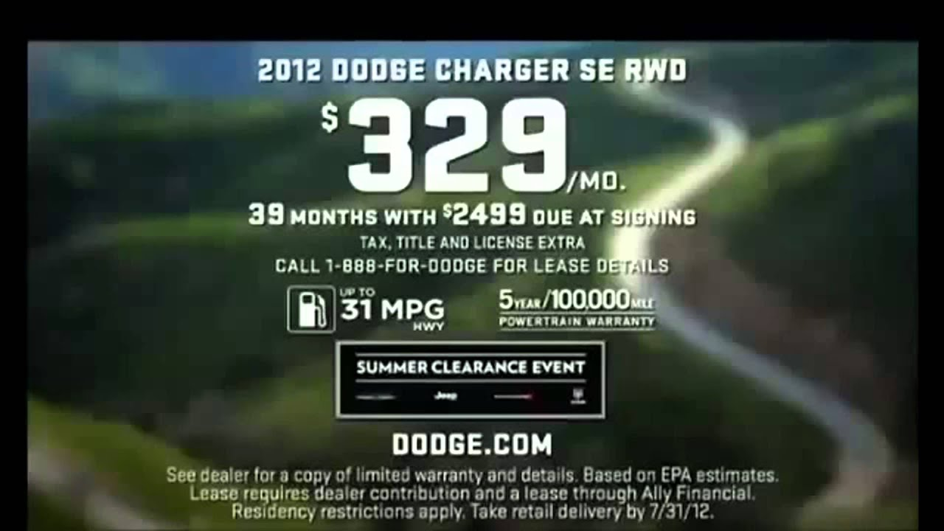
Types of Supporting Arguments
Logos—an appeal to logic
Often contain expert testimony
Often contain statistical information
Suggest that the product is the “logical” or “right” choice

Slide 5
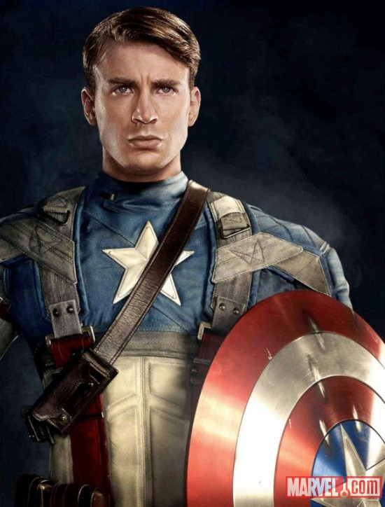
Types of Supporting Arguments
Ethos-an appeal to do the “right” thing
Being credible
Notes:
Many students will have seen “Captain America” or “The Avengers.” Talk about why this particular ad, which is featured in the film, would appeal to the Captain American character.

Slide 6
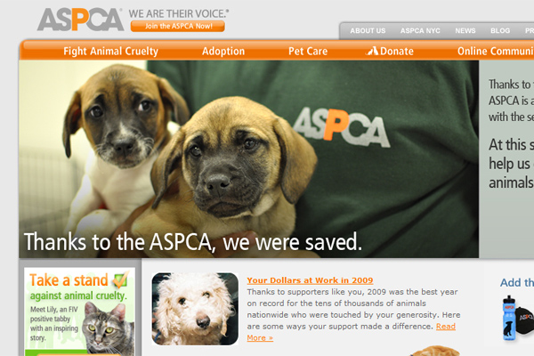
Types of Supporting Arguments
Pathos-an appeal to the emotions
http://46664.net/56/aspca-the-american-society-for-the-prevention-of-cruelty-to-animals/
Notes:
Discuss with students why sad images are often used in ads for companies that are soliciting donations. Discuss the effects of music in these ads as well—an example would be Sarah MacLachlan’s song “In the Arms of an Angel”

Slide 7
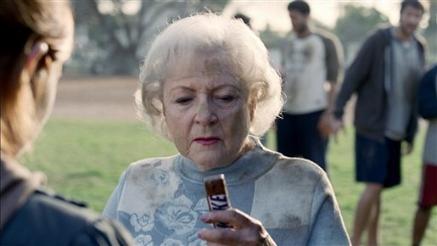
Forms of Persuasive Writing
Advertisements try to convince you to do or buy something.

Slide 8
Forms of Persuasive Writing
Editorials about current issues appear in newspapers and magazines, or on television, radio, and the internet.
http://topmagazines.wordpress.com/2011/06/29/recommended-magazines-for-people-who-can%E2%80%99t-get-enough/

Slide 9
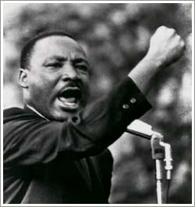
Forms of Persuasive Writing
Persuasive speeches try to convince an audience to take action

Slide 10
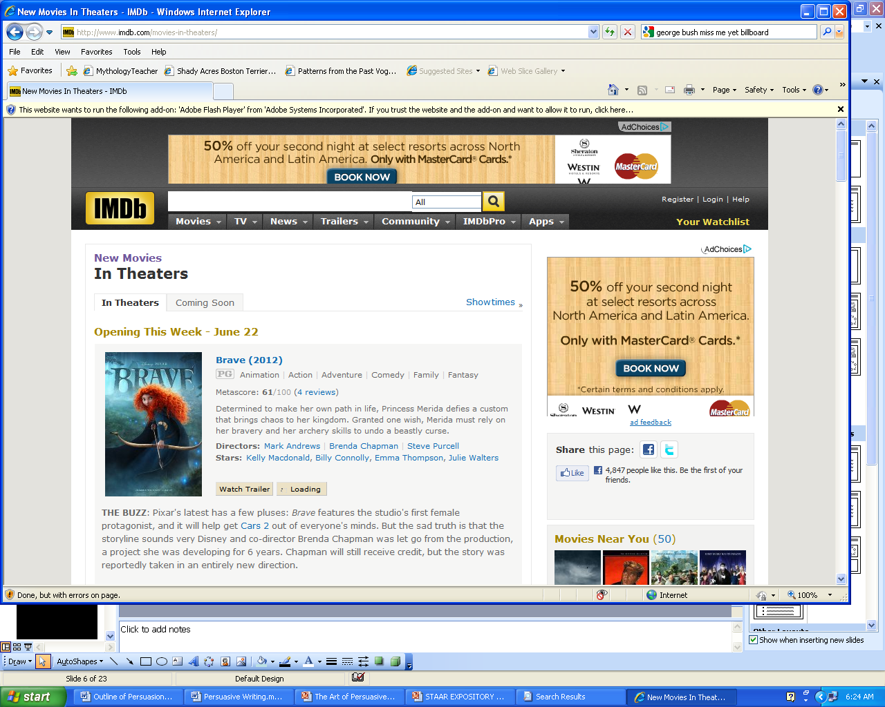
Forms of Persuasive Writing
Reviews evaluate items like books or movies and state an opinion as to whether the product is worth the reader’s time and money.
http://www.imdb.com/movies-in-theaters/

Slide 11
Forms of Persuasive Writing
Blogs provide commentary on a particular topic, often combining text, images, and links to other blogs, web pages, and other media related to its topic. Blogs also allow readers to respond.
http://www.ted.com/talks/marcel_dicke_why_not_eat_insects.html

Slide 12
Persuasive Writing can be used to…
Purpose
Persuasive Statement
“Please support my football team by buying discount coupons.”
“Vote for Sarah!”
“The principal should let us wear hats.”
“Cell phones don’t cause brain cancer.”
Support a cause
Urge people to action
Make a change
Prove something wrong

Slide 13
Persuasive Writing can be used to…
Purpose
Stir up sympathy
Create interest
Get people to agree with you
Persuasive Statement
“If you don’t adopt this dog, it could have to live in a shelter.”
“Better grades get you a better job and more money.”
“I am sure you’ll agree that Milky Way is the best candy bar.”

Slide 14
First…Know Your Audience…
Before you start writing, you should know your audience:
Who will read your writing? Who do you need to convince?
The audience may be your friends, your teacher, your parents, your principal, the readers of a newspaper or the President of the United States!
Will you be graded? On What?
Should you be casual or professional?

Slide 15
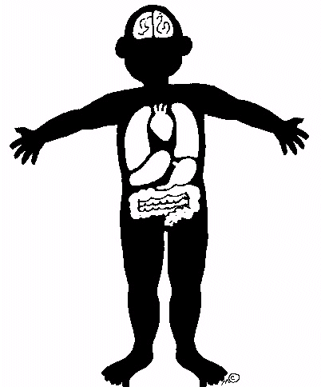
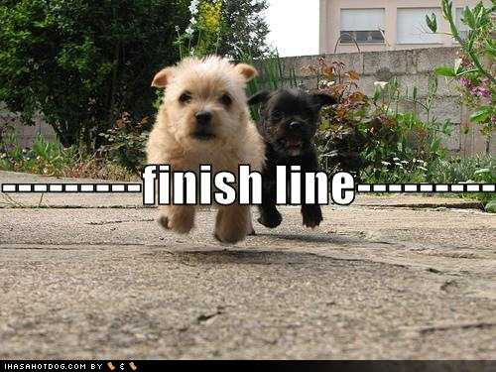
Persuasive writing format:
INTRODUCTION with a “hook” and thesis statement
BODY where the argument is explained
CONCLUSION where main points are summarized and reviewed and the reader is left with something to think about.

Slide 16
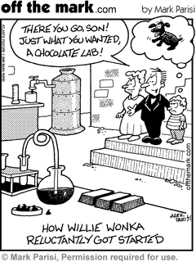
In order to convince the reader you need more than just an opinion; you need facts or examples to back your opinion. So, be sure to do the research!
Three: Do Your Research…

Slide 17
You Could Begin with a Strong Statement:
Example:
Fast food consumption has risen 500 percent since 1970 and today reaches nearly every part of society, including some public school cafeterias.

Slide 18
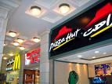
You Could Open with a Quotation:
Example:
University of Delaware professor states:
“Advertising, including television ads, billboards, and other advertising,
including toys in boxed meals, has had an effect upon children as never before.
Children these days are growing up with low concern for their health and more concern for what tastes good.”

Slide 19
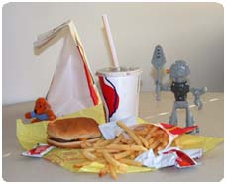
You Could Open with a interesting fact:
Example:
“Did you know that a typical child needs 2,000 calories for an entire day and Burger King’s Whopper with triple cheese has 1,230 calories?”

Slide 20
You Could Open with an Anecdote:
An anecdote can provide an amusing and attention-getting opening if it is short and to the point.
“My hands felt sticky after pulling open the doors to “Big Bobby’s Boisterous Burger Hut”. The odor smelled of fried everything. I ordered a Big Bobby Combo #2. There was enough food to serve a small third world country on my tray. I nibbled at the ¾ pound burger and my chin was covered in a mayonnaise and ketchup concoction. I asked the server if I could have a few fries with my salt. I left the place feeling like my stomach was mad at me.”

Slide 21
You Could Open with a Fact or Statistic:
Example:
Thirty percent of the children in the survey ate fast food on any given day during the survey, and they ate an average of 187 calories a day more than those who did not eat fast food. These additional calories could account for an extra six pounds of weight gain per year, according to Ludwig.

Slide 22
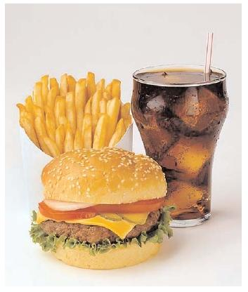
You Could Open with a Question:
How many times have you eaten fast food this month?

Slide 23
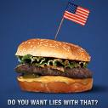
Open with an Outrageous Statement:
Example:
“Fast food is killing America!”

Slide 24
You Could Start with a Riddle:
Get your reader’s attention with a challenging thought.
“What’s plain, and boring? What makes all students in a school building look the same and lose their individuality? If you guessed UNIFORMS, you’re correct!”

Slide 25
Lead / Hook Match the type to the example
Anecdote (narrative vignette) | At Knowledge Valley School, a controversy is brewing. Walk down the hallways, and amidst a tranquil sea of black pants and red polo shirts, the blades of a fuchsia mohawk cut through the peaceful learning environment.
Question | “Give me liberty or give me death.” (Patrick Henry)
Hyperbole | I walked proudly through the hallways of KVS, my new blue mohawk glistening magnificently in the florescent lighting of the hallway, but then I saw Mrs. Shoura I felt the wax in my hair start to melt.
Setting | For the past 300 years in this country, schools have been crushing the artistic freedom of students with oppressive dress codes!
Alliterative Phrase | Do schools have the right to tell kids how to dress?
Quotation | Timeless. Tasteful. Tried and true. The traditional school uniform is the foundation of a true learning environment.
Notes:
Here are some possible leads for a persuasive paper about school dress codes. Have students consider tone and audience. Which would be most appropriate?

Slide 26
Lead / Hook Match the type to the example
Anecdote (narrative vignette) | At Knowledge Valley School, a controversy is brewing. Walk down the hallways, and amidst a tranquil sea of black pants and red polo shirts, the blades of a fuchsia mohawk cut through the peaceful learning environment. Setting
Question | “Give me liberty or give me death.” (Patrick Henry) Quotation
Hyperbole | I walked proudly through the hallways of KVS, my new blue mohawk glistening magnificently in the florescent lighting of the hallway, but then I saw Mrs. Shoura I felt the wax in my hair start to melt. ANECDOTE
Setting | For the past 300 years in this country, schools have been crushing the artistic freedom of students with oppressive dress codes! Hyperbole
Alliterative Phrase | Do schools have the right to tell kids how to dress? Question
Quotation | Timeless. Tasteful. Tried and true. The traditional school uniform is the foundation of a true learning environment. Alliterative Phrase
Notes:
Here are some possible leads for a persuasive paper about school dress codes. Have students consider tone and audience. Which would be most appropriate?

Slide 27
Next: Creating a Thesis Statement
A thesis statement is one sentence at the end of your introduction that states your opinion. It needs to be strong.
First, choose 3 main focus points to discuss in your essay. These points will become the focus of three paragraphs in the body of your paper.
Let’s use fast food as an example again.
Fast food…(3 Discussion Points)
rapidly increases weight
causes high blood pressure
leads to sluggishness

Slide 28
H.W:Writing the Thesis Statement
Now take your three main focus points and summarize them. Put your completed thesis statement at the end of your first paragraph.
THREE MAIN FOCUS POINTS
I believe fast food is harmful because it rapidly increases weight, causes high blood pressure, and leads to lethargy.
COMPLETED THESIS STATEMENT
I believe fast food has negative health effects.

Slide 29
CATCHY TITLE
Fast Food Is Killing America!
Did you know that a typical child needs 2,000 calories for an entire day and Burger King’s Whopper with triple cheese has 1,230 calories? That is far more calories than anyone needs in one day! Fast food consumption has risen 500 percent since 1970 and today reaches nearly every part of society, including some public school cafeterias. Fast food is harmful because it rapidly increases weight, causes high blood pressure, and leads to sluggishness. Fast food is bad for your health!
HOOK THE READER
YOUR THREE ARGUMENTS
THESIS STATEMENT

Slide 30
H.W: Persuasive Devices exercise

