Slide 1
VOCABULARY WORDS
Week 3

Slide 2
Out-dated
"
Meaning: No longer current or fashionable.
Synonyms: old-fashioned.
Antonyms: modern, current, up-to-date.

Slide 3
sophisticated
"
Meaning: Having acquired worldly knowledge
Synonyms: cultured.
Antonyms: unsophisticated, simple

Slide 4
Lightweight
Meaning: Having little weight
Synonyms: featherweight, light
Antonyms: heavyweight

Slide 5
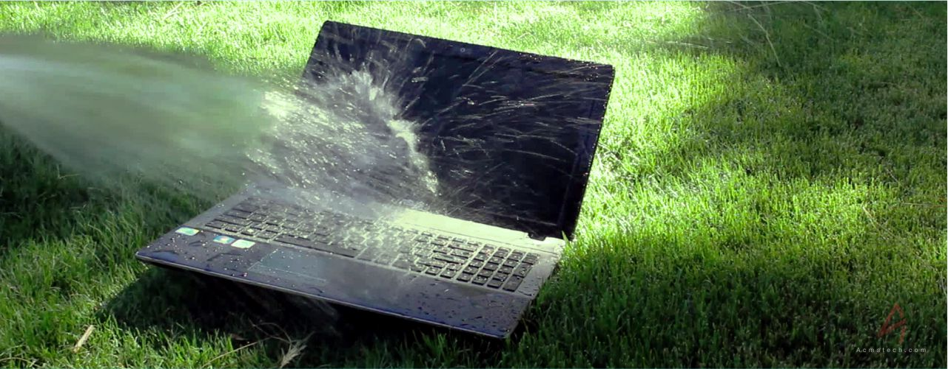
waterlogged
Meaning: excessively soaked.
Synonyms: soggy, water-soaked.
Antonyms: dry, waterless

Slide 6
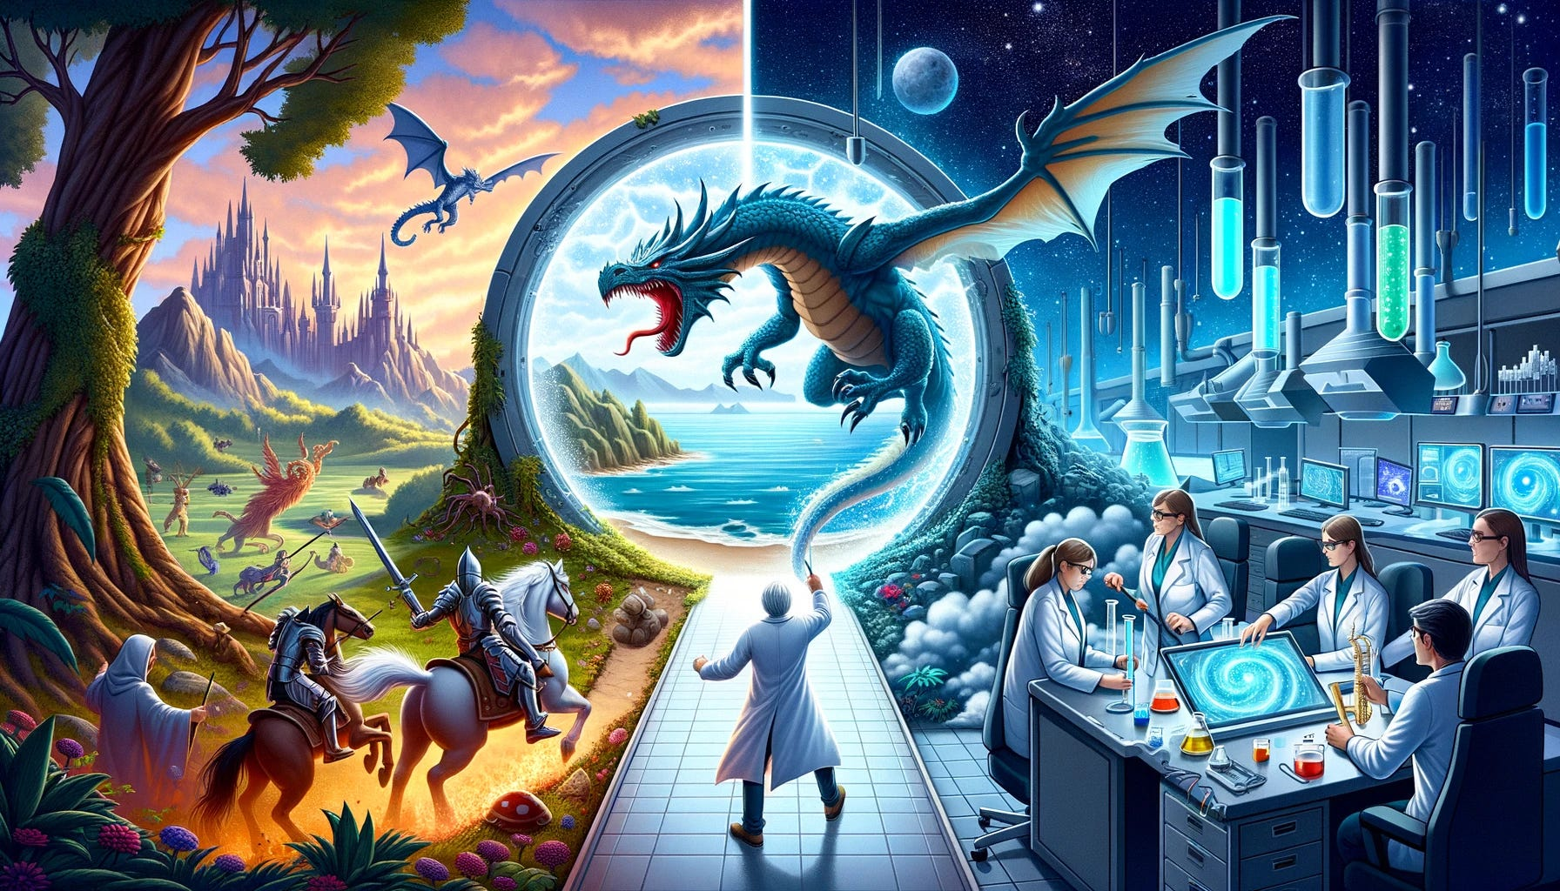
imaginary
Meaning: Existing only in the imagination; not real.
Synonyms: fictional, unreal, imaginary, fanciful, fantastical.
Antonyms: real, actual

Slide 7
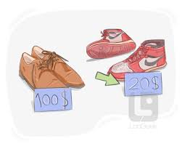
inexpensive
Meaning: Not costing
Synonyms: cheap, economical, low-cost,
Antonyms: expensive, costly, high-priced.

