Slide 2
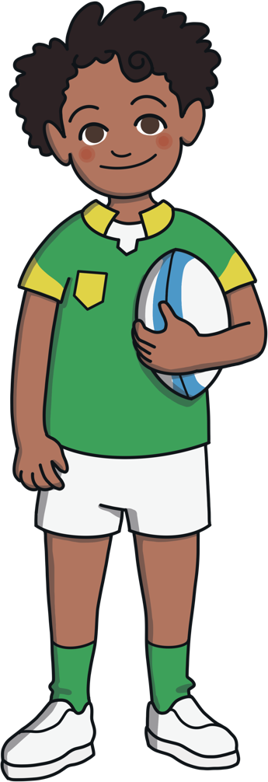
Prefixes
What is a prefix?
A prefix is a sound or group of letters that attach to the front of a root word, for example, ‘un’ or ‘re’

Slide 3
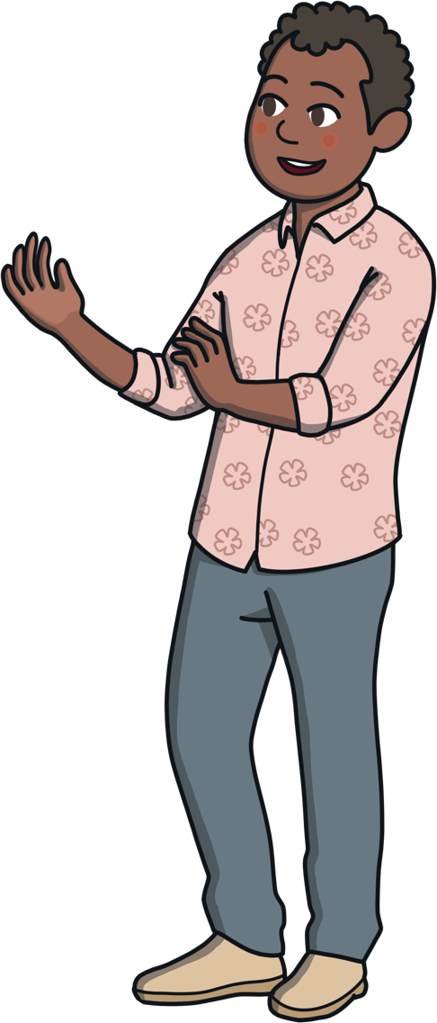
Prefixes
What is a root word?
A root word is a basic word, from which other words are made, by adding prefixes and suffixes.

Slide 4
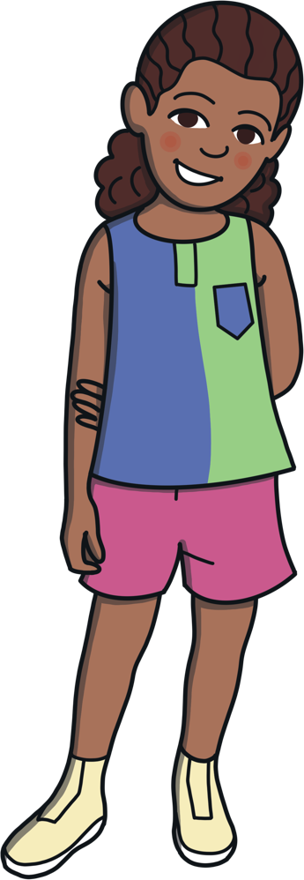
Prefixes
What does a prefix do?
A prefix changes the meaning of the root word.

Slide 5
Prefixes
Here are some questions to think about.
Think of words that start with un- or re-?
Are you able to identify the root word?
How does the un- or re- change the meaning of the word?

Slide 6
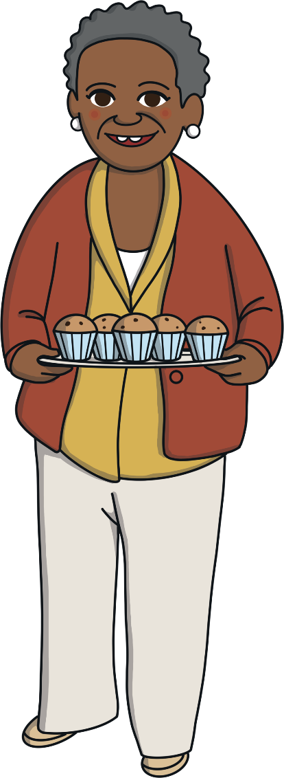
Examples
un | re
unable | remake
uncomfortable | remix
unsafe | repaint
undo | redo
untie | retie

Slide 7
What do all of these words have in common?
unhappy
undo
unkind
unable
They all begin with the prefix ‘un’.

Slide 8
What does the prefix ‘un’ mean?
unhappy
not happy
unkind
not kind
uncover
to take a cover off something
It means ‘not’ or the opposite of something.

Slide 9
Can you add an ‘un’ to the beginning of these words to make new ones?
comfortable
uncomfortable
certain
uncertain
fair
unfair
It means ‘not’ or the opposite of something.

Slide 10
What other words can you think of that start with the prefix ‘un’?
unusual
unhealthy
untrue
unclear
How many more can you come up with?

Slide 11
Add one of these ‘un’ words to complete each sentence:
unhappy
unkind
unhealthy
unwrap
It is to eat too much chocolate.
It is to call people names.
At Christmas, I my presents.
I was very when my friend moved schools.

Slide 12
Prefix re-
How does re- change the meaning of the word?
Re- means to do again, or it shows repetition (to do again) for example, refill, which means to fill up again.
I need to refill my water bottle because it’s empty.
If we wash the milk bottles, we can reuse them.

Slide 13
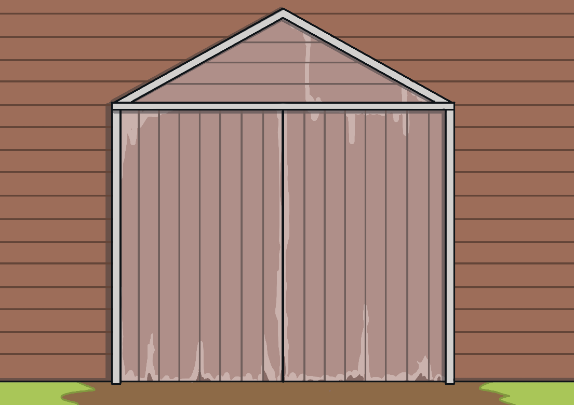
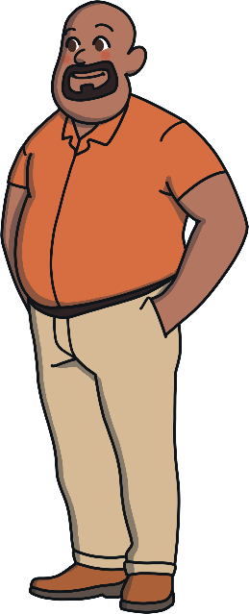
Prefix re-
Meanwhile the Langa’s family are still on Uncle Lebo’s farm…
Bongi and Nandi have been having so much fun with Uncle Lebo. They have been milking the cows, and finding out about what happens to the wheat once it has been harvested and leaves the farm.

Slide 14
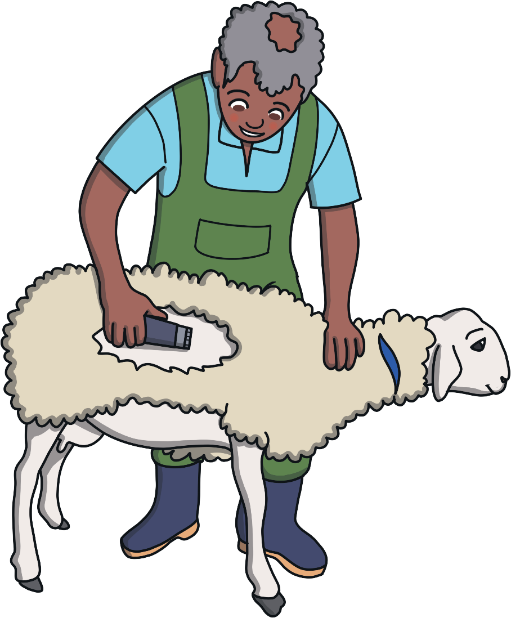
Prefix re-
“Look at all the sheep we herded into the pen.” said Bongi.
“Don’t they get hot in summer? What happens to their fur?” asked Nandi.
“It’s not fur.” laughed Uncle Lebo, “It’s wool. We shear the sheep, and send the wool to the factory to be graded, sorted and cleaned. It’s then repacked to be shipped off to be woven into material.”

Slide 15
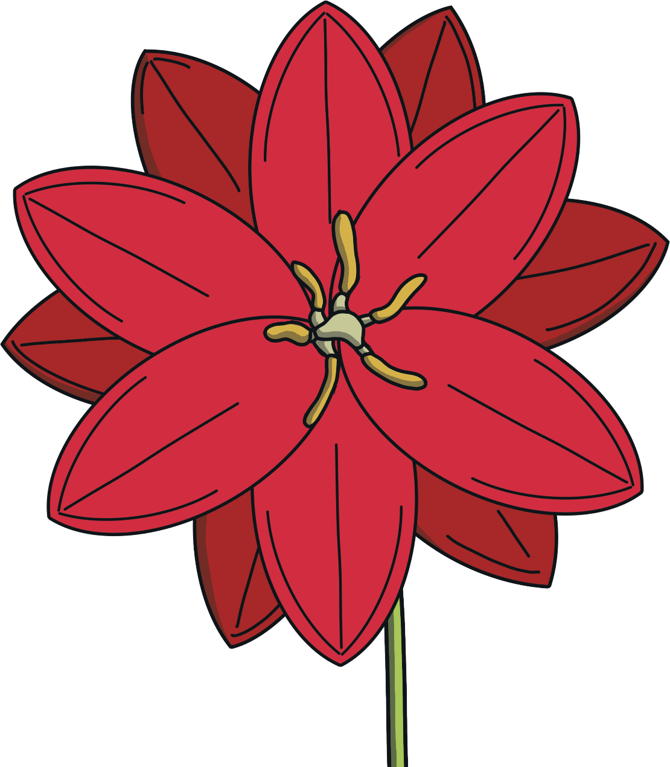
Prefix re-
“Look at the honey bee!” said Nandi excitedly.
The bee zoomed around and around. It disappeared, then reappeared on a beautiful red flower.

Slide 16
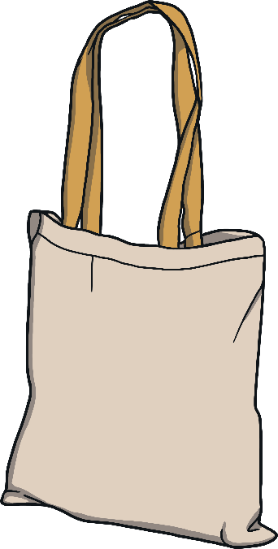
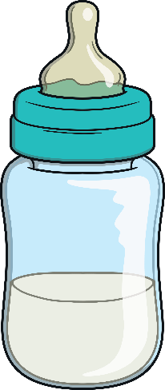
Prefix re-
Lets recap the new prefix re- words we have learnt.
refill
reuse
reappear
fill
use
appear

Slide 17
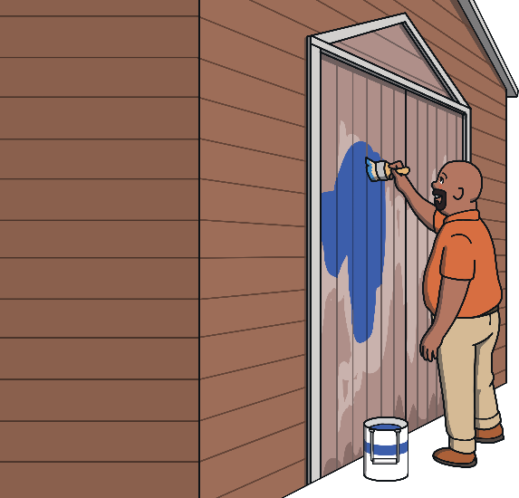
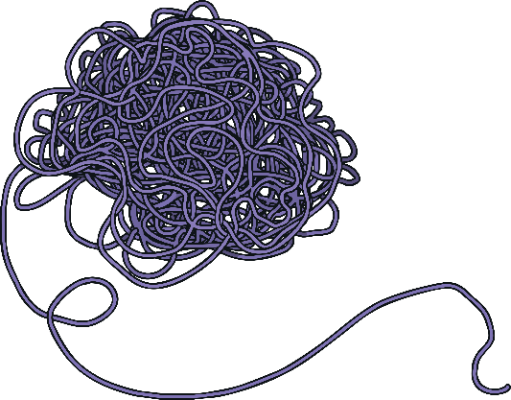
Prefix re-
rewind
repaint
rename
wind
paint
name

Slide 18
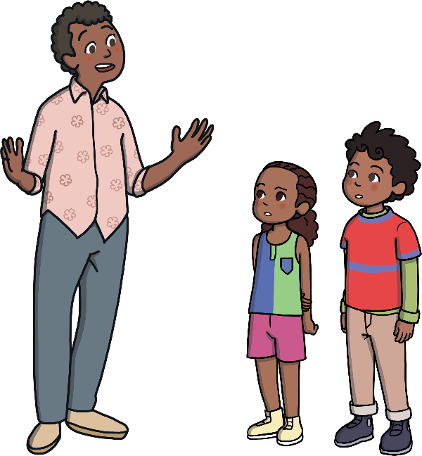
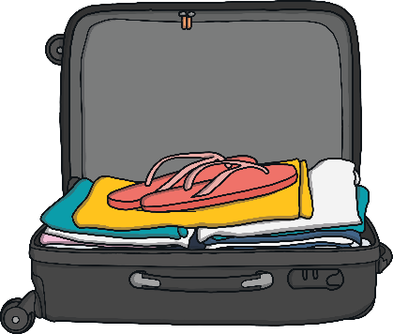
Prefix re-
retell
repack
reread
tell
pack
read

Slide 19
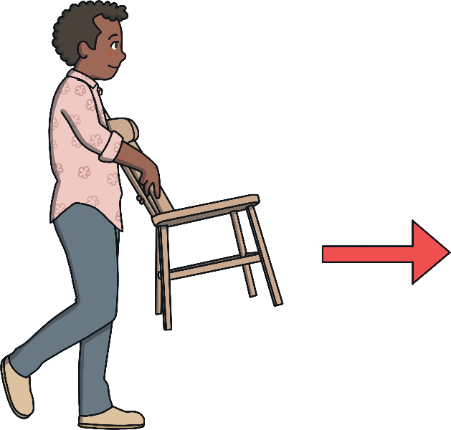
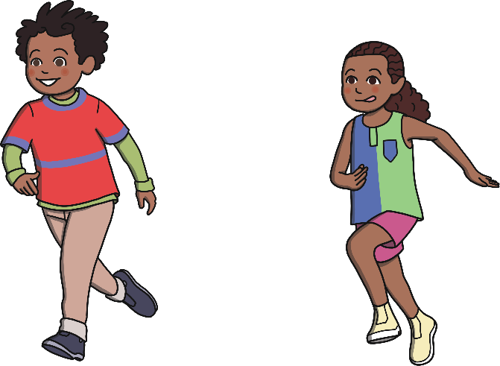
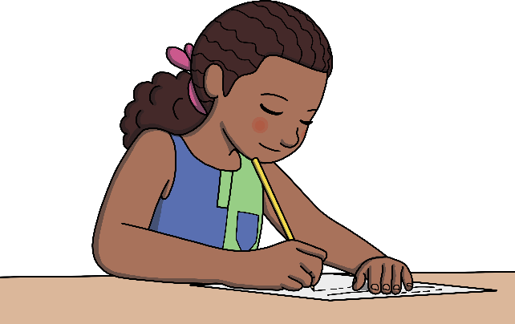
Prefix re-
rerun
remove
redo
run
move
do

