Slide 5
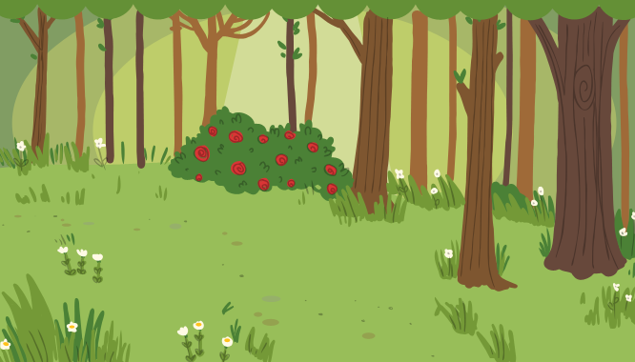
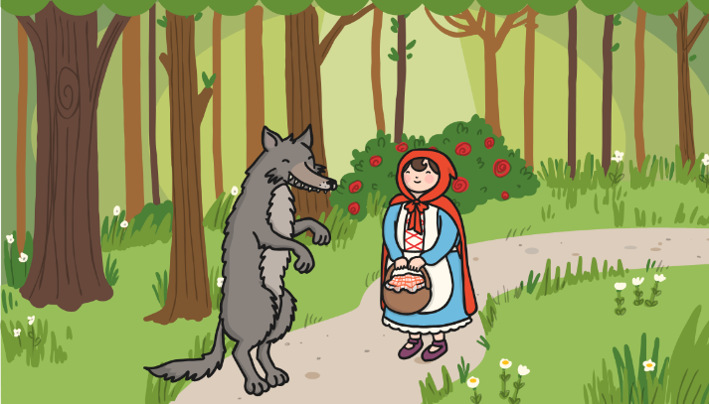
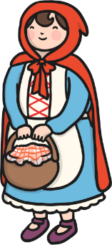
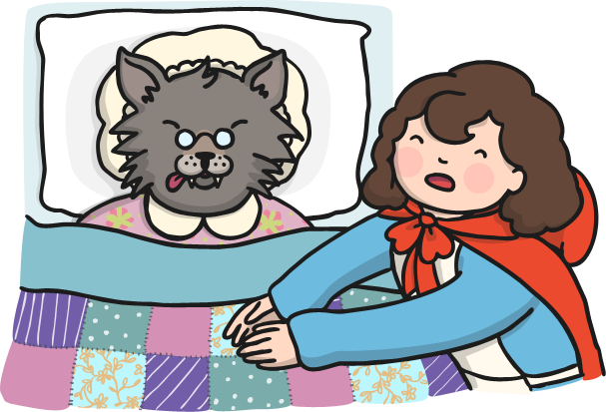
Can you write a sentence underneath each picture in the comic strip, using a full stop, to describe what is happening? Click the pictures for an example.
Little Red Riding Hood was going to see her grandma.
She met a wolf in the woods.
She thought Grandma looked very strange.
A woodcutter arrived and scared the wolf away.
Can you write some sentence from another fairy tale, using full stops?

Slide 6
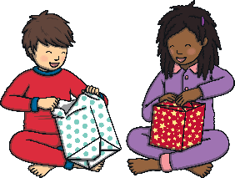
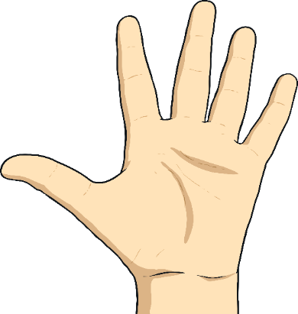
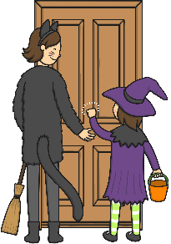
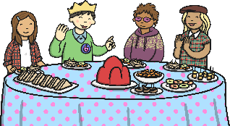
Can you write a question beginning with each of the question words on this hand and ending in a question mark? Write about the picture for each finger.
Where did the spider go?
When can we have ice cream?
What did you get for Christmas?
Why are you dressed up?
Where?
What?
When?
Who is coming to the party?
Why?
Who?
Can you write some more questions for each finger, using your own ideas?
Show examples

Slide 7
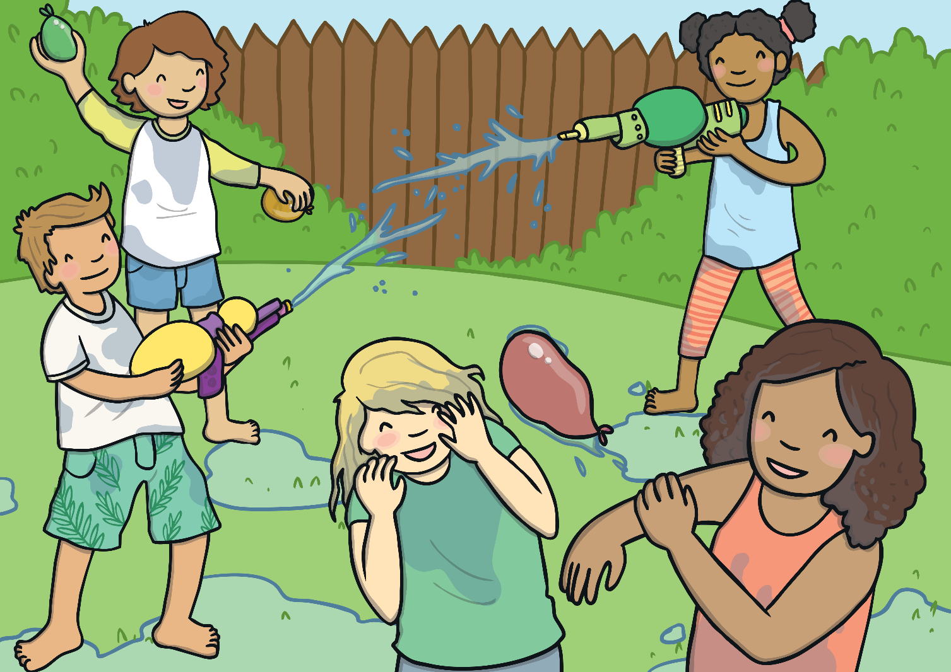
All these children are being very noisy! Can you write what you think each child is shouting, using an exclamation mark?
This will cool you down!
I’m going to squirt you both!
Get ready to be soaked!
Oh no, not a water balloon!
This is so much fun!
Show examples

Slide 8
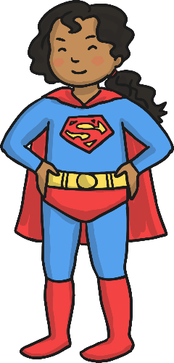
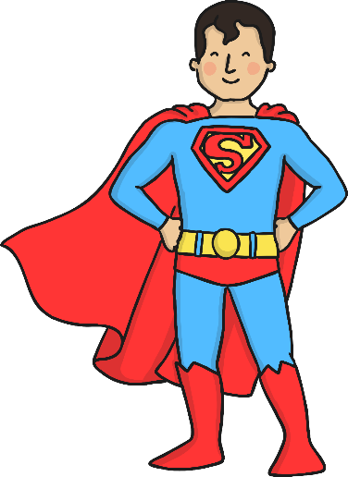
These superheroes are here to help make these sentences super! But which super hero are you going to call? If the sentence needs an exclamation mark you need Exclamation Mark Girl! If the sentence needs a question mark you need Captain Question Mark! Click on the superhero needed for each sentence.
What an amazing class you are
What an amazing class you are!
Exclamation Mark Girl
Captain Question Mark
Correct!
Try again!

Slide 9
These superheroes are here to help make these sentences super! But which super hero are you going to call? If the sentence needs an exclamation mark you need Exclamation Mark Girl! If the sentence needs a question mark you need Captain Question Mark! Click on the superhero needed for each sentence.
Which way is the fair
Which way is the fair?
Exclamation Mark Girl
Captain Question Mark
Try again!
Correct!

Slide 10
These superheroes are here to help make these sentences super! But which super hero are you going to call? If the sentence needs an exclamation mark you need Exclamation Mark Girl! If the sentence needs a question mark you need Captain Question Mark! Click on the superhero needed for each sentence.
How old are your sisters
How old are your sisters?
Exclamation Mark Girl
Captain Question Mark
Try again!
Correct!

Slide 11
These superheroes are here to help make these sentences super! But which super hero are you going to call? If the sentence needs an exclamation mark you need Exclamation Mark Girl! If the sentence needs a question mark you need Captain Question Mark! Click on the superhero needed for each sentence.
How incredible the magic show was
How incredible the magic show was!
Exclamation Mark Girl
Captain Question Mark
Correct!
Try again!

Slide 12
These superheroes are here to help make these sentences super! But which super hero are you going to call? If the sentence needs an exclamation mark you need Exclamation Mark Girl! If the sentence needs a question mark you need Captain Question Mark! Click on the superhero needed for each sentence.
What shall I wear to my cousin’s wedding
What shall I wear to my cousin’s wedding?
Exclamation Mark Girl
Captain Question Mark
Try again!
Correct!

Slide 13
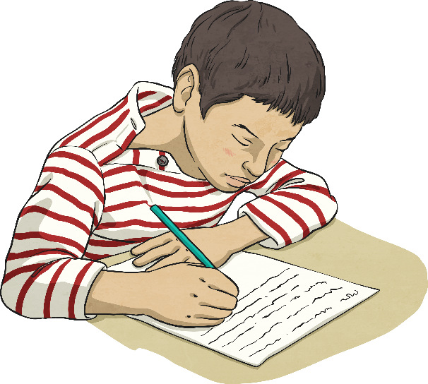
Choose the correct punctuation for the sentence.
He works very well in his maths lesson.
He works very well in his maths lesson
.
?
!

Slide 14
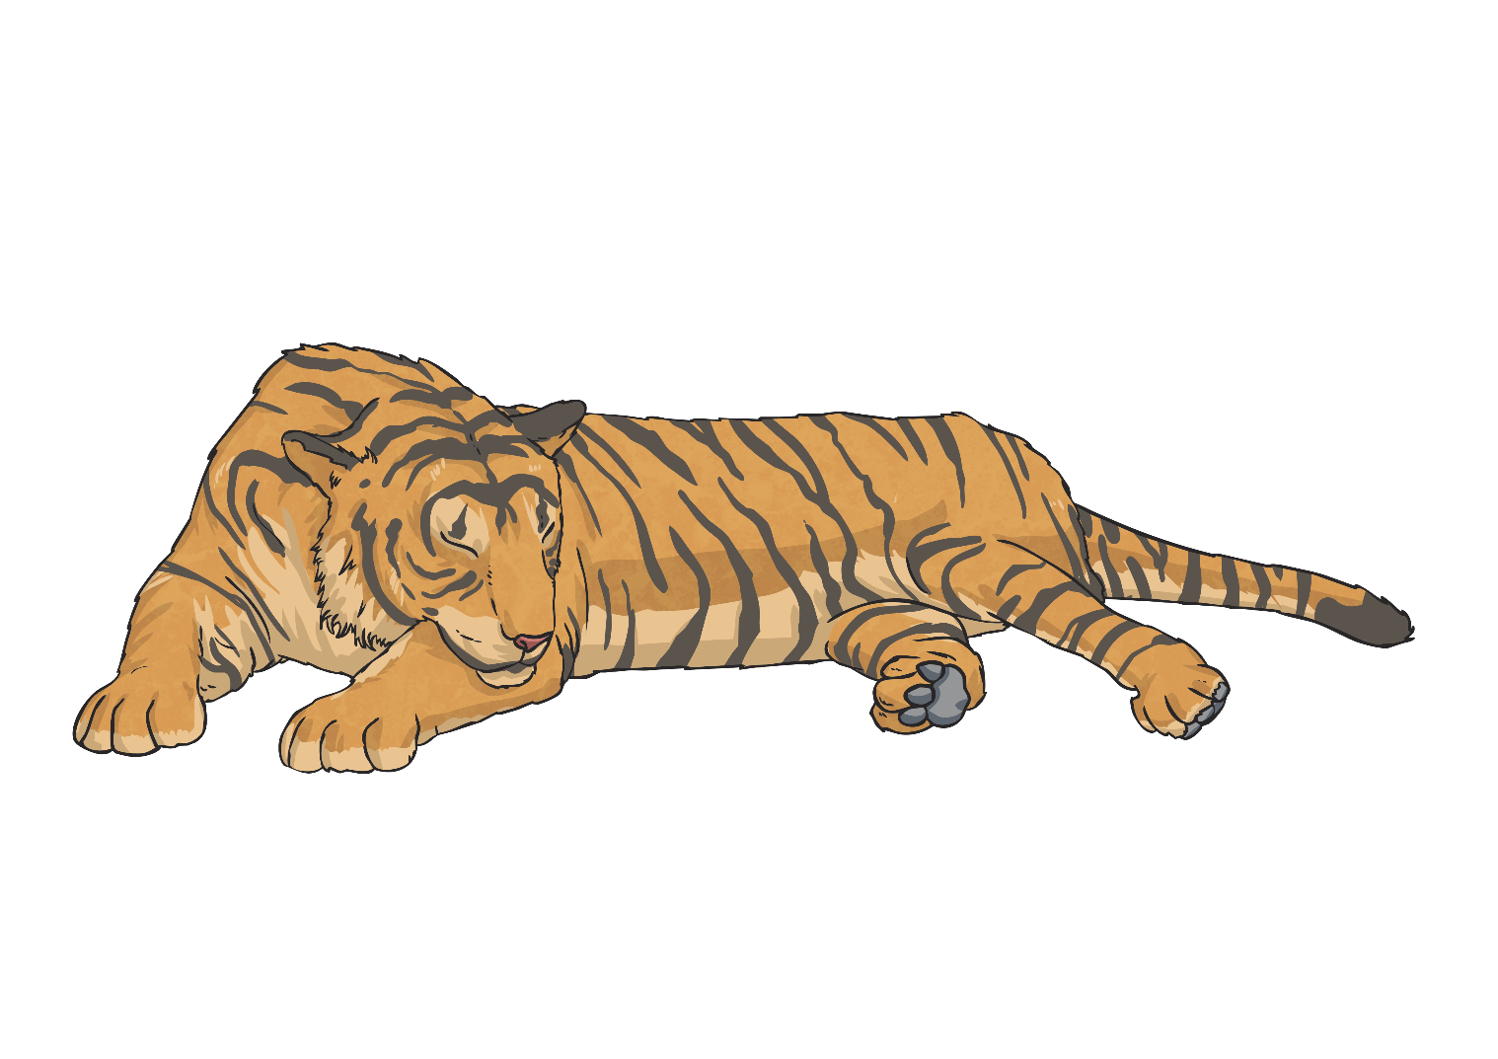
Choose the correct punctuation for the sentence.
How exciting, I love going to the zoo!
How exciting, I love going to the zoo
.
?
!

Slide 15
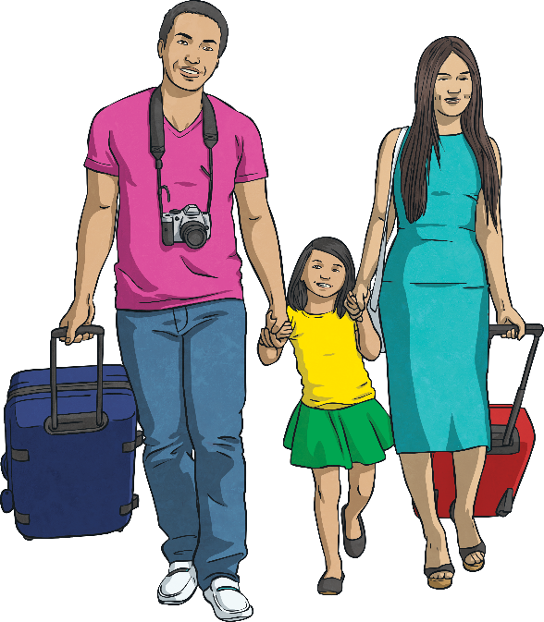
Choose the correct punctuation for the sentence.
Where are you going on holiday this year?
Where are you going on holiday this year
.
?
!

Slide 16
Choose the correct punctuation for the sentence.
What an amazing piece of writing!
What an amazing piece of writing
.
?
!

Slide 17
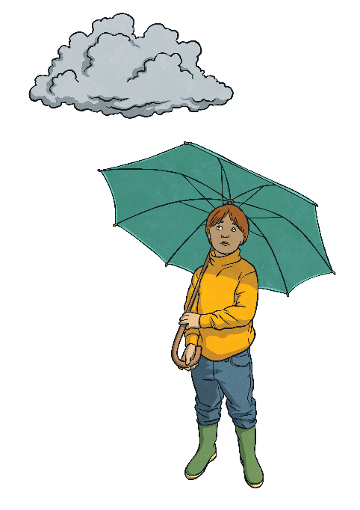
Choose the correct punctuation for the sentence.
I don’t like damp weather.
I don’t like damp weather
.
?
!

Slide 18
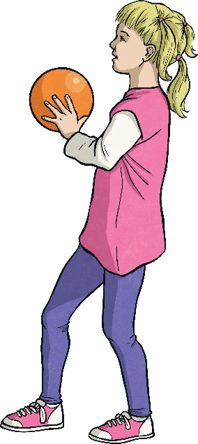
Choose the correct punctuation for the sentence.
Watch out!
Watch out
.
?
!

Slide 19
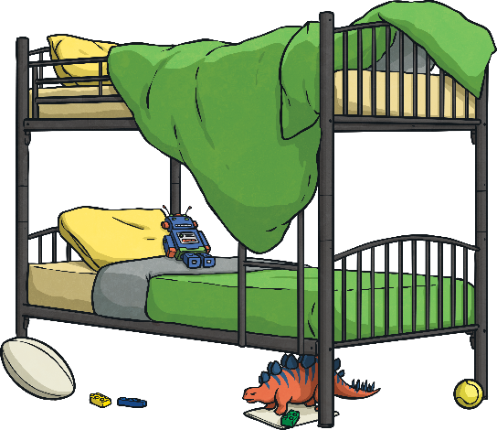
Choose the correct punctuation for the sentence.
What a mess!
What a mess
.
?
!

Slide 20
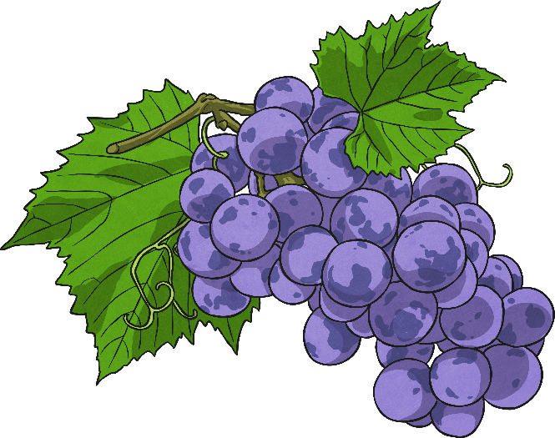
Choose the correct punctuation for the sentence.
Grapes are my favourite fruit.
Grapes are my favourite fruit
.
?
!

Slide 21
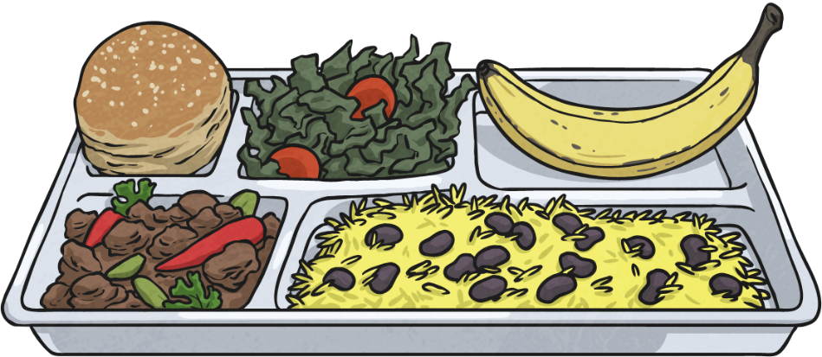
Choose the correct punctuation for the sentence.
What are you having for lunch?
What are you having for lunch
.
?
!

Slide 22
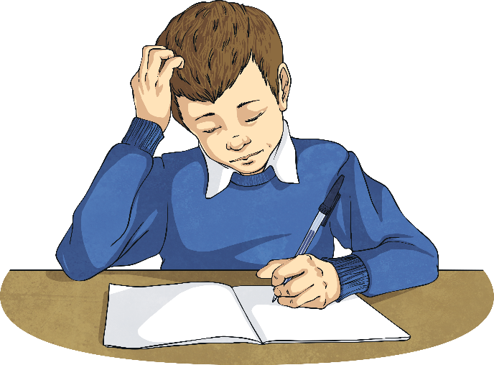
Choose the correct punctuation for the sentence.
Have you done your homework?
Have you done your homework
.
?
!

Slide 23
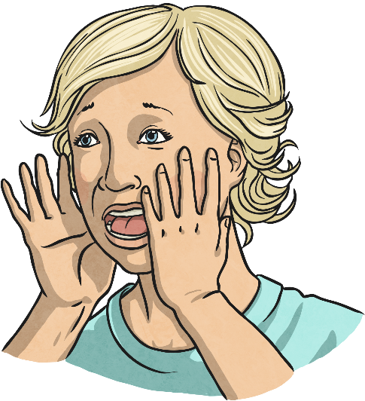
Choose the correct punctuation for the sentence.
How ridiculous!
How ridiculous
.
?
!

